Slide 1
Chapter 12: Solids
© 2015 Pearson Education, Inc.

Slide 2
This lecture will help you understand:
Crystal Structure
Density
Elasticity
Tension and Compression
Arches
Scaling

Slide 3
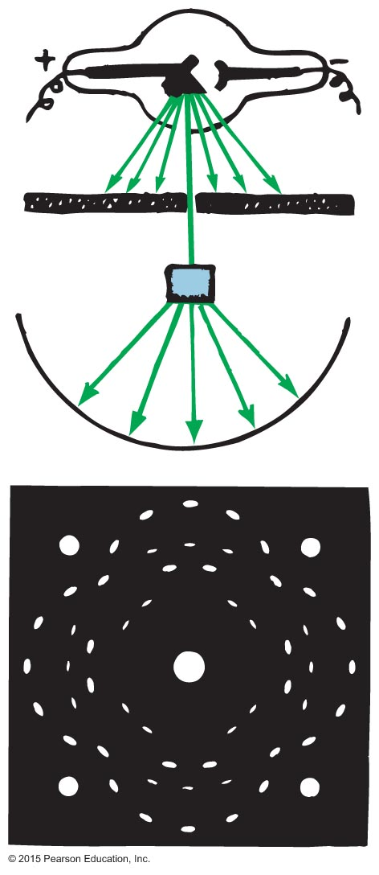
Crystal Structure
Metals, salts and most minerals made up of crystals
Crystal- atoms in a solid are arranged in a regular array
3-D lattice
If you shine an X-ray beam on a solid and it produces an X-ray diffraction pattern, this is evidence of the crystalline nature of the solid.

Slide 4
Amorphous solids- solids that do not have atoms arranged in a regular array
Wax, glass, rubber, plastic
Particles free to “wander”
Gives elasticity

Slide 5
Crystal Structure, Continued
Atomic structure determines shape.
Principle types of bonding in a solid:
Ionic
Covalent
Metallic
Van der Waals—the weakest
The properties of a solid are dependent upon the kind of bonds that exists between the atoms

Slide 6
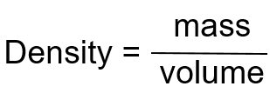
Density
Amount of mass per unit volume of a material.
Unit of density is
or g/cm³
Example:
Density of water is
or

Slide 7
Density, Continued
Is also sometimes expressed as weight density.
Unit of weight density is

Slide 8
Density, Continued-1
Density depends upon
mass of the atoms.
spacing between the atoms.
Density is a property of the material—it does not matter how much material you have.
Water density @ 4°C= 1 g/cm³
Max density will be less at other temperarues

Slide 9
Which is more dense water or ice? Why?
Ice, it floats ( has pockets of air)
Which weighs more: a liter of ice or a liter of water?
Liter of water
Which has a greater density, 100 kg of lead or 1000 kg of aluminum?
lead
What is the density of 1000 kg of water?
1 g/cm3 remember amount doesn’t change density

Slide 10
Elasticity
An object subjected to external forces may undergo changes in shape and/or size
Elasticity is a measure of how much a body changes when a deforming force is exerted on it and how well it returns to its original shape
Materials that do not return to their original shape are inelastic.

Slide 11
Elasticity CHECK YOUR NEIGHBOR
Which is more elastic—steel or rubber?
Steel
Rubber
They are equally elastic.
Not enough information.
Notes:
11
A. Steel

Slide 12
Elasticity CHECK YOUR ANSWER
Which is more elastic—steel or rubber?
Steel
Explanation:
Steel regains its original shape much better than rubber after the force is removed.
Notes:
12
A. Steel
Explanation:
Elasticity is a measure of how well a material regains its original shape after the force on it is removed.
Steel regains its shape much better than rubber

Slide 13
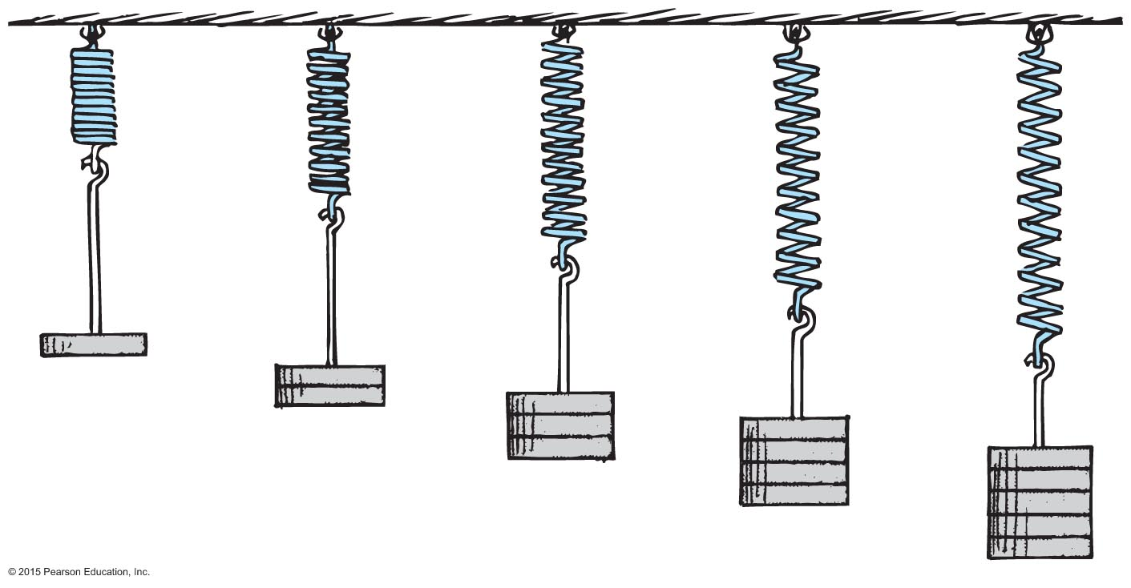
Elasticity, Continued
Hooke's law: The extension of a spring is directly proportional to the force applied to it.
Force ~ extension or F ~ Δx

Slide 14
Elastic limit- the distance beyond which permanent distortion occurs
Hooke’s law holds as long as material hasn’t reached elastic limit

Slide 15
Elasticity CHECK YOUR NEIGHBOR, Continued
A 10-cm-long spring extends to 12 cm when a 1-kg load is suspended from it. What would be its length if a 3-kg load were suspended from it?
14 cm
16 cm
20 cm
24 cm
Notes:
15
A. 16 cm

Slide 16
Elasticity CHECK YOUR ANSWER, Continued
A 10-cm-long spring extends to 12 cm when a 1-kg load is suspended from it. What would be its length if a 3-kg load were suspended from it?
16 cm
Explanation:
Extension ~ force
When force is 1 kg weight,
extension is 2 cm.
If force is 3 kg weight,
extension is
So, length is 10 cm + 6 cm = 16 cm.
Notes:
16
A. 16 cm

Slide 17
A 2 kg painting is hung form the end of a spring. The spring stretches 10 cm. If a 4 kg painting is hung form the same spring, how much will the spring stretch? A 6kg painting?
Twice the mass, twice the stretch= 20 cm
3x mass= 3x stretch= 30 cm

Slide 18
If a force of 10 N stretches a spring 4 cm, how much stretch will occur fro an applied force of 15 N?
Use ratio and propotion, 10 N / 4cm= 15 / x cm N
X= 6 cm

Slide 19
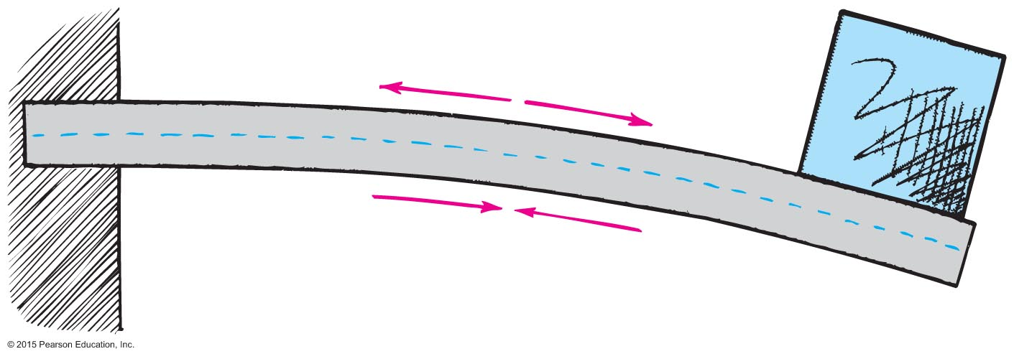
Tension and Compression
When something is
pulled it is in tension.
squashed it is in compression.
When girder is as shown, it is under
tension on the upper side.
compression on the lower side.

Slide 20
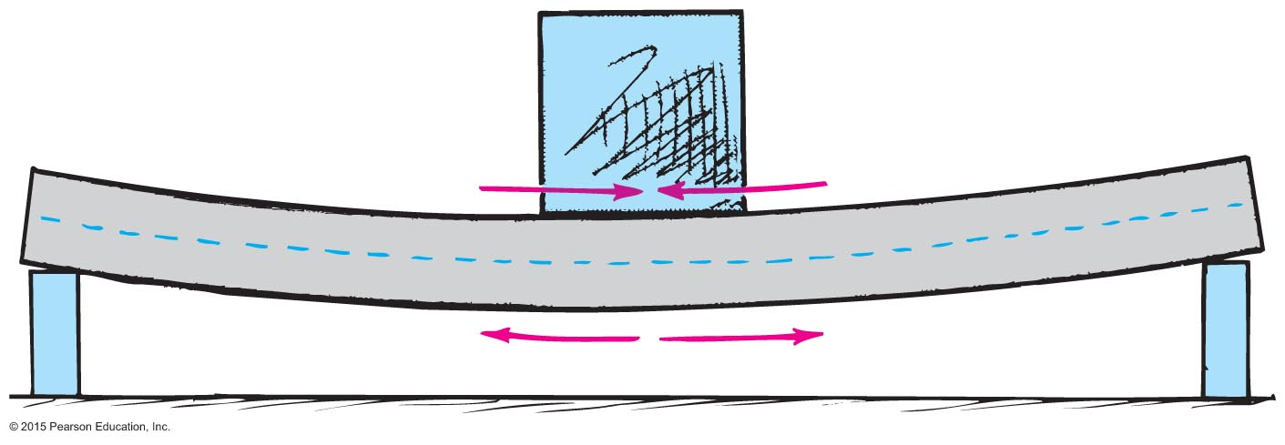
Tension and Compression, Continued
When girder is as shown, it is under
tension on the lower side.
compression on the upper side.

Slide 21
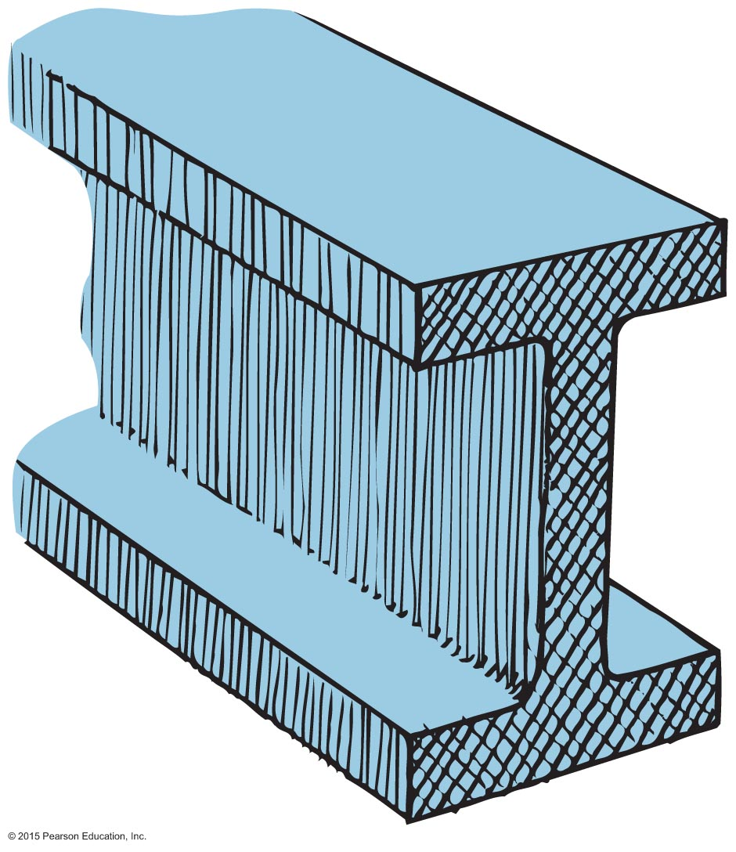
Tension and Compression, Continued-1
Often construction uses an I–beam, i.e., a beam with a cross-section shaped as letter I.
When the beam is used as shown, the shape of the I-beam
maximizes strength because the top (under tension) and bottom (under compression) have the most material.
minimizes weight because the middle of the beam that is not under stress has the least material.

Slide 22
Flanges have most stress
Neutral layer- region with no stress (usually in middle)
What materials make good beams?
Can return to original shape after stress

Slide 23
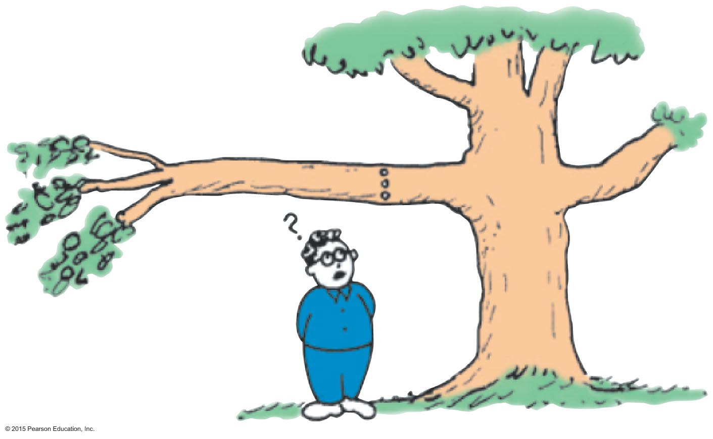
Tension and Compression CHECK YOUR NEIGHBOR
Suppose you drill a hole horizontally through a tree branch as shown. Where will the hole weaken the branch the least?
Near the top
Near the bottom
Near the middle
It does not matter.
Notes:
23
C. Near the middle

Slide 24
Tension and Compression CHECK YOUR ANSWER
Suppose you drill a hole horizontally through a tree branch as shown. Where will the hole weaken the branch the least?
Near the middle
Explanation:
Both the top and bottom part are under stress (tension and compression, respectively).
There is no stress in the middle, so making a hole there will not weaken the tree branch.
Notes:
24
C. Near the middle

Slide 25
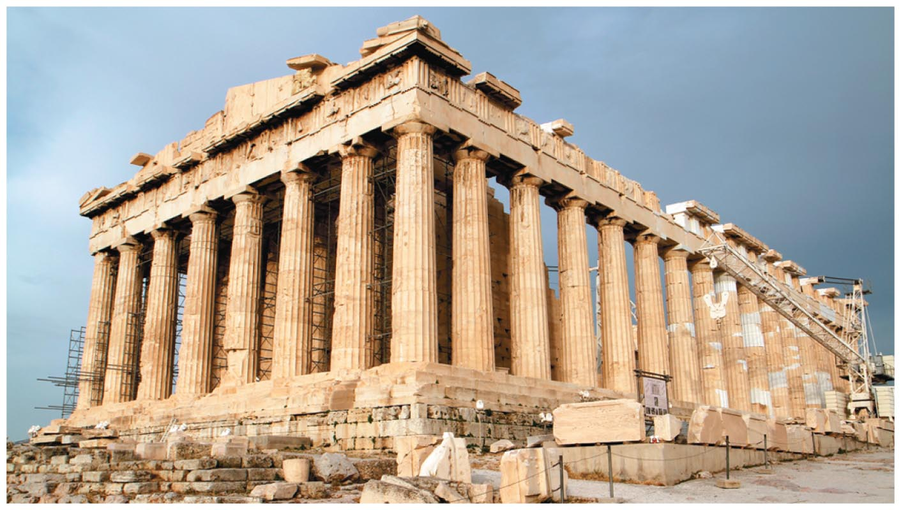
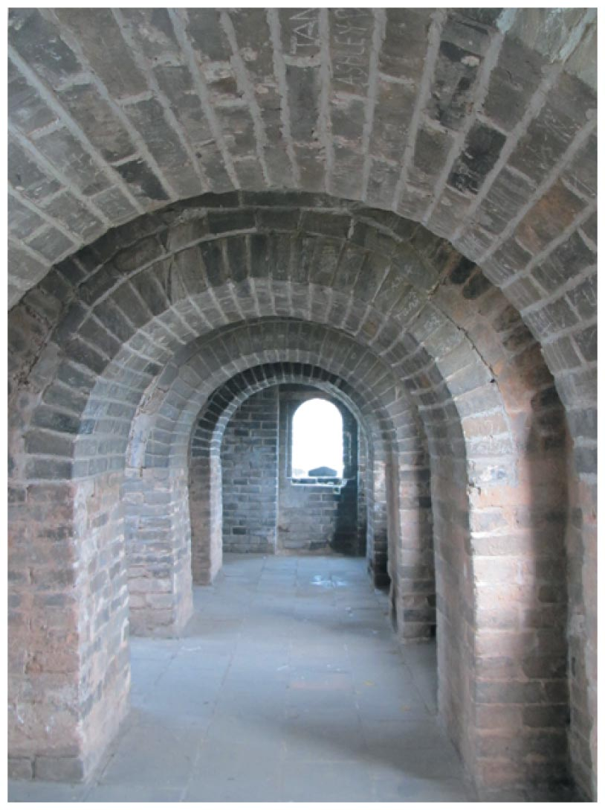
Arches
Roofs of some older buildings needed many supporting columns.
But with the discovery of arches, supporting columns were no longer needed.
Arches take advantage of the capacity of stone to withstand compression.
They use this ability of stone to increase the strength of the structure.

Slide 26
Objects break easily under tension than compression
WHY?
Compression forces parts together
arch

Slide 27
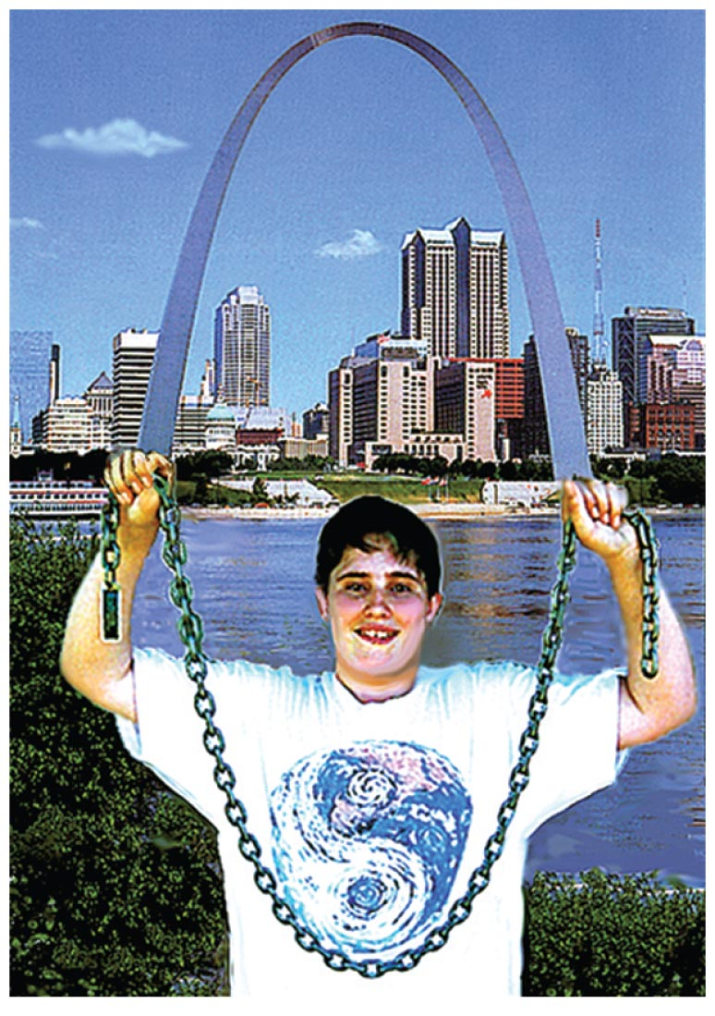
Arches, Continued
If the arch is supporting only its own weight, then the proper shape is a catenary (e.g., Arch of St. Louis).
The catenary is also the natural shape of a chain that hangs between two points.
An arch rotated around is a dome (e.g., Jefferson monument).

Slide 28
Why is it easier for chick to peck out of egg instead of peck in?
From outside have tension to overcome
From inside only weaker tension
Try crushing egg along long axis

Slide 29
Scaling (allometry)
Scaling is the study of how the volume and shape (size) of any object affect the relationship of its strength, weight, and surface area.
Strength is related to the area of the cross section (which is two-dimensional and is measured in square centimeters).
Weight relates to volume (which is 3-dimensional and is measured in cubic centimeters).

Slide 30
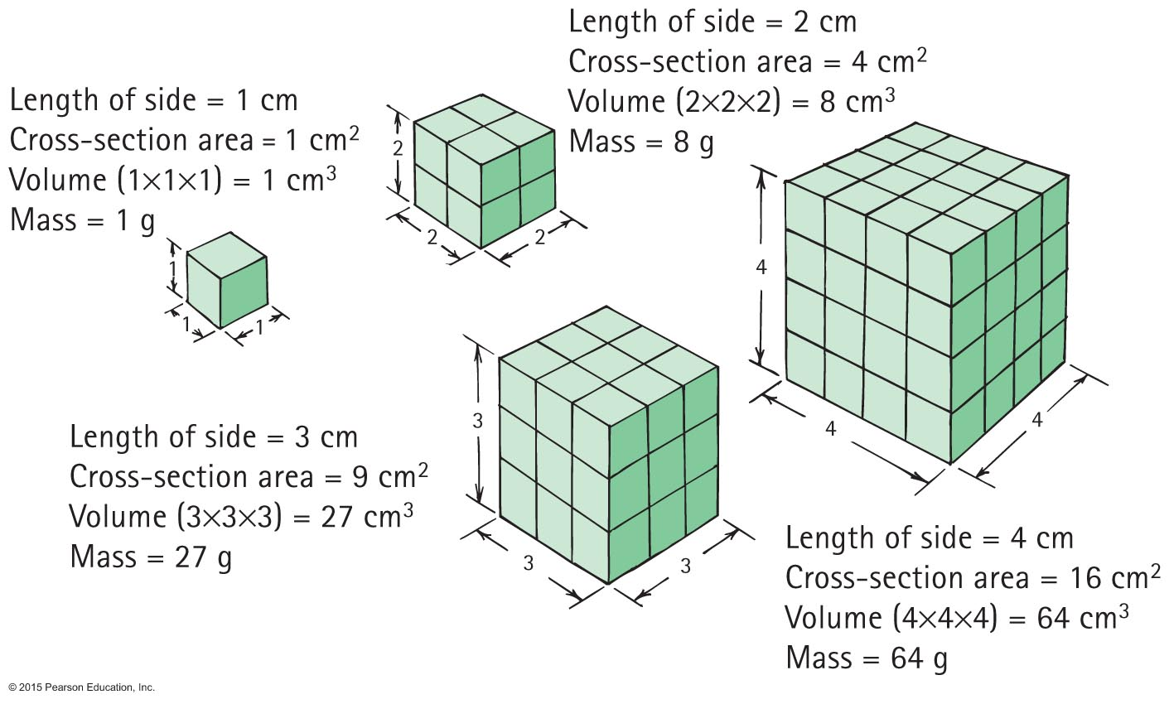
Scaling, Continued
For increases in linear dimension,
cross-sectional area and strength grow as the square of the increase.
volume and weight grow as the cube of the increase.

Slide 31
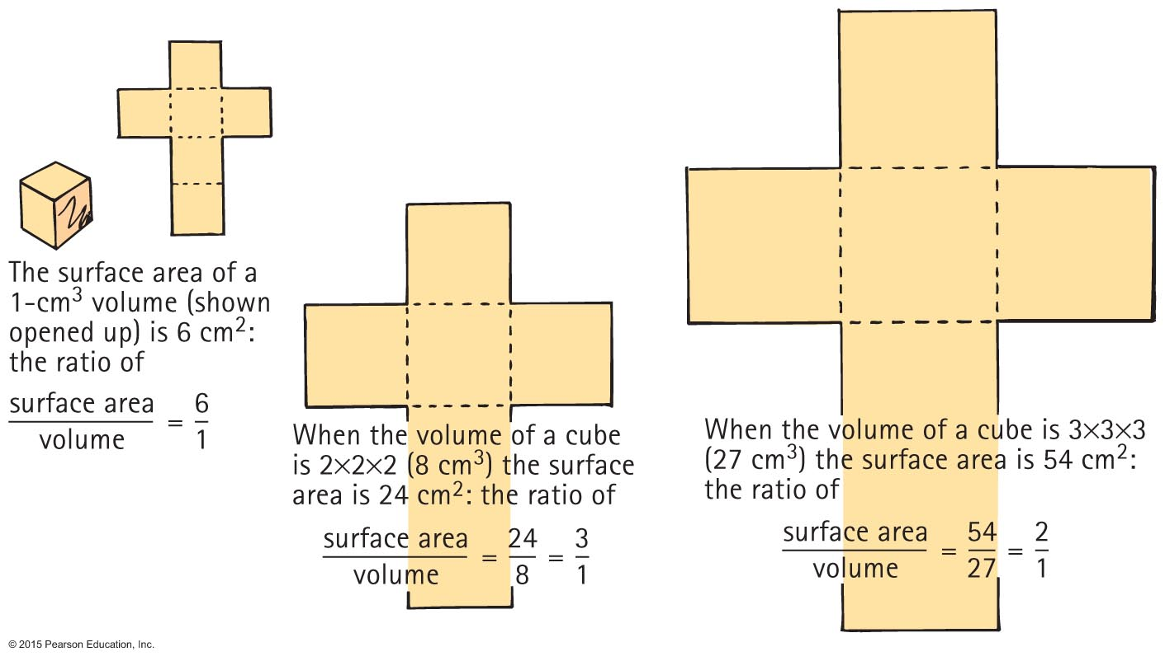
Scaling, Continued-1
So the surface area to volume ratio is
Ratio decreases with increasing size.

Slide 32
Sphere- has the least surface area for a given volume

Slide 33
Rule of Scaling
When a body is scaled up by factor of x, the surface area increase by x²
When a body is scaled up by factor of x, the volume increases by x³

Slide 34
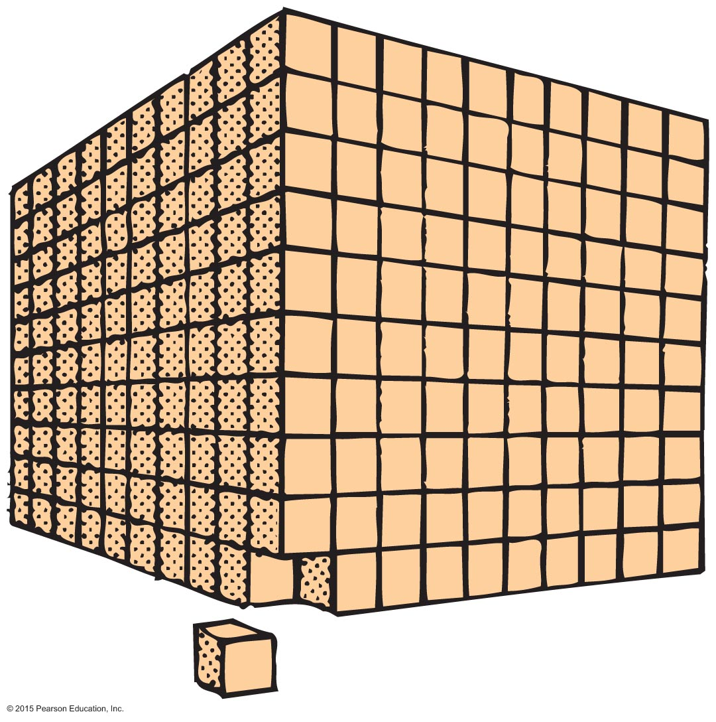
Scaling CHECK YOUR NEIGHBOR
cube is scaled up to a cube that is 10 cm long on each side, how does the surface area to volume ratio change?
1/100 of original
1/10 of original
10 times original
100 times original
If a
Notes:
34
B. 1/10 of original

Slide 35
Scaling CHECK YOUR ANSWER
If a
cube is scaled up to a cube that is 10 cm long on each side, how does the surface area to volume ratio change?
1/10 of original
Explanation:
Surface area to volume ratio ~ 1/size
If the size of the cube is now 10 times original size, surface to volume ratio will be100/1000= 1/10 original.
Notes:
35
B. 1/10 of original

Slide 36
1 cm cubed sugar cube scaled up by a factor of 10 has a volume of
=1000 cm³
1 cm cubed sugar cube scaled up by a factor of 10 has a surface are of
= 600 cm²
10x1= 10 cm²
(10 cm² )² = 100 cm²
x 6 sides for surface area

Slide 37
Scaling
A creature scaled up in size but keeping proportions
2x size = 4x as strong because cross sectional area of bones is 4x
Weight is 8x as big
4x as strong but 8x as big
Weaker relative to greater weight

Slide 38
Which takes more caramel to cover, 100 kg of large apples or 100 kg of small apples?
100kg small apples
Large apples have less surface per kilogram
Which produces more peelings, 100 kg of small apples or 100 kg of large apples?
Small, more surface area

Slide 39
Do you bake cupcakes with the same instructions as a cake? Why?
No, greater surface area

Slide 40
Chapter 12 Homework
p. 241
#31,32,34,40,42,44-59,63,65,66,68-71,73,81

