Slide 1
Chapter 6: Momentum

Slide 2
This lecture will help you understand:
Momentum
Impulse
Impulse Changes Momentum
Bouncing
Conservation of Momentum
Collisions
More Complicated Collisions

Slide 3
Momentum
a property of moving things
means inertia in motion
more specifically, mass of an object multiplied by its velocity
Vector (Why?)
in equation form:
Momentum = mass x velocity (p=mv)
p often used to represent momentum

Slide 4
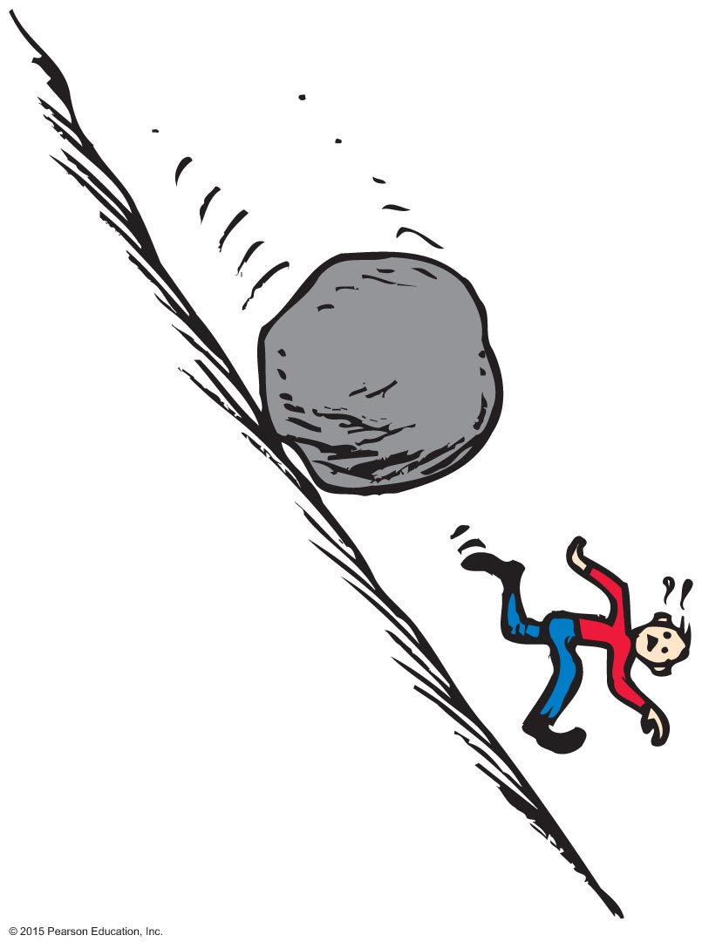
Momentum
Example:
A moving boulder has more momentum than a stone rolling at the same speed.
A fast boulder has more momentum than a slow boulder.
A boulder at rest has no momentum.

Slide 5
A 6025 kg truck has a velocity of 35 m/s south. What is the momentum of the truck?
Momentum = mv
Monemtum= (6025 kg) (35 m/s south)
= 2.11 x 10 ⁵ kg· m/s south

Slide 6
Momentum CHECK YOUR NEIGHBOR
A moving object has
momentum.
energy.
speed.
All of the above.
Notes:
D. All of the above.

Slide 7
Momentum CHECK YOUR ANSWER
A moving object has
momentum.
energy.
speed.
All of the above.
Comment:
We will see in the next chapter that energy in motion is called kinetic energy.
Notes:
D. All of the above.

Slide 8
Momentum CHECK YOUR NEIGHBOR
When the speed of an object is doubled, its momentum
remains unchanged in accord with the conservation of momentum.
doubles.
quadruples.
decreases.
Notes:
B. doubles.

Slide 9
Momentum CHECK YOUR ANSWER
When the speed of an object is doubled, its momentum
remains unchanged in accord with the conservation of momentum.
doubles.
quadruples.
decreases.
Notes:
B. doubles.

Slide 10
Impulse
Impulse= change in momentum
Product of force and time (force x time)
In equation form: Impulse = Ft
Example:
A brief force applied over a short time interval produces a smaller change in momentum than the same force applied over a longer time interval.
or
If you push with the same force for twice the time, you impart twice the impulse and produce twice the change in momentum.

Slide 11
Which has more momentum: a 1 ton car moving at 100 km/h or a 2 ton truck moving at 50 km/h?
Same: p= (1 ton x 100 km/h)= (2 ton x 50 km/h)
Does a moving object have impulse?
No, object cant have impulse. Object can provide impulse or experience it.
Does a moving object have momentum?
Yes, but it is relative to object around it (moving or at rest)

Slide 12
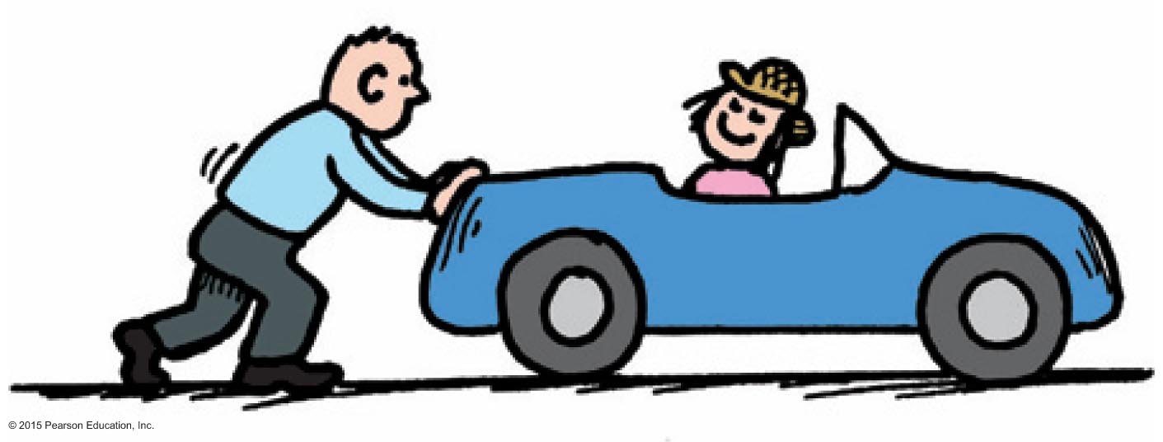
Impulse Changes Momentum
The greater the impulse exerted on something, the greater the change in momentum.
In equation form: Ft = ∆(mv)
m must be Kg
V must be m/s

Slide 13
A 2000 kg truck moving eastward with a velocity of 14 m/s collides with a guard rail and is brought to rest in 0.20 s. Find the magnitude of the force exerted on the truck during the collision.
FΔt= Δp = mv_{f}- mv_{i}
F= (2000 kg x 0 m/s) – ( 2000 kg x 14 m/s)/ 0.20 s
= - 1.4 x 10⁵ N to the east
= 1.4 x 10⁵ N to the west

Slide 14
Impulse Changes Momentum CHECK YOUR NEIGHBOR
When the force that produces an impulse acts for twice as much time, the impulse is
not changed.
doubled.
quadrupled.
halved.
Notes:
B. doubled.

Slide 15
Impulse Changes Momentum CHECK YOUR ANSWER
When the force that produces an impulse acts for twice as much time, the impulse is
not changed.
doubled.
quadrupled.
halved.
Notes:
B. doubled.

Slide 16
Impulse Changes Momentum
Different forces exerted over different time interval can produce the same impulse
Ft or Ft

Slide 17
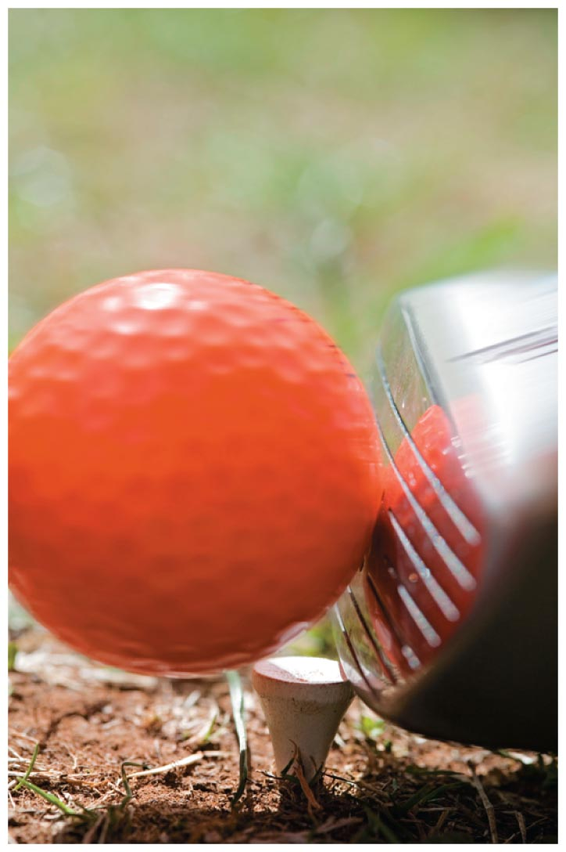
Impulse Changes Momentum
Case 1: increasing momentum
Apply the greatest force for as long as possible and you extend the time of contact.
Force can vary throughout the duration of contact.
Examples:
Golfer swings a club and
follows through.
Baseball player hits a ball and
follows through.

Slide 18
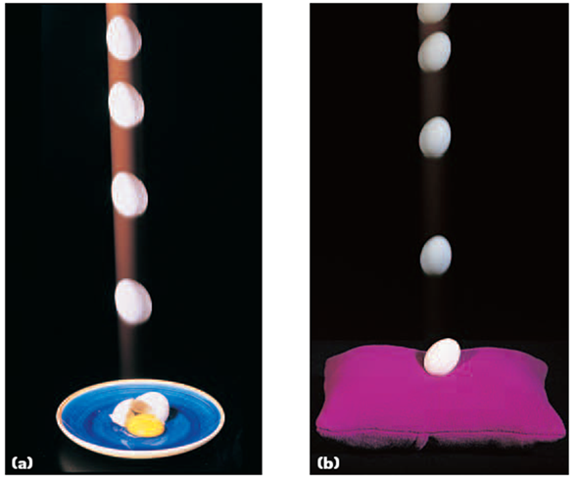
Impulse Changes Momentum
Case 2: decreasing momentum over a long time
extend the time during which momentum is reduced

Slide 19
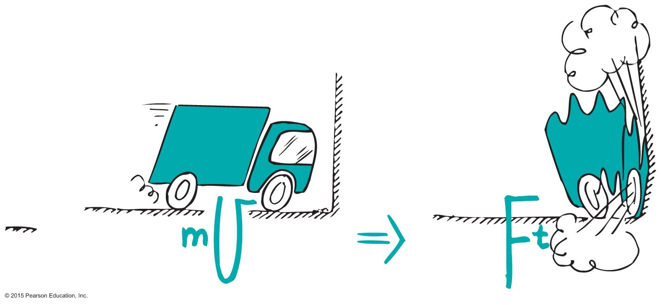
Impulse Changes Momentum
Examples:
When a car is out of control, it is better to hit a haystack than a concrete wall.
Physics reason: Same impulse either way, but extension of hitting time reduces the force.

Slide 20
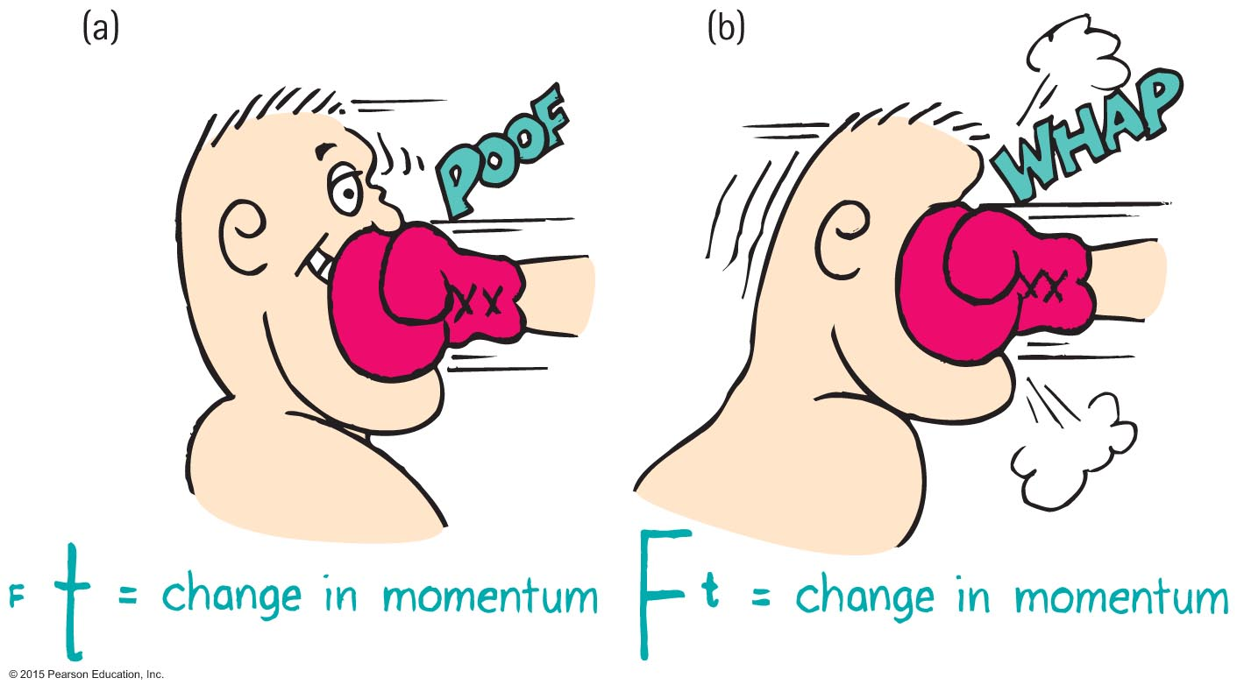
Impulse Changes Momentum
Example (continued):
In jumping, bend your knees when your feet make contact with the ground because the extension of time during your momentum decrease reduces the force on you.
In boxing, ride with the punch.

Slide 21
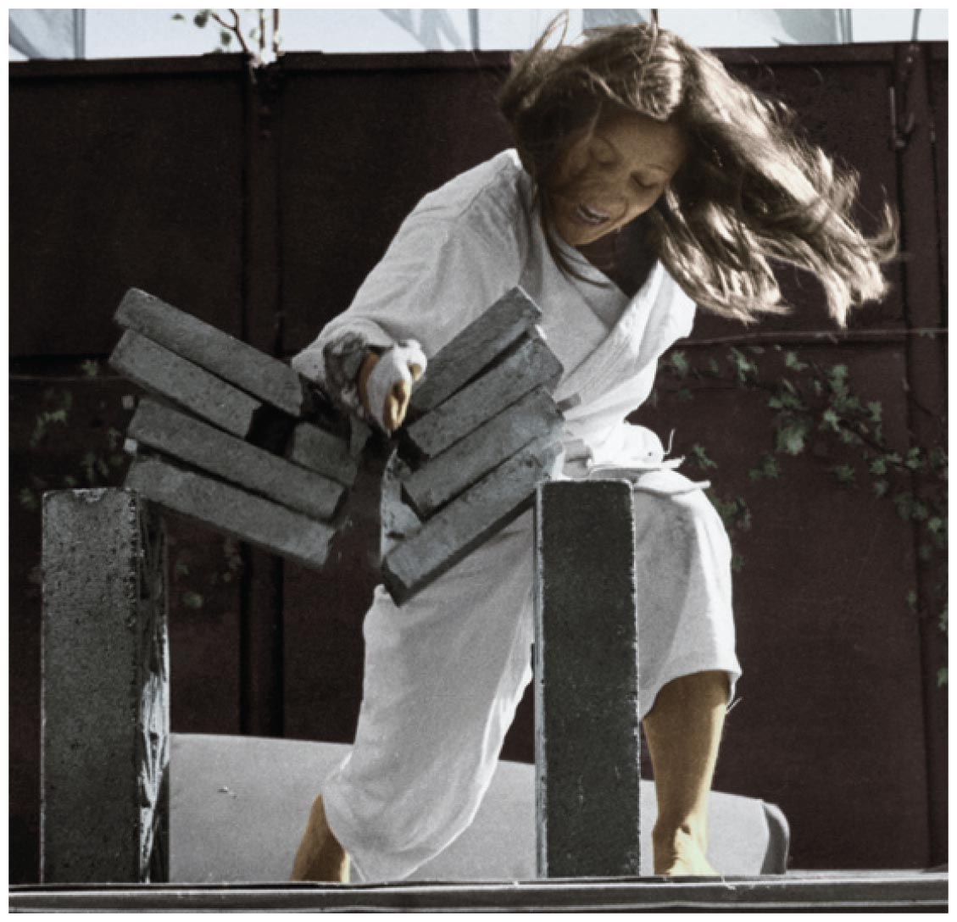
Impulse Changes Momentum
Case 3: decreasing momentum over a short time
short time interval produces large force.
Example: Karate expert splits a stack of bricks by bringing her arm and hand swiftly against the bricks with considerable momentum. Time of contact is brief and force of impact is huge.

Slide 22
Impulse Changes Momentum CHECK YOUR NEIGHBOR
A cannonball shot from a cannon with a long barrel will emerge with greater speed because the cannonball receives a greater
average force.
impulse.
Both of the above.
None of the above.
Notes:
B. impulse.

Slide 23
Impulse Changes Momentum CHECK YOUR ANSWER
A cannonball shot from a cannon with a long barrel will emerge with greater speed because the cannonball receives a greater
average force.
impulse.
Both of the above.
None of the above.
Explanation:
The average force on the cannonball will be the same for a short- or long-barreled cannon. The longer barrel provides for a longer time for the force to act, and therefore, a greater impulse. (The long barrel also provides a longer distance for the force to act, providing greater work and greater kinetic energy to the cannonball.)
Notes:
B. impulse.

Slide 24
Impulse Changes Momentum CHECK YOUR NEIGHBOR
A fast-moving car hitting a haystack or hitting a cement wall produces vastly different results. 1. Do both experience the same change in momentum? 2. Do both experience the same impulse? 3. Do both experience the same force?
Yes for all three
Yes for 1 and 2
No for all three
No for 1 and 2
Notes:
B. Yes for 1 and 2

Slide 25
Impulse Changes Momentum CHECK YOUR ANSWER
A fast-moving car hitting a haystack or hitting a cement wall produces vastly different results. 1. Do both experience the same change in momentum? 2. Do both experience the same impulse? 3. Do both experience the same force?
Yes for all three
Yes for 1 and 2 ( longer time hitting hay, reduces force)
No for all three
No for 1 and 2
Explanation:
Although stopping the momentum is the same whether done slowly or quickly, the force is vastly different. Be sure to distinguish among momentum, impulse, and force.
Notes:
B. Yes for 1 and 2

Slide 26
Impulse Changes Momentum CHECK YOUR NEIGHBOR
When a dish falls, will the change in momentum be less if it lands on a carpet than if it lands on a hard floor? (Careful!)
No, both are the same.
Yes, less if it lands on the carpet.
No, less if it lands on a hard floor.
No, more if it lands on a hard floor.
Notes:
A. No, both are the same.

Slide 27
Impulse Changes Momentum CHECK YOUR ANSWER
When a dish falls, will the change in momentum be less if it lands on a carpet than if it lands on a hard floor? (Careful!)
No, both are the same.
Yes, less if it lands on the carpet.
No, less if it lands on a hard floor.
No, more if it lands on a hard floor.
Explanation:
The momentum becomes zero in both cases, so both change by the same amount. Although the momentum change and impulse are the same, the force is less when the time of momentum change is extended. Be careful to distinguish among force, impulse, and momentum.
Notes:
A. No, both are the same.

Slide 28
If the boxer is able to increase the f=duration of impact to 4x as long, by how much will the force of impact be reduced?
¼
If the boxer moves into the punch so as to decrease the duration of impact by half, by how much will the force of impact be increased?
Force of impact 2x greater
How is boxing and karate different?
Boxing want reduced force( max time)
Karate want max force ( min time)

Slide 29
Bouncing
Impulses are generally greater when objects bounce.
Example:
Catching a falling flower pot from a shelf with your hands. You provide the impulse to reduce its momentum to zero. If you throw the flower pot up again, you provide an additional impulse. This "double impulse" occurs when something bounces.

Slide 30
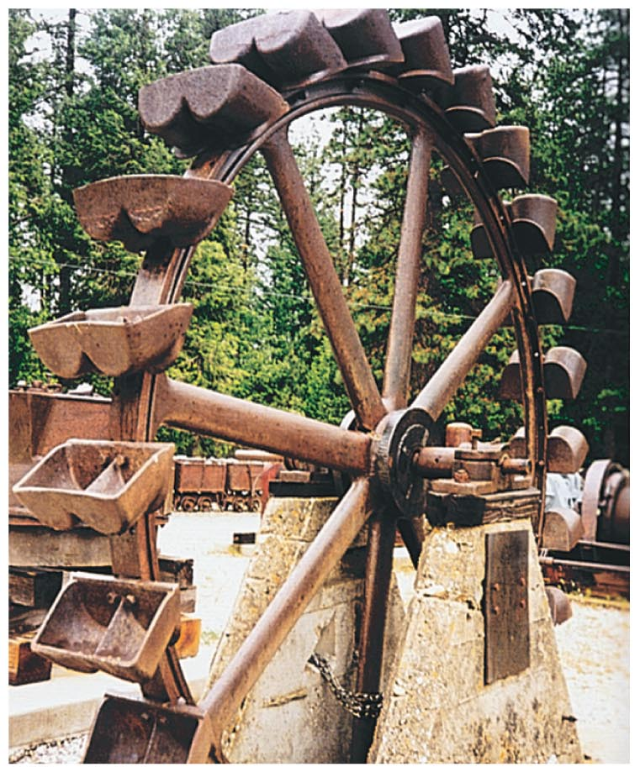
Bouncing
Pelton wheel designed to "bounce" water when it makes a U-turn on impact with the curved paddle

Slide 31
https://www.youtube.com/watch?v=3Oe8YAJ9eSQ

Slide 32
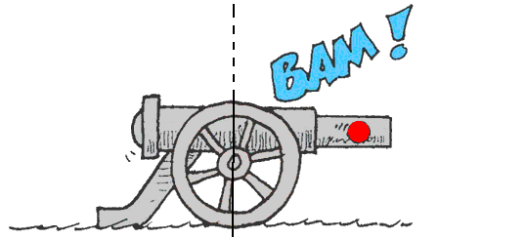
Conservation of Momentum
Law of conservation of momentum:
In the absence of an external force, the momentum of a system remains unchanged.

Slide 33
Conservation of Momentum
Examples:
When a cannon is fired, the force on the cannonball inside the cannon barrel is equal and opposite to the force of the cannonball on the cannon.
The cannonball gains momentum, while the cannon gains an equal amount of momentum in the opposite direction—the cannon recoils.
When no external force is present, no external impulse is present, and no change in momentum is possible.

Slide 34
Conservation of Momentum
Examples (continued):
Internal molecular forces within a baseball come in pairs, cancel one another out, and have no effect on the momentum of the ball.
Molecular forces within a baseball have no effect on its momentum.
Pushing against a car's dashboard has no effect on its momentum.

Slide 35
Collisions
For all collisions in the absence of external forces,
net momentum before collision equals net momentum after collision.
(net mv)_{before} = (net mv)_{after}
m₁v_{1i} + m₂v_{2i}= m₁v_{1f} + m₂v_{2f}
Total initial momentum = total final momentum

Slide 36
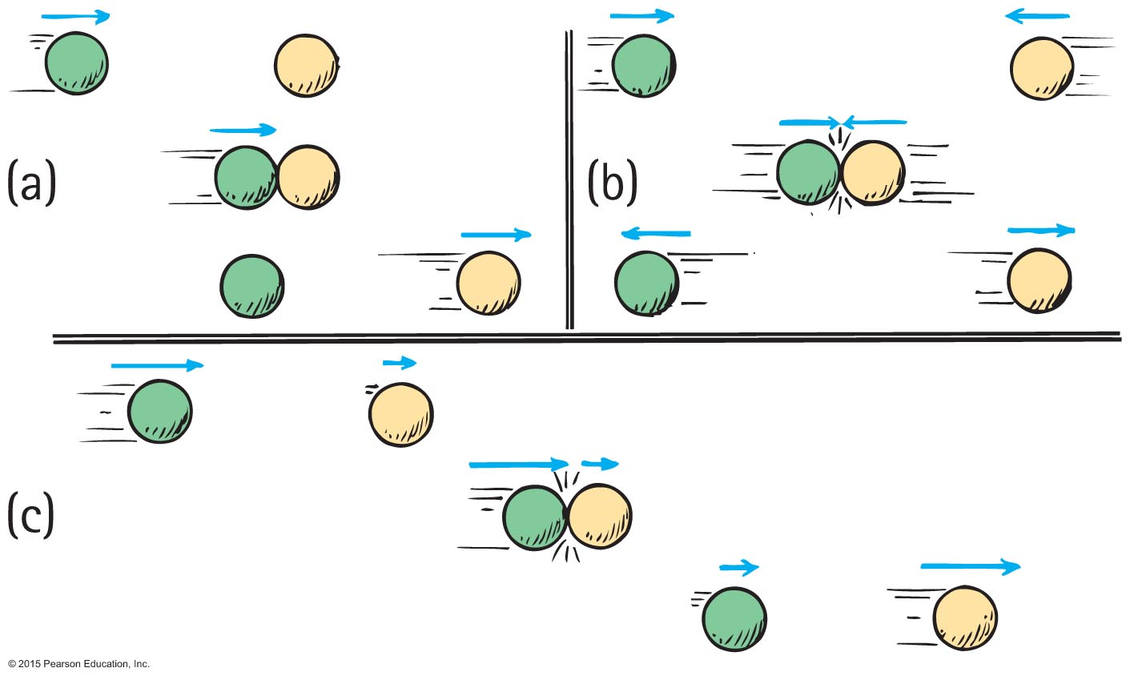
Collisions
Elastic collision
occurs when colliding objects rebound without lasting deformation or any generation of heat.

Slide 37
Collisions-Elastic
single car moving at 10 m/s collides with another car of the same mass, m, at rest
From the conservation of momentum,
(net mv)_{before} = (net mv)_{after}
(m x 10)_{before} = (2m x V)_{after}
V = 5 m/s

Slide 38
A 65 kg person, initially at rest on a stationary 30. kg wheeled cart, steps off of the cart onto the floor. If the person moves off of the cart with a velocity of 2.5 m/s to the left, what is the final velocity of the cart?
m₁v_{1i} + m₂v_{2i}= m₁v_{1f} + m₂v_{2f}
0 = (65 kg x 2.5 m/s) + (30. kg x v_{2f})
Can set equal to zero because cart and person are at rest
-(65 kg x 2.5 m/s)= (30. kg x v_{2f})
-(65 kg x 2.5 m/s)/(30. kg )= v_{2f}
= -5.4 m/s left or 5.4 m/s right

Slide 39
Collisions
Inelastic collision
occurs when colliding objects result in deformation and/or the generation of heat.

Slide 40
A 1850 kg car stopped at a traffic light is struck from the rear by a compact car with a mass of 975 kg. The two cars become entangled as a result of the collision. If the compact car was moving at a velocity of 22.0 m/s north before the collision, what is the velocity of the entangled mass after the collision?
m₁v_{1i} + m₂v_{2i}= (m₁+ m₂) v_{f}
( 1850 kg x 0 m/s) +( 975 kg x 22.0 m/s) = (1850 kg + 975 kg) v_{f}
V_{f} = 7.59 m/s north

Slide 41
Collisions CHECK YOUR NEIGHBOR
Freight car A is moving toward identical freight car B that is at rest. When they collide, both freight cars couple together. Compared with the initial speed of freight car A, the speed of the coupled freight cars is
the same.
half.
twice.
None of the above.
Notes:
B. half.

Slide 42
Collisions CHECK YOUR ANSWER
Freight car A is moving toward identical freight car B that is at rest. When they collide, both freight cars couple together. Compared with the initial speed of freight car A, the speed of the coupled freight cars is
the same.
half.
twice.
None of the above.
Explanation:
After the collision, the mass of the moving freight cars has doubled. Can you see that their speed is half the initial velocity of freight car A?
Notes:
B. half.

Slide 43
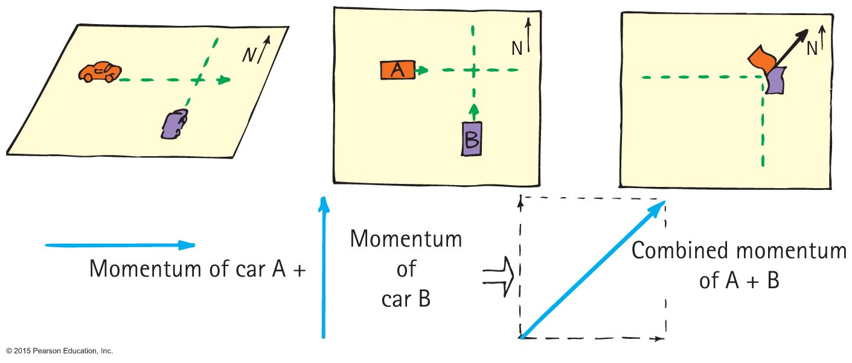
More Complicated Collisions
Sometimes the colliding objects are not moving in the same straight line.
In this case you create a parallelogram of the vectors describing each initial momentum to find the combined momentum.
Example: collision of two cars at a corner

Slide 44
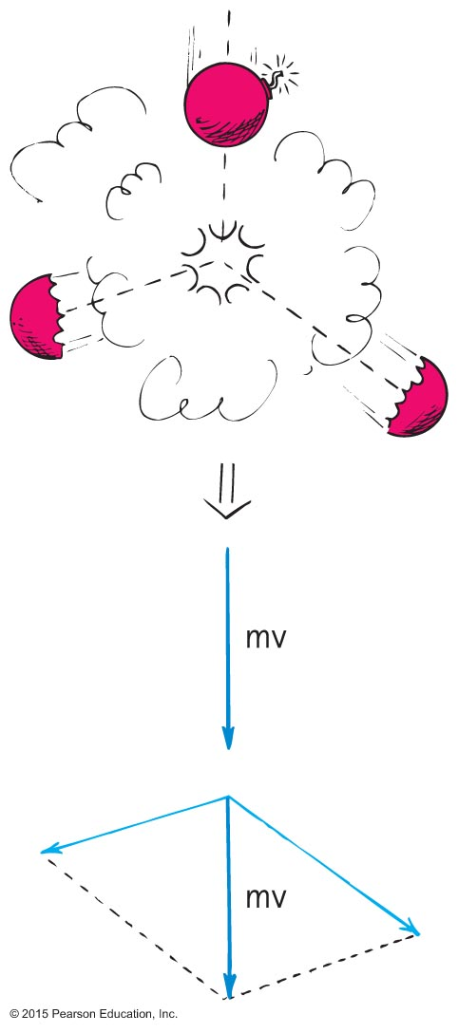
More Complicated Collisions
Another example:
A firecracker exploding; the total momentum of the pieces after the explosion can be added vectorially to get the initial momentum of the firecracker before it exploded.

Slide 45
Chapter 6 homework
P. 104-107
#22-29,32,33,37,39-44,49,50,66,69,78,81,83

