Slide 1
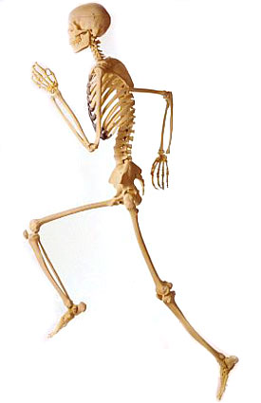
Chapter 2
Motion in One Dimension

Slide 2
Learning Targets 2-1
Describe motion using displacement, time, velocity, and frame of reference
Calculate displacement
Construct and interpret position-time graphs

Slide 3
Motion
Can be described in terms of displacement, time, and velocity
Can be described in words, equations, or graphs

Slide 4
Displacement
Length of the straight line drawn from your initial position to your final position
This is the change in position of object
SI units is meters (m)
Displacement DOES NOT equal distance traveled

Slide 5
Things with both magnitude (size) and direction (east / west) are called vectors

Slide 6
Displacement
Calculated:
Δx=x_{f}– x_{i}
Displacement = change in position= final position –initial position
It is a vector so it has both magnitude and direction

Slide 7
Displacement
Can be positive (right and up)
Negative (left and down)
Known as convention
System that is chosen for convenience and consistency
If the object does not move, there is no displacement
If object returns to original starting point, there is no displacement

Slide 8
Distance
Needs no reference frame, it is the space between two objects
Distance has magnitude, but no direction, so it is called scalar

Slide 9
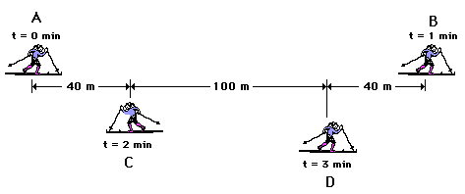

Slide 10
Coordinate system used to describe motion
Need a starting point, or a reference point that we can describe against
Reference point is zero point
What should be used as reference points??

Slide 11
System can be on x or y axis (has negative and positive values)
Position -the final separation between the object and the reference point
Direction is also needed for position
If the direction is right, east (+); and if left, west (-)

Slide 12
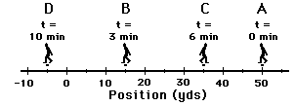

Slide 13
Velocity
Measure how fast something moves from one point to another
SI unit is meters per second m/s
Velocity has both magnitude and direction
Velocity and speed are not the same thing
Speed= distance / time
Has only magnitude

Slide 14
1. What is the displacement of the cross-country team if they begin at the school, run 10 miles and finish back at the school?
0 miles
2. What is the distance and the displacement of the race car drivers in the Indy 500?
Distance = 500 miles
Displacement = 0 miles

Slide 15
Speed
Magnitude (size) of Velocity
How fast something moves
Always positive

Slide 16
Average Velocity
Is equal to the displacement divided by the time during which the displacement occurred
V_{avg}= displacement
time interval
V= Δx= x_{f}-x_{i}
Δt t_{f}-t_{i}

Slide 17
Problem Solving Strategies
When converting a velocity, convert one factor at a time
Called Factor Label Method
Ex. Convert 100. km/h to m/s
100.km x 1000m x 1h = 27.8 m/s
1 h 1 km 3600s

Slide 18
Constant velocity
If the average velocity is the same for all intervals, then the object moves at a constant velocity
Constant Velocity V = x / t

Slide 19
Position Time Graphs
A graph that shows how position depends on time
Independent variable is the X
Time
Dependent variable on Y axis
Position

Slide 20
Position vs time
position
time

Slide 21
Where was the object located at 2 seconds?
5 m
4 m
3 m
position
2 m
At 2 seconds the object is located 2 meters from the reference point
1 m
0 m
2 s
3 s
4 s
5 s
0 s
1 s
time

Slide 22
Where is the object located at 15 seconds?
At 15 seconds the object is located 3 meters from the reference point
5 m
4 m
3 m
position
2 m
1 m
0 m
5 s
10 s
15 s
20 s
25 s
0 s
time

Slide 23
What would a stopwatch read when the object is located 5 meters from the reference point?
5 m
4 m
It would read 3 seconds when the object was 5 meters from the reference point
3 m
position
2 m
1 m
0 m
1 s
2 s
3 s
4 s
5 s
0 s
time

Slide 24
Quiz yourself

Slide 25
Where is the object located at 3 seconds?
5 m
4 m
3 m
#1
position
2 m
1 m
0 m
time
0 s
1 s
2 s
3 s
4 s
5 s

Slide 26
Where is the object located at 3 seconds?
5 m
At 3seconds the object is located 1 m from the reference point
4 m
#1
3 m
position
2 m
1 m
0 m
0 s
1 s
2 s
3 s
4 s
5 s
time

Slide 27
Where is the object located at 40 seconds?
10 m
8 m
#2
6 m
position
4 m
2 m
0 m
0 s
10 s
20 s
30 s
40 s
50 s
time

Slide 28
Where is the object located at 40 seconds?
10 m
8 m
#2
6 m
position
4 m
At 40 seconds the object is located 6 m from the reference point
2 m
0 m
0 s
10 s
20 s
30 s
40 s
50 s
time

Slide 29
At what time was the object located 50 meters away?
50 m
40 m
#3
position
30 m
20 m
10 m
0 m
0 s
0.5s
1.0 s
1.5 s
2.0 s
2.5 s
time

Slide 30
At what time was the object located 50 meters away?
50 m
40 m
When the object was 50 meters away, it was 1.5 s.
position
#3
30 m
20 m
10 m
0 s
0.5s
1.0 s
1.5 s
2.0 s
2.5 s
time

Slide 31
At what time was the object located 10 meters away?
50 m
40 m
position
#4
30 m
20 m
10 m
0 m
0 s
1 s
2 s
3 s
4 s
5 s
time

Slide 32
At what time was the object located 10 meters away?
50 m
40 m
#4
30 m
position
20 m
When the object was 10 meters away from the origin, it was 0 s.
10 m
0 m
0 s
1 s
2 s
3 s
4 s
5 s
time

Slide 33
At what time was the object located 10 meters away?
25 m
20m
#5
position
15 m
10 m
5 m
0 m
0 s
10 s
20 s
30 s
40 s
50s
time

Slide 34
At what time was the object located 10 meters away?
25 m
the object was 10 meters away between 0 to 50 s
20m
#5
15 m
position
10 m
5 m
0 m
0 s
10 s
20 s
30 s
40 s
50s
time

Slide 35
Why, on some graphs, did the line not start on the coordinates of 0,0?
8 m
6 m
4 m
2 m
0 m
0 s
10 s
20 s
30 s
40 s
50 s

Slide 36
Position-Time Graphs
Each type of motion has a characteristic shape on a P-T graph.
Constant speed
Zero speed (at rest)
Accelerating (speeding up)
Decelerating (slowing down)

Slide 37
Position-Time Graphs
Constant speed is represented by a straight segment on the P-T graph.
pos. (m)
time (s)
pos. (m)
time (s)
Constant speed in positive direction.
Constant speed in negative direction.

Slide 38
Position-Time Graphs
Object at rest
pos. (m)
time (s)
A horizontal segment means the object is at rest.

Slide 39
Position-Time Graphs
Curved segments on the P-T graph mean the object’s speed is changing.
pos. (m)
time (s)
pos. (m)
time (s)
Speeding up in positive direction.
Speeding up in negative direction.

Slide 40
Position-Time Graphs
Curved segments on the P-T graph mean the object’s speed is changing.
pos. (m)
time (s)
pos. (m)
time (s)
Traveling in positive direction, but slowing down.
Traveling in negative direction, but slowing down.

Slide 41
Position vs time graphs
Of an object at rest

Slide 42
Describe what the object is doing at 1 second, 2 seconds, 3 seconds, etc.?
5 m
4 m
At 1 seconds the object is located 4 meters from the origin
3 m
position
2 m
1 m
0 m
2 s
3 s
4 s
5 s
0 s
1 s
time

Slide 43
Describe what the object is doing at 1 second, 2 seconds, 3 seconds etc.?
5 m
From 0 to 5 seconds the object is located 4 meters from the origin
4 m
3 m
position
2 m
1 m
0 m
2 s
3 s
4 s
5 s
0 s
1 s
time

Slide 44
If an object is staying in the same position for a time interval than its…
at rest.
stopped.
not moving.
still.
Represented by a horizontal line on a position vs time graph

Slide 45
Quiz tourself

Slide 46
1) When and where is the object at rest?
10m
8 m
6 m
position
4 m
2 m
0 m
2 s
3 s
4 s
5 s
0 s
1 s
time

Slide 47
1) When and where is the object at rest?
10 m
From 2 to 4 seconds the object is located 6 meters from the origin
8 m
6 m
position
4 m
2 m
0 m
2 s
3 s
4 s
5 s
0 s
1 s
time

Slide 48
2) When and where is the object not moving?
5 m
4 m
3 m
position
2 m
1 m
0 m
4 s
6 s
8 s
10 s
0 s
2 s
time

Slide 49
3) When and where is the object still?
+3 m
+2 m
+1 m
position
0m
-1 m
-2 m
10 s
15 s
20 s
25 s
0 s
5 s
time

Slide 50
3) When and where is the object still?
+3 m
+2 m
From 15 to 25 seconds the object is located -1 meters from the origin
+1 m
position
0m
-1 m
-2 m
10 s
15 s
20 s
25 s
0 s
5 s
time

Slide 51
Position-Time Graphs
The following P-T graph corresponds to an object moving back and forth along a straight path. Can you describe its movement based on the graph?
N
position (m)
time (s)
S

Slide 52
As Δt becomes smaller, the average velocity becomes closer and closer to the instantaneous velocity at that point

Slide 53
Instantaneous Velocity
The velocity at that exact moment in time
To determine we would draw a straight line that is tangent to the curve at that point, the slope of that tangent then, is the instantaneous velocity

Slide 54
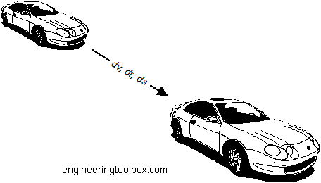
Acceleration
2-2

Slide 55
2-2 Learning Targets
Define Acceleration
Interpret velocity-time graphs
Apply kinematic equations to calculate distance, time, or velocity under constant acceleration

Slide 56
Average Acceleration
A= ΔV = (v_{f}-v_{i})
ΔT ( t_{f}-t_{i})
Velocity units = m/s
Time units= s
Acceleration units= m/s²
P. 47

Slide 57
Average Acceleration
A ratio between the change in velocity and the change in time
If the number is large, then the change is great
Acceleration has magnitude and direction
SI units = m/s²

Slide 58
Velocity and Acceleration p. 49
V_{i} | a | Motion
+ | + | Speeding up
- | - | Speeding up
+ | - | Slowing down
- | + | Slowing down
- or+ | 0 | Constant velocity
0 | - or + | Speeding up from rest
0 | 0 | Remaining at rest

Slide 59
Velocity can be interpreted graphically
Velocity can be found from position-time graph
Slope of the line Δx/Δt (position-time graph) is equal to the average velocity

Slide 60
Position-Time Graphs
The slope of a P-T graph is equal to the object’s velocity in that segment.
change in y
slope =
50
change in x
40
(30 m – 10 m)
30
slope =
position (m)
(30 s – 0 s)
20
10
(20 m)
slope =
(30 s)
10
20
30
40
time (s)
slope = 0.67 m/s

Slide 61
Tangent Lines
x
t
On a position vs. time graph:
SLOPE | VELOCITY
Positive | Positive
Negative | Negative
Zero | Zero
SLOPE | SPEED
Steep | Fast
Gentle | Slow
Flat | Zero

Slide 62
Velocity VS. Time Graph
A velocity-time (V-T) graph shows an object’s velocity as a function of time
The slope of the velocity versus time graph is the acceleration.
This only works if the acceleration is Constant!
The area under the velocity versus time graph is the displacement.

Slide 63
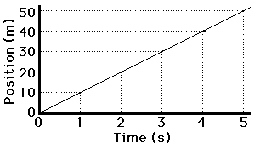
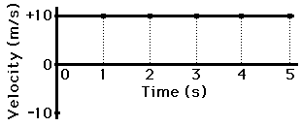
P-T graph to Velocity Time Graphs
A tool that can be used to describe motion with either constant or changing velocity
A constant velocity from a position time graph, becomes a horizontal line on the velocity time graph

Slide 64
Velocity-Time Graphs
A horizontal line on the V-T graph means constant velocity. (No acceleration)
N
Object is moving at a constant velocity North.
velocity (m/s)
time (s)
S

Slide 65
Velocity-Time Graphs
A horizontal line on the V-T graph means constant velocity. (No acceleration)
N
Object is moving at a constant velocity South.
velocity (m/s)
time (s)
S

Slide 66
Velocity-Time Graphs
If an object isn’t moving, its velocity is zero.
N
Object is at rest
velocity (m/s)
time (s)
S

Slide 67
Velocity-Time Graphs
Positive slope = positive constant acceleration
Not necessarily speeding up!
If v is positive also, object is speeding up.
If v is negative, object is slowing down.

Slide 68
Velocity-Time Graphs
V-T graph has positive slope.
N
N
velocity (m/s)
time (s)
velocity (m/s)
time (s)
S
Positive velocity and positive acceleration: object is speeding up!
S
Negative velocity and positive acceleration: object is slowing down.

Slide 69
Velocity-Time Graphs
Negative slope = negative constant acceleration.
Not necessarily slowing down!
If v is positive, the object is slowing down.
If v is negative also, the object is speeding up.

Slide 70
Velocity-Time Graphs
V-T graph has negative slope.
N
N
velocity (m/s)
time (s)
velocity (m/s)
time (s)
Negative velocity and negative acceleration: object is speeding up! (in negative direction)
S
Positive velocity and negative acceleration: object is slowing down,
S

Slide 71
Explain how someone can have positive position, but negative velocity.
Driving west
https://www.physicsclassroom.com/Physics-Interactives/1-D-Kinematics/Name-That-Motion/Name-That-Motion-Interactive
Ticker tape

Slide 72
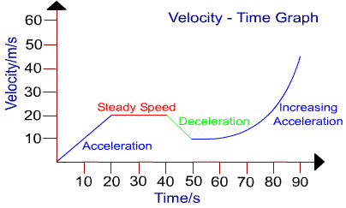

Slide 73
Motion with constant Acceleration
As velocity increases the object travels a greater distance during a set time interval
Because the acceleration is constant the velocity increases by the same amount during the time interval
Because the velocity increases by the same amount in each interval the displacement for each time interval increases by the same amount

Slide 74
If acceleration is constant, then
V_{avg}= V_{i} + V_{f} and V_{avg} = Δx
2 Δt
then V_{i} + V_{f} = Δx
2 Δt
Then Δx= ½ (V_{i} + V_{f}) Δt
Displacement = ½ (initial v + final v) (time interval)

Slide 75
Final velocity depends on initial velocity, acceleration and time
If we want to calculate displacement but do not know V_{f} how to we do it?
If we know V_{i}, A_{avg}, Δt then we can calculate V_{f} and use this to calculate Δx
a= Δ V =V_{f} - V_{i} = V_{f} - V_{i}
Δt t_{f} -t_{i} Δt
aΔt = V_{f}-V_{i}
Velocity with constant acceleration
V_{f}= aΔt + V_{i}

Slide 76
If we want to know displacement with constant acceleration and we are not given V_{f} the n we can substitute the earlier equation into the equation for Δx
Δx= ½ (V_{i} + V_{f}) Δt
Δx= ½ (V_{i} +aΔt + V_{i}) Δt
Δx= ½ [2V_{i} Δt +a (Δt)²]
Δx= V_{i} Δt +½a (Δt)²
Displacement with constant acceleration

Slide 77
Time can be found from displacement and velocities
Why: to find V_{f} of an accelerated object without knowing how long it has been accelerating
How: start with the equation for displacement
Δx= ½ (V_{i} + V_{f}) Δt
Solve for Δt
Δt = 2Δx
V_{i} + V_{f}

Slide 78
Substitute the earlier equation for Δt into the equation for V_{f}
V_{f}= V_{i} + aΔt
V_{f}= V_{i} + a 2Δx
V_{i} + V_{f}
This is not helpful, since V_{f} is on both sides of the equation

Slide 79
Solve for V_{f}
V_{f}= V_{i} + a 2Δx
V_{i} + V_{f}
V_{f}-V_{i} = a (2Δx)
V_{i} + V_{f}
(V_{f}-V_{i} )(V_{f}+V_{i} )= a (2Δx)
(V_{f}²- V_{i}²) = a (2Δx)
V_{f}²= V_{i}² + 2aΔx
Final velocity after any displacement

Slide 80
p. 56
Form with V_{i} Form without V_{i}
Δx= ½ (V_{i} + V_{f}) Δt Δx= ½ ( V_{f}) Δt
V_{f}= aΔt + V_{i} V_{f}= aΔt
Δx= V_{i} Δt +½a (Δt)² Δx= ½a (Δt)²
V_{f}²= V_{i}² + 2aΔx V_{f}²= 2aΔx

Slide 81
Falling Objects
2-3

Slide 82
2-3 Learning Targets
Relate the motion of a free falling body to constant acceleration
Calculate displacement, time, and velocity during the motion of a falling object

Slide 83
Freefall- motion of an object falling with a constant acceleration without air resistance
g
a=-g= -9.81 m/s²

Slide 84
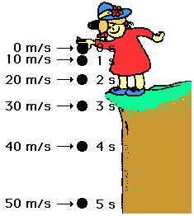
Throw ball upward
As soon as the ball is released the acceleration is -9.81 m/s²
Acceleration is constant at any point
Velocity is 0 m/s at the peak

Slide 85
In absence of air resistance all objects dropped will fall with the same constant acceleration

Slide 86
 | Velocity | Acceleration | Results
Anything goes up | + | - | Slows down
Anything falling | - | - | Speeds up

Slide 87
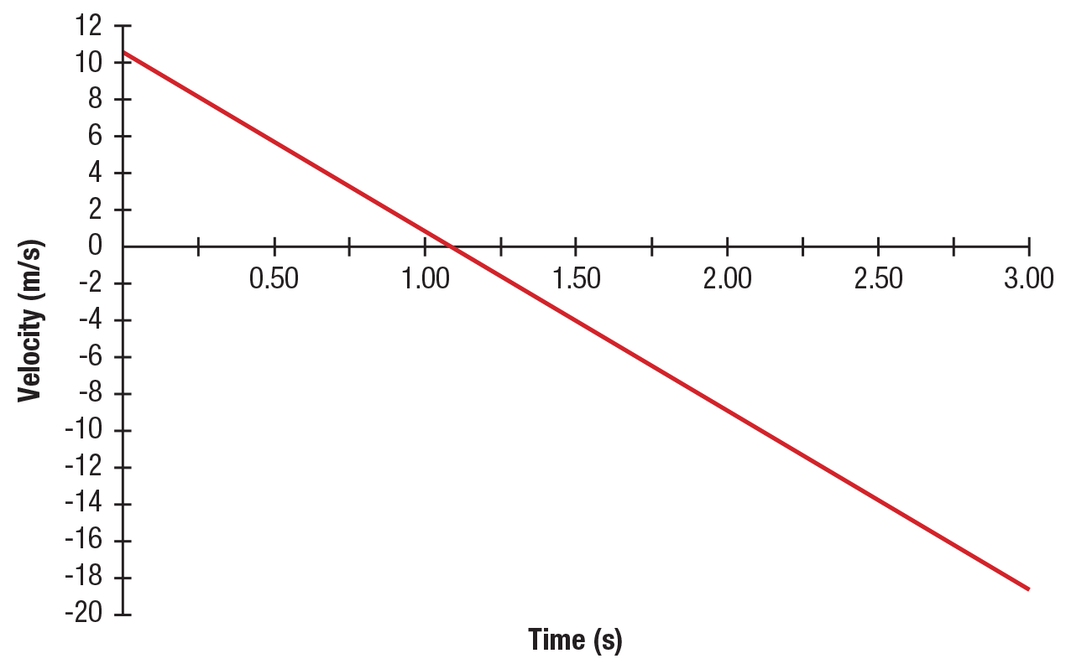
V-T graph thrown object

Slide 88
Form with V_{i} Form without V_{i}
Δy= ½ (V_{i} + V_{f}) Δt Δy= ½ ( V_{f}) Δt
V_{f}= aΔt + V_{i} V_{f}= aΔt
Δy= V_{i} Δt +½a (Δt)² Δy= ½a (Δt)²
V_{f}²= V_{i}² + 2aΔy V_{f}²= 2aΔy

Slide 89
The time for the Demon Drop to freely fall is 1.5 s. What is the velocity at the end of this time? How far does it fall?
V_{f}= aΔt + V_{i}
V_{f} = (-9.81 m/s²) (1.5s) + 0 m/s
Vf= -15 m/s
Δy= V_{i} Δt +½a (Δt)²
Δy= (0 m/s)(1.5s) +½(-9.81 m/s²) (1.5)²
Δy= 11 m

Slide 90
A tennis ball is thrown straight up with an initial velocity of + 22.5 m/s. It is caught at the same distance above ground from which it was thrown. How high does the ball rise?
V_{f}²= V_{i}² + 2aΔy
0 m/s= (22.5 m/s)² + 2(-9.81 m/s²)Δy
Final velocity is 0 because ball is at top of arch in flight
Δy = + 25.8 m

Slide 91
How long does the ball remain in the air if not caught and allowed to fall to the ground?
V_{f}= aΔt + V_{i}
0 m/s = (-9.81 m/s²) t + 22.5 m/s
t= 2.30 s
This is for half the trip so total time is 4.60 s.

Slide 92
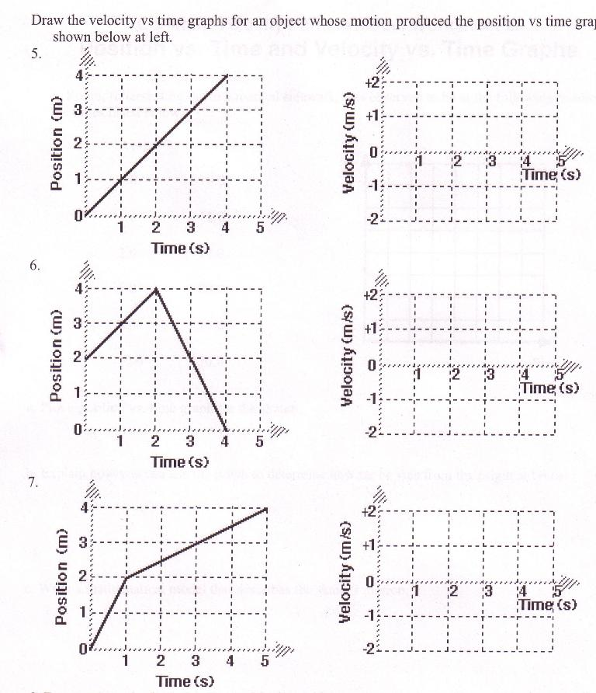

Slide 93
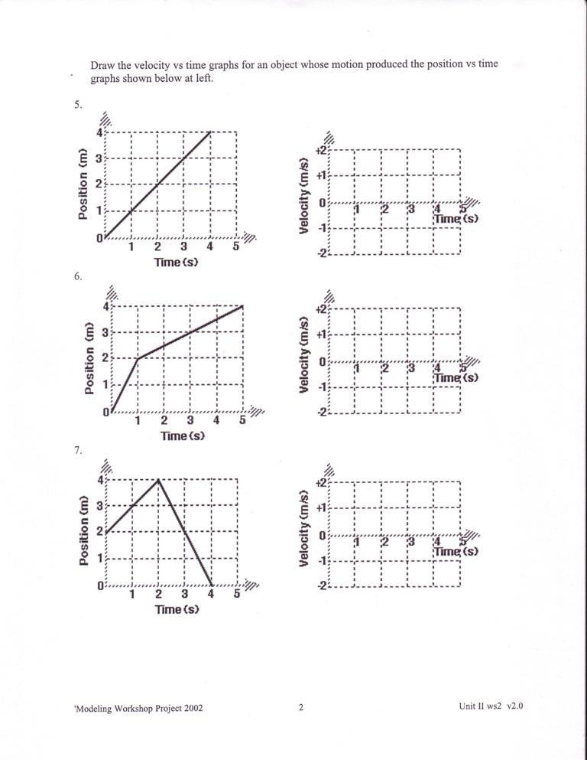

Slide 94
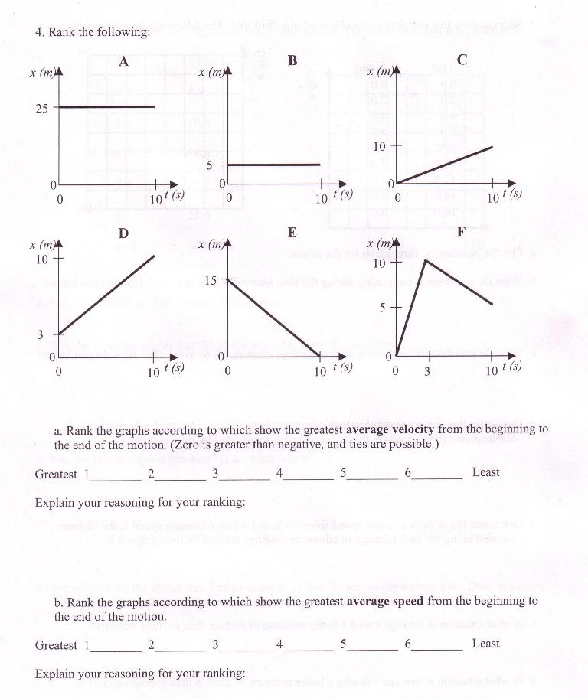

Slide 95
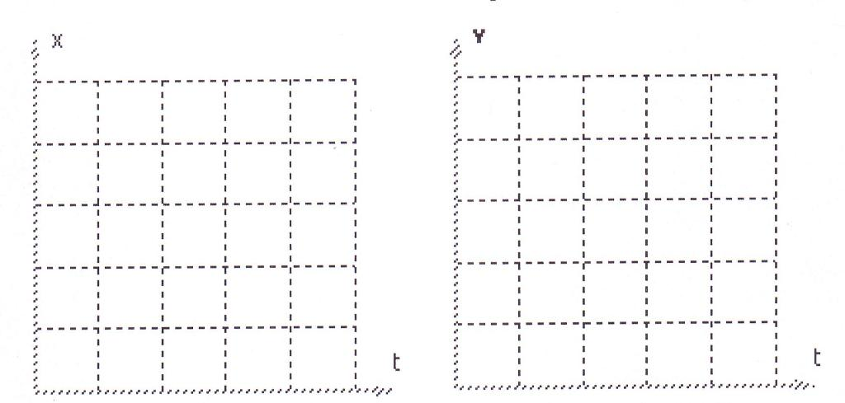

Slide 97
Chapter 2 Review
P. 73
#1,4-8,10,12-14,16,18,20,21,23,24,26,30,31

