Slide 1
Acid- Base Titration and pH
Chapter 15

Slide 2
Aqueous Solutions and the Concept of pH
15-1

Slide 3
Hydronium ions and hydroxide ions
Self-ionization of water
Autoprotolysis
H₂O (l) + H₂O (l) → H₃O⁺ (aq)+ OH⁻ (aq)
Molarity at 25 ºC
1.0 x 10 ⁻⁷ moles H₃O⁺ per liter of solution
1.0 x 10 ⁻⁷ moles OH⁻ per liter of solution

Slide 4
Ionization constant for water (K_{w})
K_{w} = [H₃O⁺ ][OH⁻]= (1.0 x 10 ⁻⁷ M)(1.0 x 10 ⁻⁷ M)
K_{w} = 1.0 x 10 ⁻¹⁴ M²
K_{w} is a constant at ordinary ranges of room temperature

Slide 5
Concentrations and Kw

Slide 6
Neutral, Acidic, and Basic Solutions
Neutral [H₃O⁺ ] = [OH⁻]
Acidic [H₃O⁺ ] >[OH⁻]
Basic [H₃O⁺ ] <[OH⁻]

Slide 7
Calculating [H₃O⁺ ] and [OH⁻]
[H₃O⁺ ] = 1.0 x 10 ⁻¹⁴ M²
[OH⁻]
[OH⁻] = 1.0 x 10 ⁻¹⁴ M²
[H₃O⁺ ]
Assume strong acids and bases are completely ionized in solution
1.0 M H₂SO₄ = 2.0 M H₃O⁺
1.0 M Ba(OH)₂ = 2.0 M OH⁻

Slide 8
A 1.0 × 10−2 M NaOH solution has an [OH−] of 1.0 × 10−2 M.
Find the [H3O+] of this solution
Kw = [H3O+][OH−] = 1.0 × 10−14
[H₃O⁺ ] = 1.0 x 10 ⁻¹⁴ M²
[1.0 × 10−2 M]
[H₃O⁺ ] = 1.0 x 10 ⁻¹² M

Slide 9
Determine the hydronium and hydroxide ions concentrations in a solution that is 3.0 x 10 ⁻² M NaOH.
NaOH (s) Na +(aq) + OH⁻ (aq)
(3.0 x 10 ⁻² mol NaOH/ L) (1mol OH⁻ / 1mol NaOH)
= 3.0 x 10 ⁻² M OH⁻
[H₃O⁺ ] = 1.0 x 10 ⁻¹⁴ M²
[OH⁻]
[H₃O⁺ ] = 1.0 x 10 ⁻¹⁴ M² = 3.3 x 10 ⁻¹³ M H₃O⁺
3.0 x 10 ⁻² M OH⁻

Slide 10
Strong acids and bases completely ionize
P. 481 list of acids and bases

Slide 11
pH Scale
Scale from 0 to 14
pH of 7 is neutral
Below 7 is acidic
Above 7 is basic
Basic means more OH⁻ ions than H⁺ ions
Acidic means more H⁺ ions than OH⁻ ions

Slide 14
Approximate pH Range of Common Materials

Slide 15
pH Scale
pH the negative of the common logarithm of the hydronium ion concentration
pH= - log [H₃O⁺ ]
pOH the negative of the common logarithm of the hydroxide ion concentration
pOH= - log [OH⁻]
pH + pOH= 14.0

Slide 16
Formulas for 15-1
K_{w} = [H₃O⁺ ][OH⁻]
[OH-]= antilog -pOH
[H₃O⁺ ]=antilog -pH
pH= - log [H₃O⁺ ]
pOH= - log [OH⁻]
pH + pOH= 14.0

Slide 17
Calculations of pH and pOH
What is the pH of a solution if [H₃O⁺ ] is 2.5 x 10⁻²M?
pH= - log [H₃O⁺ ]
-log 2.5 x10⁻²= 1.6
What is the pOH of a pH= 1.6 solution?
pH + pOH= 14.0
1.6 + pOH = 14.0
pOH= 12.4

Slide 18
Finding [H₃O⁺ ] from pH
What is the concentration of [H₃O⁺ ] in a solution of pH=4.0?
[H₃O⁺ ]=antilog -pH
Antilog – 4.0
=1.0 x 10 ⁻⁴ M

Slide 19
The pH of a solution is 8.7
1- find hydronium concentration.
[H₃O⁺ ]=antilog -pH
[H₃O⁺ ]= antilog- 8.7
= 2.0 x 10 ⁻⁹ M
2- find hydroxide concentration.
K_{w} = [H₃O⁺ ][OH⁻]
1.0 x 10-14= (2.0 x 10 ⁻⁹ M)[OH⁻]
[OH⁻]=5.0x 10 ⁻⁶ M
3- is it basic or acidic?
basic

Slide 21
pH calculations and strength of Weak Acids and Bases
Weak acids and bases cannot be assumed to be 100% ionized
[H₃O⁺ ] and[OH⁻] Cannot be determined from acid and base concentrations and must be determined experimentally

Slide 22
Determining pH and Titrations
15-2

Slide 23
Acid-Base Indicators
Compounds whose colors are sensitive to pH
DO NOT use too much will effect endpoint
Transition interval
pH range over which an indicator color change occurs
Indicators are useful when they change color in pH range which includes the endpoint of the reaction

Slide 24
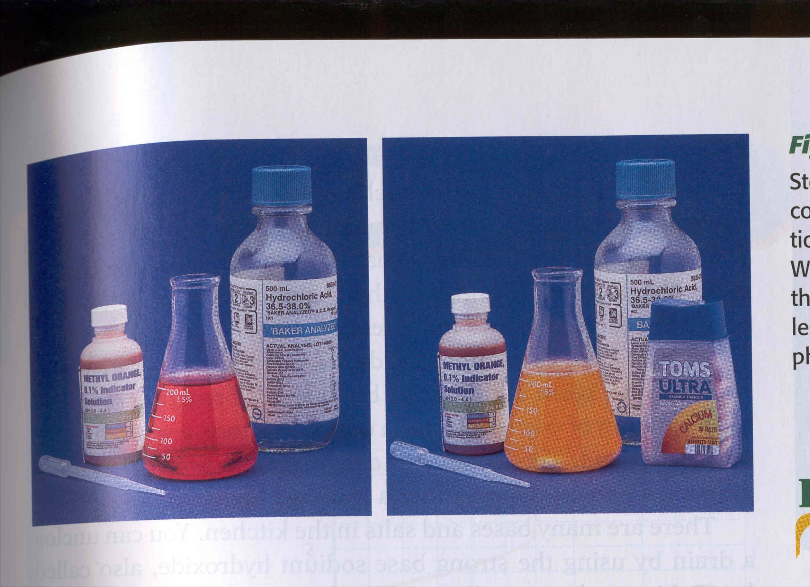

Slide 25
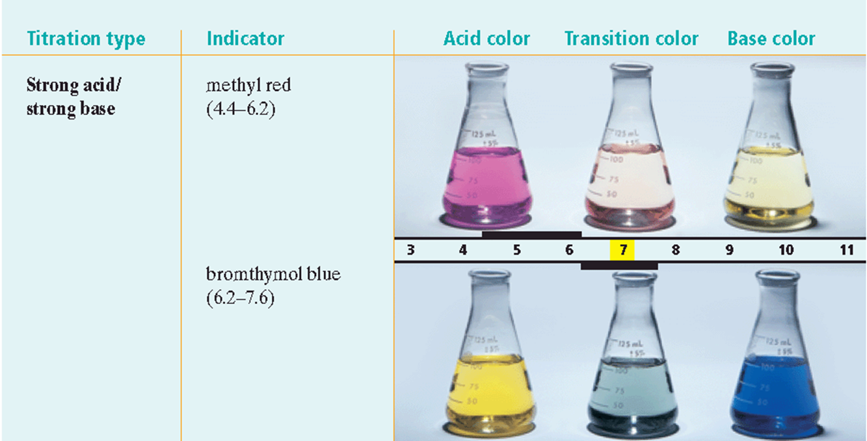

Slide 26
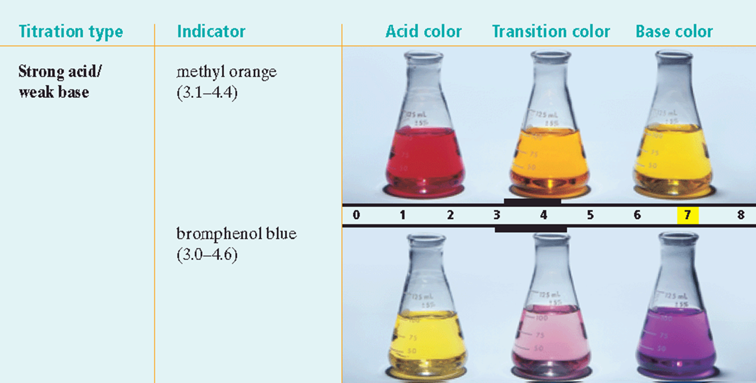

Slide 27
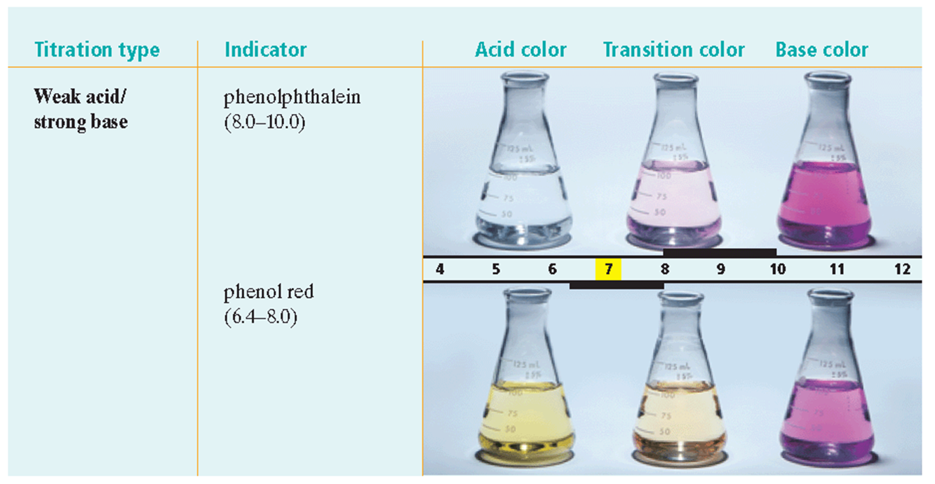

Slide 28
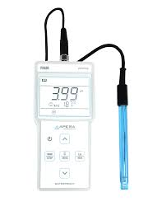
pH meter
Measures voltage difference between two electrodes placed in solution
Voltage changes as hydronium ion concentration changes

Slide 29
Acid-Base Indicator Selections
Combination | Endpoint | Indicator(s)
Strong acid-strong base | Endpoint pH is 7 | Litmus Bromthymol blue
Strong acid- weak base | Endpoint is less than 7 | Methyl orange Bromphenol blue
Weak acid- strong base | Endpoint is greater than 7 | Phenolphthalein Phenol red
Weak acid- weak base | Endpoint pH can fall in a wide range | No single indicator is suitable

Slide 30
Titration
Controlled addition of the measured amount of a solution of a known concentration required to react completely with a measured amount of solution of unknown concentration

Slide 31
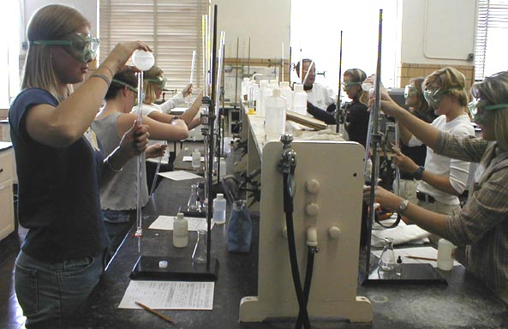

Slide 32
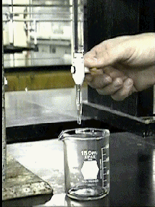
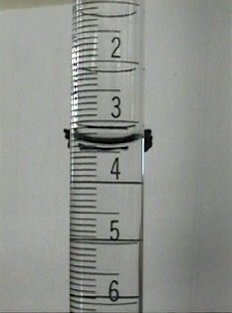

Slide 33
Titration/ crash course
https://www.youtube.com/watch?v=g8jdCWC10vQ
https://www.youtube.com/watch?v=LS67vS10O5Y

Slide 34
Equivalence Point
The point at which the solutions used in a titration are present in chemically equivalent amounts

Slide 35
Titration Curves
Endpoint- the point in a titration at which the reaction is just complete
Where indicator changes color
Not necessarily at same point as equivalence point

Slide 36
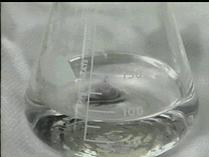

Slide 37
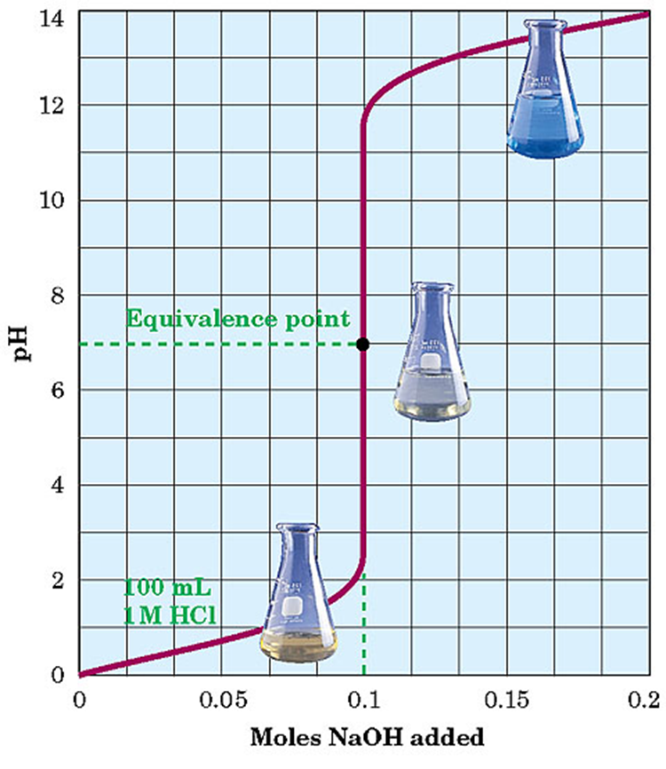
Titration Curve for a Strong Acid and a Strong Base

Slide 38
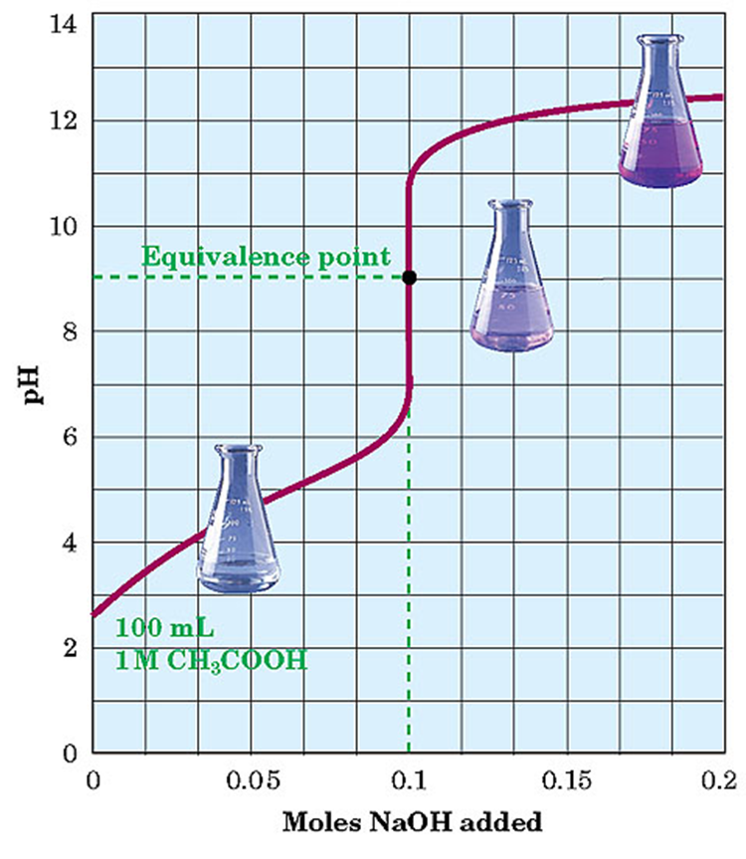
Titration Curve for a Weak Acid and a Strong Base

Slide 39
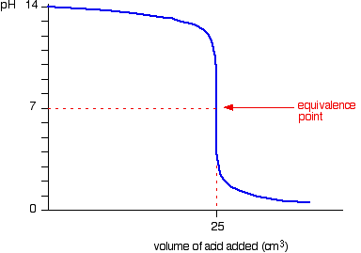
Running acid into the alkali

Slide 40
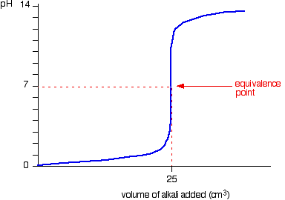
Running alkali into the acid

Slide 41
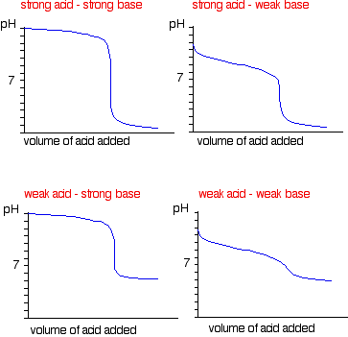

Slide 42
Molarity and Titration
Standard Solution- (“known” solution) a solution that contains the precisely known concentration of a solute used in titration to find the concentration of the solution of unknown concentration
Primary standard- a highly purified solid compound used to check the concentration of the known solution in titration

Slide 43
Calculations with Molar Titrations
1- start with balanced equation or the neutralization reaction and determine the chemically equivalent amount of the acid and base
2- determine the moles of acid (or base) from the known solution used during the titration
3- determine the moles of solute of the unknown solution used during the titration
4- determine the molarity of the unknown solution

Slide 44
In a titration, 27.4 ml of 0.0154 M Ba(OH)₂ is added to a 20.0 ml sample of HCl solution of unknown concentration. What is the molarity of the acid solution?
1- Balance equation
Ba(OH)₂ + 2HCl → BaCl₂ + 2H₂O
1 mol 2mol 1mol 2 mol
2- Volume of known base solution to amount of base used (mol)
(0.0154 mol/L Ba(OH)₂ ) (0.0274 L )
= 4.22 x 10 ⁻⁴ mol Ba(OH)₂

Slide 45
3-mole ratio moles of base used to moles of acid from unknown solution
(2 mol HCl/ 1 mol Ba(OH)₂) (4.22 x 10 ⁻⁴ mol Ba(OH)₂)
= 8.44 x 10 ⁻⁴ mol HCl
4- determine molarity
(8.44 x 10 ⁻⁴ mol HCl / 0.0200 L)
= 4.22x 10 ⁻² mol HCl

Slide 46
By titration, 17.6 mL of H₂SO₄ neutralized 27.4 mL of 0.0165 M LiOH solution. What was the molarity of the aqueous acid solution?
M₁V₁=M₂V₂
H₂SO₄ M₁ (0.176 L)= (0.0165 M LiOH) (0.274 L)
M₁ = 0.0257 M H₂SO₄ / 2= 0.128 M H₂SO₄
Need to divide by 2, 1:2 ratio
H₂SO₄ + 2 LiOH → Li₂SO₄ + 2H₂O

Slide 47
M₁V₁=M₂V₂
(Molarity x volume)

