Slide 1
Chapter 14: Gases
© 2015 Pearson Education, Inc.

Slide 2
This lecture will help you understand:
The Atmosphere
Atmospheric Pressure
The Barometer
Boyle's Law
Buoyancy of Air
Bernoulli's Principle
Plasma

Slide 3
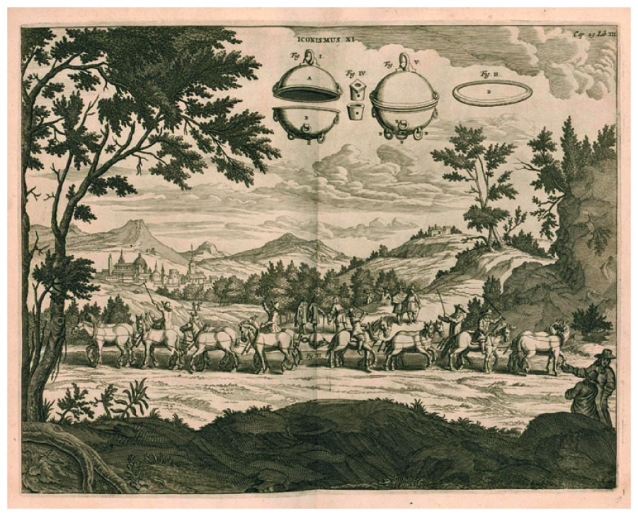
The Atmosphere
Atmosphere
Ocean of air
Exerts pressure
The Magdeburg-hemispheres demonstration in 1654 by Otto von Guericke showed the large magnitude of atmosphere's pressure.

Slide 4
https://www.youtube.com/watch?v=k1-XLjACzss

Slide 5
The Atmosphere
Energized by sunlight (stirs it, Why need?)
Need gravity to keep molecules from flying off into outer space
No definite surface
99% of atmosphere below 30 km
As altitude increases density of atmosphere decreases
As altitude increases temperature of atmosphere decreases

Slide 6
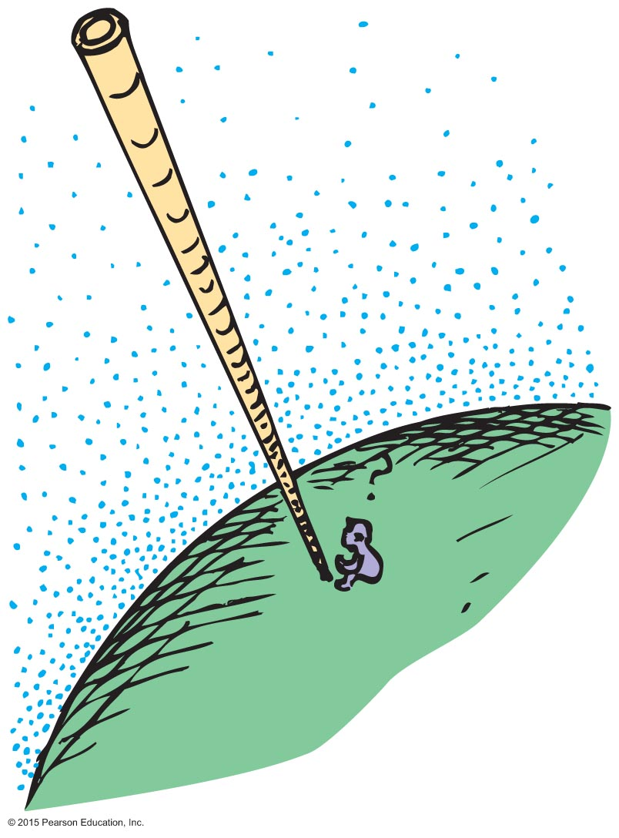
Atmospheric Pressure
Atmospheric pressure
Caused by weight of air
Varies from one locality to another
At sea level air of 1m³= 1.2 kg
Not uniform
Measurements are used to predict weather conditions

Slide 7
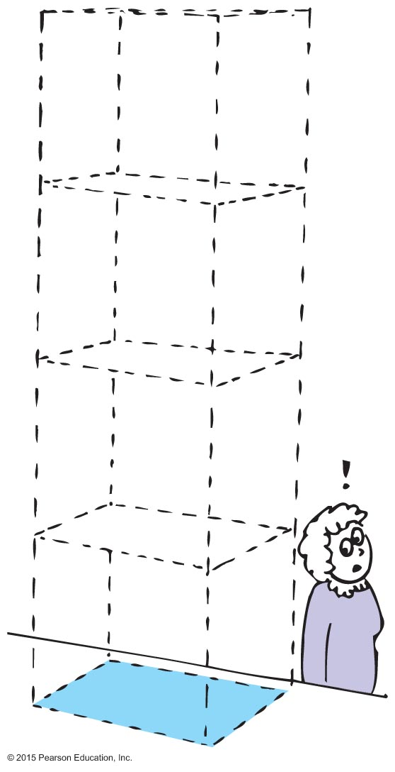
Atmospheric Pressure, Continued
Pressure exerted against bodies immersed in the atmosphere result from the weight of air pressing from above.
At sea level is 101 kilopascals (101 kPa).
Weight of air pressing down on
at sea level ~ 100,000 N,
so atmospheric pressure is ~

Slide 8
What can cause variations in atmosphere?
1- change in altitude
2- air currents
3- weather (storms, etc.)

Slide 9
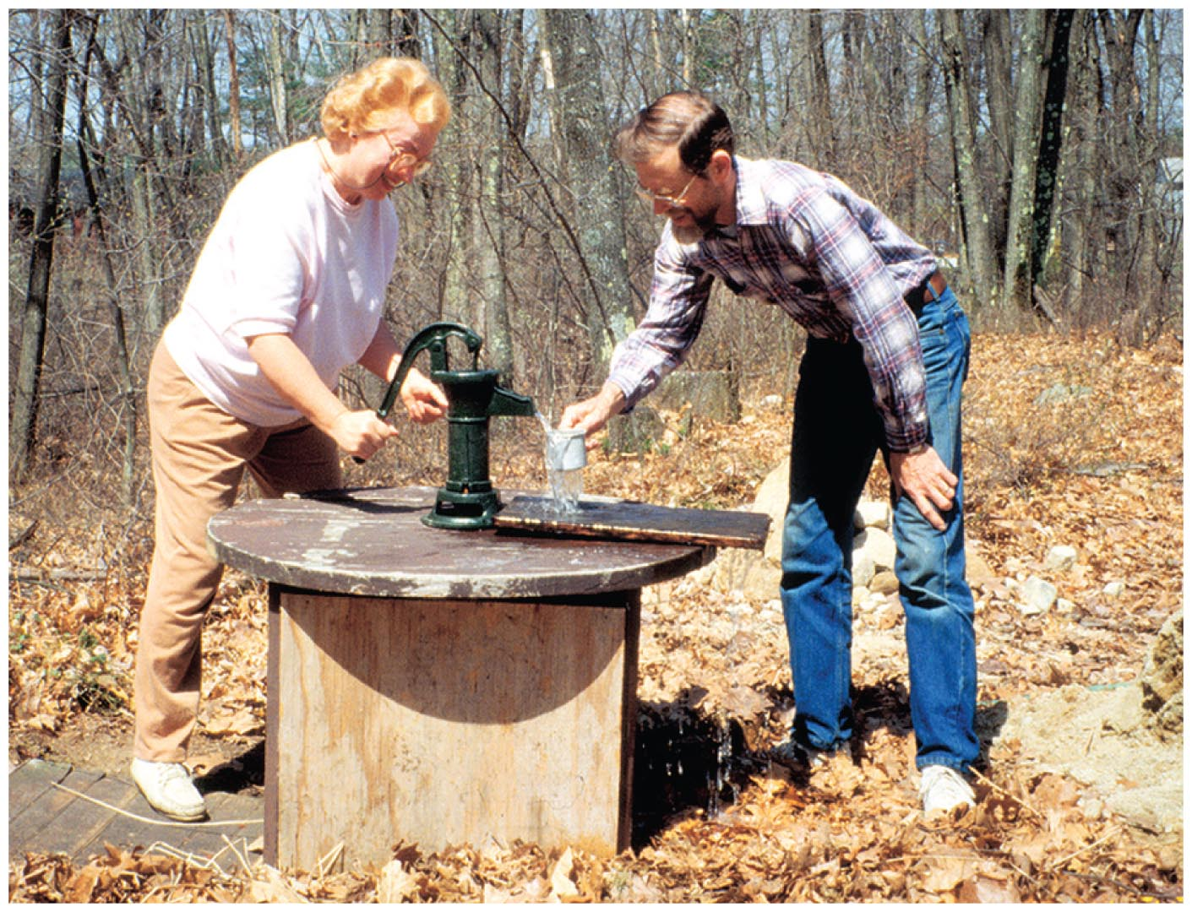
Atmospheric Pressure, Continued-1
Pressure at the bottom of a column of air reaching to the top of the atmosphere is the same as the pressure at the bottom of a column of water 10.3 m high.
Consequence: The highest the atmosphere can push water up into a vacuum pump is 10.3 m.
Mechanical pumps that don't depend on atmospheric pressure don't have the 10.3-m limit.

Slide 10
Atmospheric Pressure CHECK YOUR NEIGHBOR
The maximum height to which water can be drunk through a straw
is 10.3 m.
is about 76 cm.
has no limit.
None of the above.
Notes:
A. is 10.3 m.

Slide 11
Atmospheric Pressure CHECK YOUR ANSWER
The maximum height to which water can be drunk through a straw
is 10.3 m.
Explanation:
However strong your lungs may be, or whatever device you use to make a vacuum in the straw, at sea level the water could not be pushed up by the atmosphere higher than 10.3 m.
Notes:
A. is 10.3 m.

Slide 12
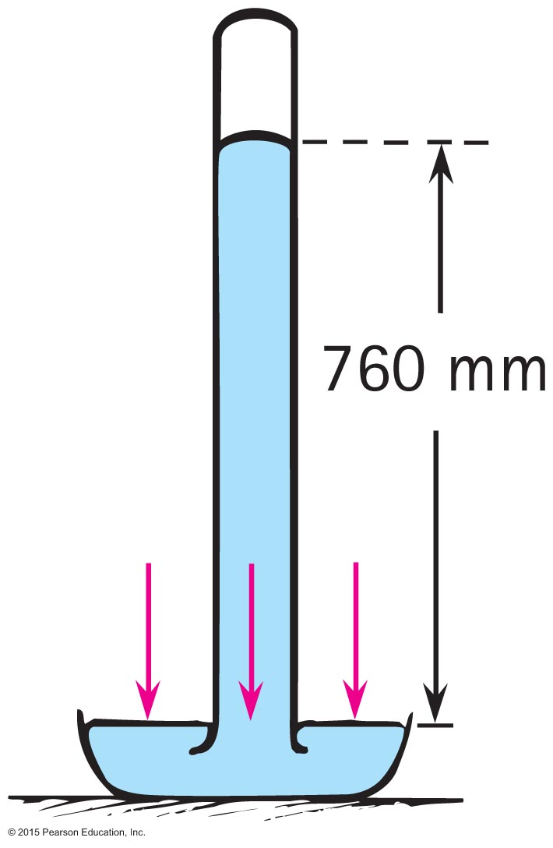
The Barometer
The barometer is a device to measure atmospheric pressure.
Standard height is 76 cm
It consists of a mercury tube upside down in a dish filled with mercury.
The height of the mercury column tells us the atmospheric pressure.

Slide 13
The Barometer, Continued
The principle of the barometer:
Mercury column exerts pressure on the mercury in the dish.
Atmosphere exerts pressure on the mercury in the dish.
These two pressures must be equal so that the atmospheric pressure supports the mercury column.

Slide 14
Barometer CHECK YOUR NEIGHBOR
Why don't barometers use water instead of mercury?
Water cannot be used because it does not exert pressure.
Water cannot be used because it sticks to the glass.
Water can be used but the barometer will be too tall.
None of the above.
Notes:
14
C. Water can be used but the barometer will be too tall.

Slide 15
Barometer CHECK YOUR ANSWER
Why don't barometers use water instead of mercury?
Water can be used but the barometer will be too tall.
Explanation:
Water is 13.6 times less dense than mercury. So, if we were to use water in a barometer, it would be 13.6 times taller than a mercury barometer. So it would be 10.3 meters tall! – not practical.
Notes:
15
C. Water can be used but the barometer will be too tall.

Slide 16
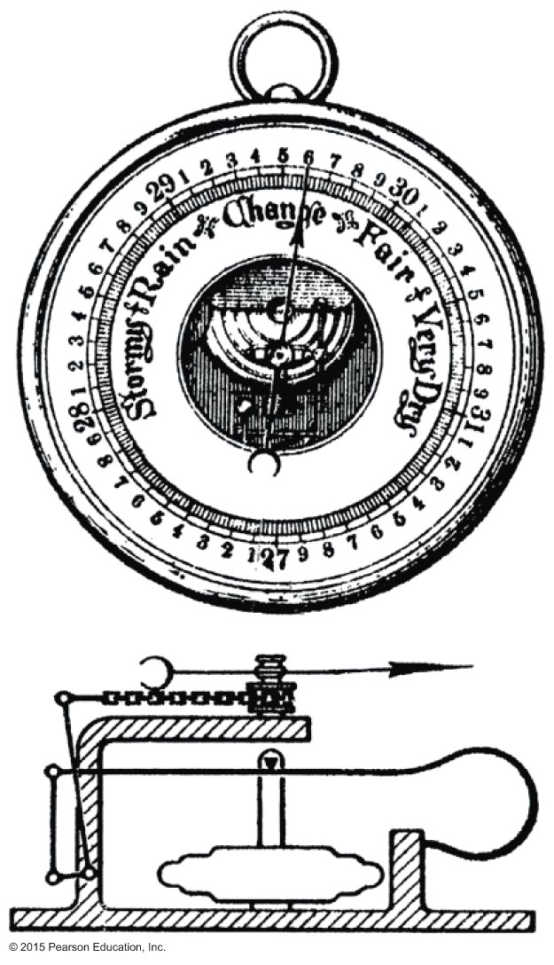
The Barometer, Continued-1
A different kind of barometer is the aneroid barometer.
A partially exhausted metal box of air with a flexible lid.
Lid bends in or out with changes in atmospheric pressure.
The motion of lid is indicated on a scale.
Atmospheric pressure decreases with increasing altitude, so it also measures elevation—an altimeter.

Slide 17
Boyle’s Law
For a constant number of molecules of gas at constant temperature, the product of pressure and volume is constant

Slide 18
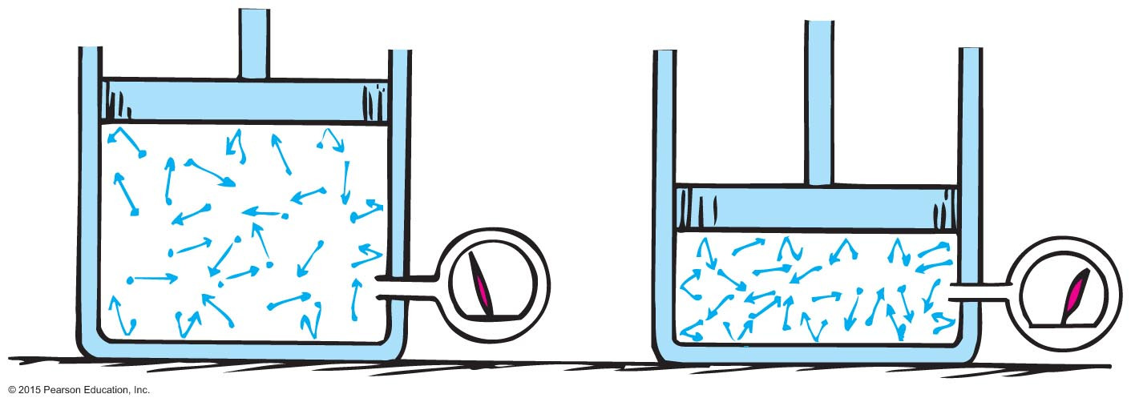
Boyle's Law
The pressure and volume of a gas enclosed in a space are inversely proportional.
If you increase pressure, the volume will decrease by the same factor.
Example: If pressure is doubled, volume will halve.

Slide 19
Pressure is proportional to density
Decrease volume will increase density
Increase volume will decrease density

Slide 20
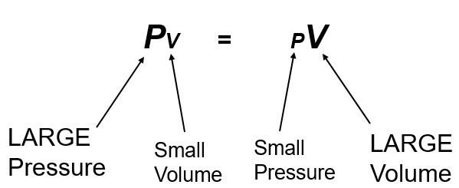
Boyle's Law, Continued
The product of pressure and volume of a given mass of gas will always remain the same.

Slide 21
Boyle's Law CHECK YOUR NEIGHBOR
A piston in an airtight pump is withdrawn so that the volume of the air chamber is increased 3 times. What is the change in pressure?
The pressure is 3 times the original pressure.
The pressure is 1/3 the original pressure.
The pressure does not change.
There is not enough information to figure this out.
Notes:
21
B. The pressure is 1/3 the original pressure.

Slide 22
Boyle's Law CHECK YOUR ANSWER
A piston in an airtight pump is withdrawn so that the volume of the air chamber is increased 3 times. What is the change in pressure?
The pressure is 1/3 the original pressure.
Explanation:
If the volume is increased 3 times, then the pressure must change inversely proportionally, i.e., be 3 times smaller: 1/3 the original pressure.
Notes:
22
B. The pressure is 1/3 the original pressure.

Slide 23
Buoyancy in Air
Archimedes' principle applies to air as well as liquids.
States that an object surrounded by air is buoyed up by a force equal to the weight of the air displaced

Slide 24
Buoyancy in Air, Continued
Rule for "lighter-than-air" objects:
When the weight of air displaced by an object is greater than the weight of the object, it rises.
When the weight of air displaced by an object equals the weight of the object, it hovers in air.
When the weight of air displaced by an object is less than the weight of the object, it is not supported by air.

Slide 25
Buoyancy in Air, Continued-1
Gas-filled balloons
Gas prevents atmosphere from collapsing them
Best buoyancy with hydrogen, the lightest gas (flammable, so seldom used)
Next-best buoyancy with helium
Heated air used in sports balloons
As balloons rise, atmosphere becomes less dense with altitude.

Slide 26
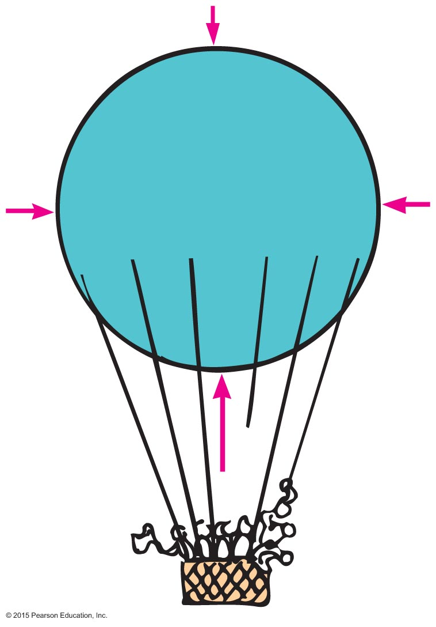
Buoyancy in Air, Continued-2
Gas-filled balloon will continue to rise until
the weight of displaced air equals the total weight of the balloon.
the buoyant force on the balloon equals its weight (which says the same thing).

Slide 27
Buoyancy in Air CHECK YOUR NEIGHBOR
As a balloon rises higher and higher into the atmosphere, its
volume decreases.
density increases.
weight increases.
None of the above.
Notes:
D. None of above.

Slide 28
Buoyancy in Air CHECK YOUR ANSWER
As a balloon rises higher and higher into the atmosphere, its
None of the above.
Notes:
D. None of above.

Slide 29
Buoyancy in Air CHECK YOUR NEIGHBOR, Continued
A dirigible that hovers in air
displaces its volume of air.
displaces its weight of air.
Both A and B.
None of the above.
Notes:
29
C. Both A and B.

Slide 30
Buoyancy in Air CHECK YOUR ANSWER, Continued
A dirigible that hovers in air
Both A and B.
Explanation:
Like a fish in water, both volume and weight of a fluid are displaced.
Notes:
30
C. Both A and B.

Slide 31
Video #65- Atmosphere
https://www.youtube.com/watch?v=m-85Rp3FTdc
Video#69 Bernoulli
https://www.youtube.com/watch?v=YKkYAPA04ZY
Video #70- Bernoulli
https://www.youtube.com/watch?v=kqbbmHs6TcA

Slide 32
Bernoulli's Principle
Bernoulli's principle
Discovered by Daniel Bernoulli, a 15th century Swiss scientist
States that where the speed of a fluid increases, internal pressure in the fluid decreases (and vice versa)
Applies to a smooth, steady flow

Slide 33
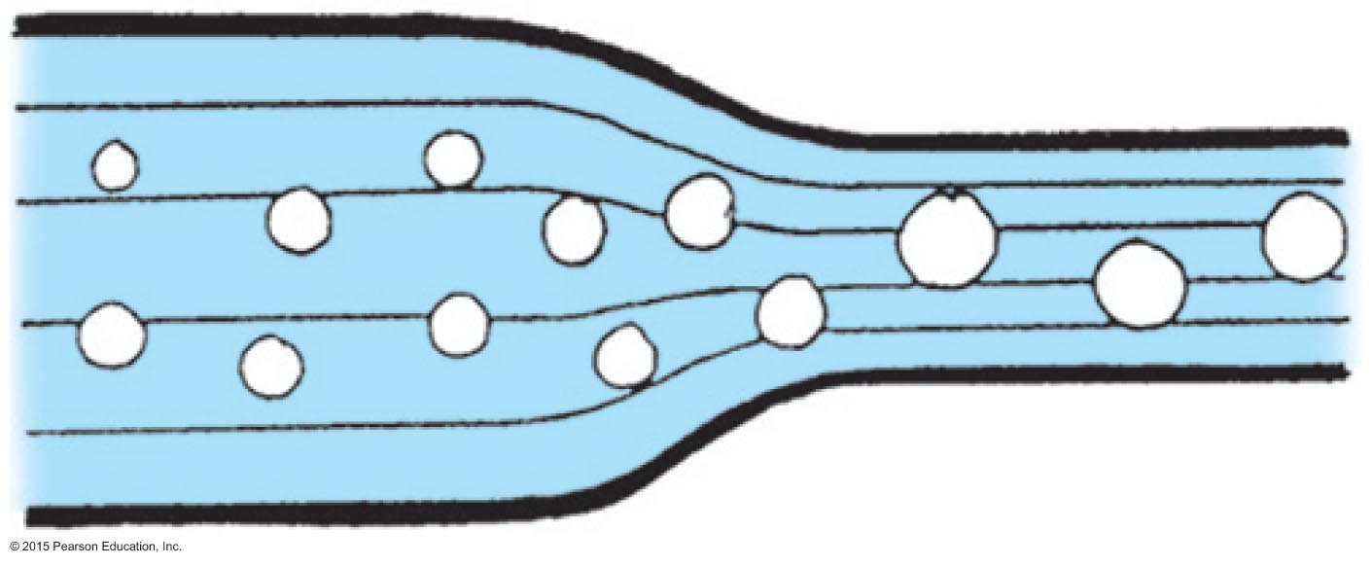
Bernoulli's Principle, Continued
Streamlines
Thin lines representing fluid motion
Closer together, flow speed is greater and pressure within the fluid is less
Wider, flow speed is less and pressure within the fluid is greater

Slide 34
Why are bubbles different sizes?
High pressure (slow moving)= smaller bubbles
Low pressure ( fast moving) = bigger bubbles

Slide 35
Bernoulli's Principle, Continued-1
Laminar flow
Smooth steady flow of constant density fluid
Turbulent flow
Flow speed above a critical point becomes chaotic

Slide 36
Bernoulli's Principle CHECK YOUR NEIGHBOR
The pressure in a stream of water is reduced as the stream speeds up. Can a stream of water from a fire hose actually knock a person off his or her feet?
It can't, as Bernoulli's principle illustrates.
It can, and is consistent with Bernoulli's principle.
Bernoulli's principle works only for laminar flow, which the stream is not.
None of the above.
Notes:
B. It can, and is consistent with Bernoulli's principle.

Slide 37
Bernoulli's Principle CHECK YOUR ANSWER
The pressure in a stream of water is reduced as the stream speeds up. Can a stream of water from a fire hose actually knock a person off his or her feet?
It can, and is consistent with Bernoulli's principle.
Explanation:
There's a difference in the pressure within flowing water and the pressure it can exert when its momentum is changed. The pressure that knocks one off his or her feet is due to the change in the water's momentum, not the pressure within the water.
Notes:
B. It can, and is consistent with Bernoulli's principle.

Slide 38
Bernoulli's Principle, Continued-2
Applications of Bernoulli's principle
Blow on the top surface of a paper and the paper rises.
Reason: Pressure of the moving air is less than the atmospheric pressure beneath it.
Convertible car roof puffs upward as air moves over its top surface.
Reason: Pressure of air moving on the top surface is less than the atmospheric pressure inside the car.

Slide 39
Bernoulli's Principle, Continued-3
Wind blowing across a peaked roof can lift the roof off the house.
Reason: Pressure is reduced as wind gains speed as it flows over the roof. The greater pressure inside the house lifts the roof up.
Perfume atomizer
Reason: Air rushes across the open end of the tube when you squeeze the bulb, reducing pressure in the tube. Atmospheric pressure on the liquid below pushes it up into the tube.

Slide 40
Bernoulli's Principle, Continued-4
Trucks passing closely on a highway are drawn to each other.
Reason: Air pressure between the trucks is less than pressure on their outer sides pushing inward.
Risk of passing ships colliding sideways
Reason: Water pressure between the ships is less than pressure on their outer sides pushing inward.

Slide 41
Bernoulli's Principle CHECK YOUR NEIGHBOR, Continued
On a windy day, waves in a lake or the ocean are higher than their average height. What factor in Bernoulli's principle contributes to the increased height?
Reduced pressure pulls water upward.
Pressure builds up over the crests.
Air travels faster over the crests than the troughs.
None of the above.
Notes:
C. Air travels faster over the crests than the troughs.

Slide 42
Bernoulli's Principle CHECK YOUR ANSWER, Continued
On a windy day, waves in a lake or the ocean are higher than their average height. What factor in Bernoulli's principle contributes to the increased height?
Air travels faster over the crests than the troughs.
Explanation: The troughs of the waves are partially shielded from the wind, so air travels faster over the crests. Pressure there is thus lower than down below in the troughs. The greater pressure in the troughs pushes water into the even higher crests.
Notes:
C. Air travels faster over the crests than the troughs.

Slide 43
Plasma
Plasma is the fourth state of matter (after solids, liquids and gases).
A plasma is an electrified (can conduct) gas. The atoms that make it up are ionized, stripped of one or more electrons, with a corresponding number of free electrons. (still generally neutral)

Slide 44
Plasma, Continued
Least abundant in our immediate environment, but
Sun and other stars contain plasma.
The aurora borealis and the aurora australis (northern and southern lights) are glowing plasmas in the upper atmosphere.
Layers of low-temperature plasma encircle the whole Earth.
Occasionally, showers of electrons from outer space and radiation belts enter "magnetic windows" near Earth's poles, crashing into the layers of plasma and producing light.

Slide 45
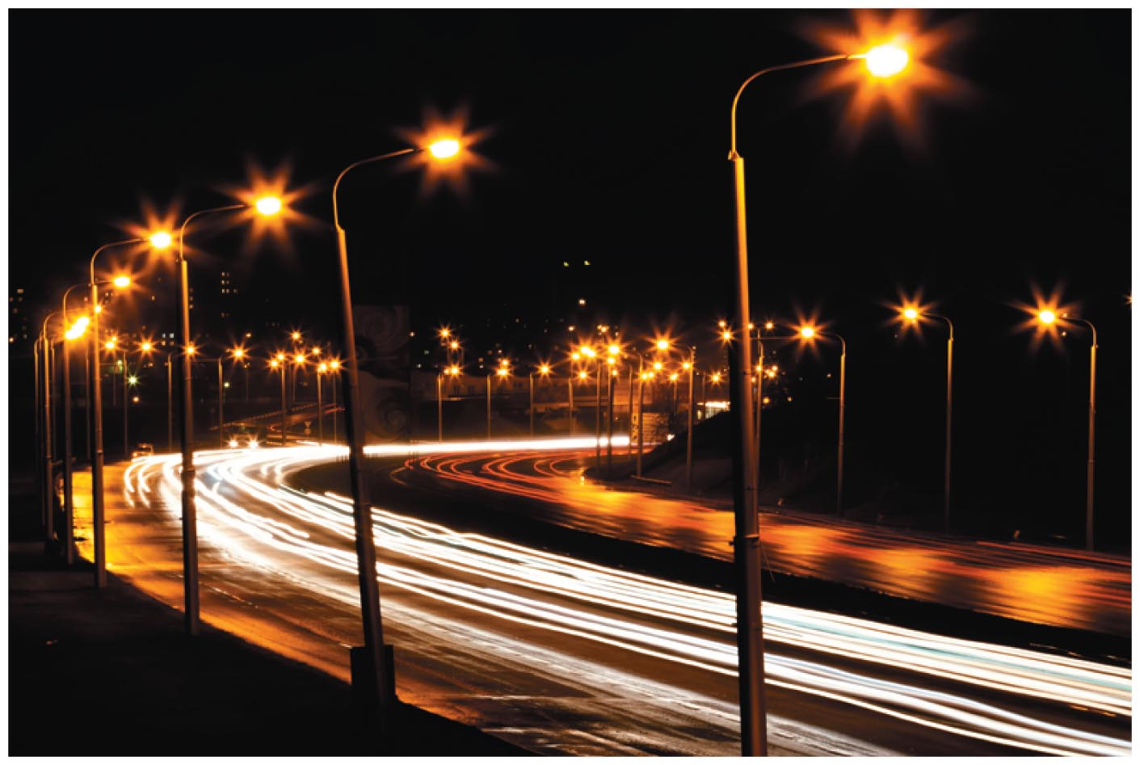
Plasma, Continued-1
Fluorescent lamps, neon signs
When you turn the lamp on, a high voltage between electrodes of the tube causes electrons to flow.
These electrons ionize some atoms, forming plasma.
Plasma provides a conducting path that keeps the current flowing.
The current activates some mercury atoms, causing them to emit ultraviolet radiation.
This radiation causes the phosphor coating on the tube's inner surface to glow with visible light.

Slide 46
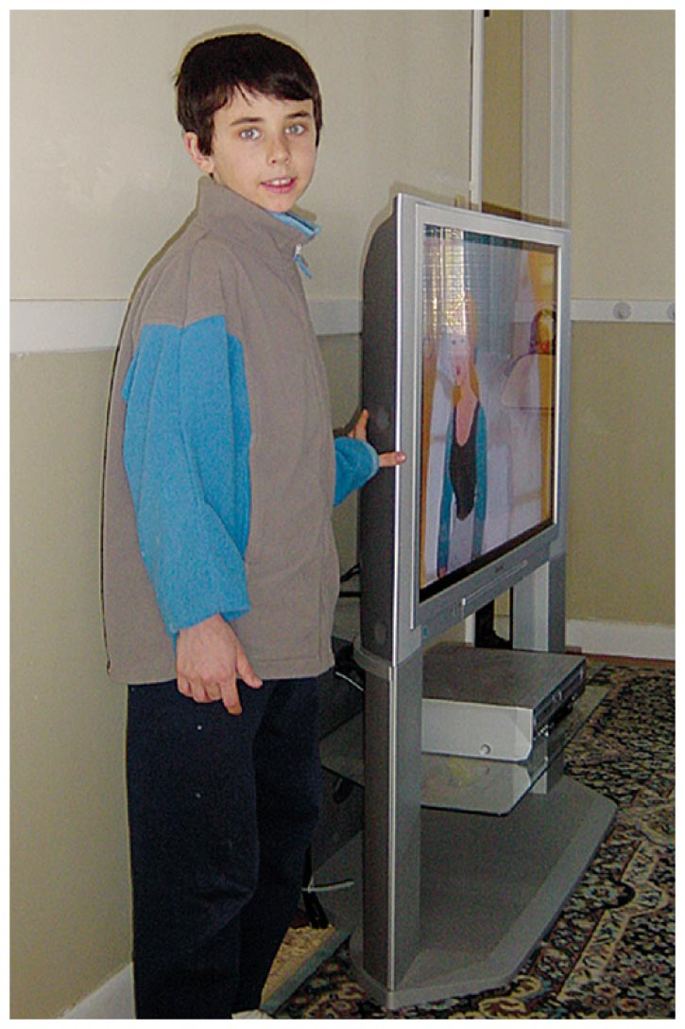
Plasma, Continued-2
Plasma screen TVs
Flat plasma TV screens are composed of many thousands of pixels.
Each has three separate cells—red, green and blue—each containing a different gas.
Pixels are sandwiched between a network of electrodes.
Electrodes are charged to produce electric currents flowing through cells.
Gases convert to glowing plasmas, releasing ultraviolet light to stimulate the phosphors.
The image on the screen is the blend of pixel colors activated by the TV control signal.

Slide 47
Plasma, Continued-3
Plasma Power
A higher-temperature plasma is the exhaust of a jet engine, a weakly ionized plasma.
When small amounts of potassium salts or cesium metal are added, it becomes a very good conductor and,
When directed into a magnet, it can generate electricity: Magneto Hydro Dynamic (MHD) Power
Low-pollution MHD power is in operation at a few places in the world already.

Slide 48
Ch 14 Homework
P.279-281
#42,45-48,50,52,55,56,60-64,68,70,72-76,78,79,81,82,84,87,89,91

