Slide 1
Types of Chemical Reactions
8-2

Slide 2
8-2 Learning Targets
Classify chemical reactions (5types)
Identify the characteristic of different classes of chemical reactions
Describe aqueous solutions
Predict if reaction in aqueous solution with produce a precipitate, water, or a gas
Write balanced chemical equations using formulas and words
Predict the products of a chemical reaction

Slide 3
Synthesis Reaction (composition rxn)
Two or more substances combine to form a new compound
Reactants are single elements
A + X → AX
2Na(s) + Cl₂ (g)→ 2NaCl (s)

Slide 4
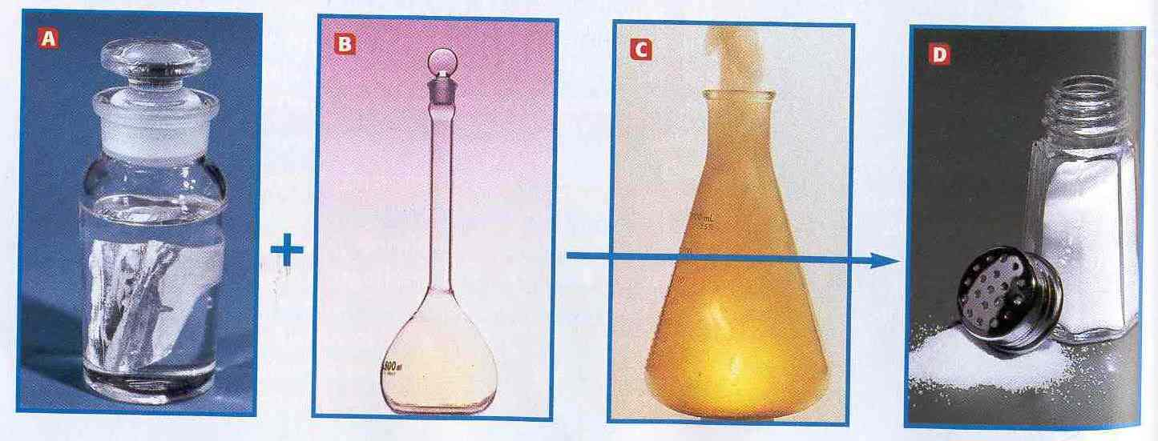
Salt Forming

Slide 5
Types of synthesis reactions
1- Metals react with oxygen to from oxides
4Al(s) + 3O₂ (g)→ 2Al₂O₃ (s)
2- Metals react with sulfur to form sulfides
8Ba (s) + S₈ (s) → 8BaS(s)

Slide 6
3- Nonmetals react with oxygen to form oxides
C(s) + O₂ (g) → CO₂ (g)
4- Metals react with halogens to form salts
2Na(s) + Cl₂ (g)→ 2NaCl (s)

Slide 7
5- Active metal oxides react with water to form metallic hydroxides
MgO (s) +H₂O (l) → Mg(OH)₂ (s)
6- Nonmetal oxides react with water to form oxyacids (acid rain)
SO₂ (g) + H₂O (l) → H₂SO₃ (aq)

Slide 8
Decomposition Reaction
Compound broken down into simpler compounds or elements
Usually done by heating or applying electric current (electrolysis)
AX →A + X
2HgO (s) →2Hg (l) + O₂ (g)

Slide 9
Types of Decomposition Reactions
1- Metallic carbonates, when heated form metallic oxides and carbon dioxide
CaCO₃ (s) →CaO (s) + CO₂ (g)
2- Metallic hydroxides when heated decompose into metallic oxides and water
Ca(OH)₂ (s) → CaO (s) +H₂O (l)

Slide 10
3- Metallic chlorates when heated decompose into metallic chlorides and oxygen
KClO₃ (s) →2KCl (s) + 3O₂ (g)
4- some acids when heated decompose into nonmetallic oxides and water
H₂SO₄ (aq) →SO₃ (g) + H₂O (l)

Slide 11
5-a few oxides when heated decompose
PbO₂ (s) → Pb (s)+ O₂ (g)
6- some decomposition rxns are produced by electrolysis
2NaCl (s) →2Na(s) + Cl₂ (g)
2H₂O (l) →2H₂ (g)+ O₂ (g)

