Slide 1
Arrangement of Electrons in Atoms
Ch 4 Chemistry

Slide 2
Electron configurations
4-3

Slide 3
4-3 Learning Targets
Write and describe electron configurations using standard electron configuration, orbitals notation, and noble gas notation.
Apply the Pauli Exclusion Principle, the Aufbau principle, and Hund’s rule to writing electron configurations.

Slide 4
Electron Configuration
Arrangement of electrons in an atom using quantum numbers
Example: Na 11 e-
Configuration = 1s² 2s² 2p⁶ 3s¹
Superscripts = #of electrons
Ground state electron configuration=the lowest-energy arrangement of the electrons for the element

Slide 5
Electron Arrangement & Configuration
Orbitals fill at s orbital and move outward
As orbitals go outward they get larger because of more sublevels
Valance electrons- electron in outermost energy level (max= 8)
Core electrons- inner electrons, not involved in bonding
4 blocks on PT (s,p,d,f) use to help get order

Slide 6
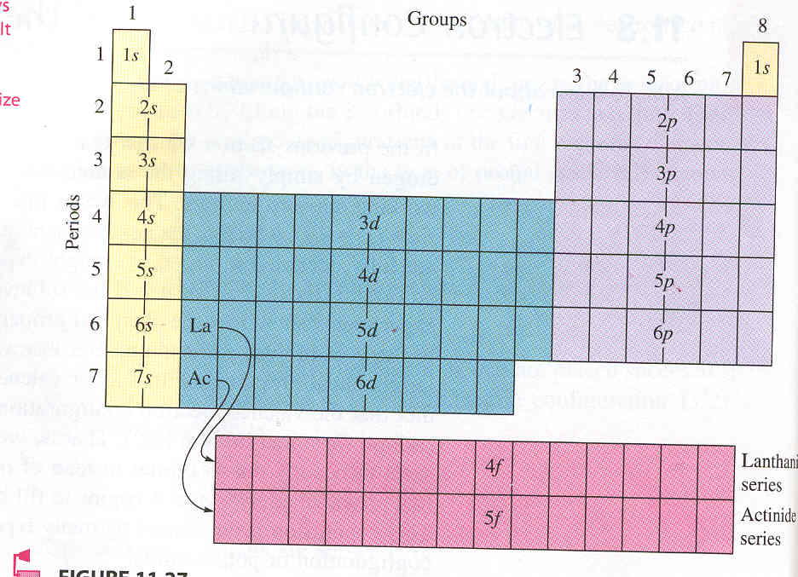

Slide 7
Electron configurations and PT
Main group elements-
  Group 1 and 2 s block
  Group 13-18 p block
Nonmetals- mostly p orbital's
Nobel gases- highest energy level s and p filled (8 e-), octet

Slide 8
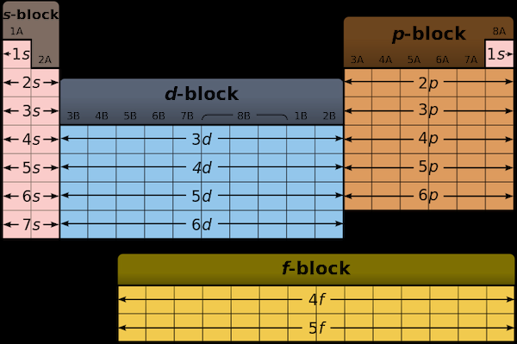

Slide 9
Metals- d orbitals
  Typical properties- malleable, high melt point
  Lose electrons to became cations
  Cr [Ar] 3d⁵4s¹- has configuration contrary to Aufbau principle
  More stable arrangement
  No simple explanation

Slide 10


Slide 11
Rare Earth- f orbitals (Lanthanide and Actinide Series)
Numerous deviations from predicted configurations in the 5th, 6th, and 7th periods because 4f and 5d are very close in energy
La [Xe] 6s²5d^{1,} then Ce [Xe] 6s²5d¹ 4f¹
Fills d with 1 electron before starting f

Slide 12
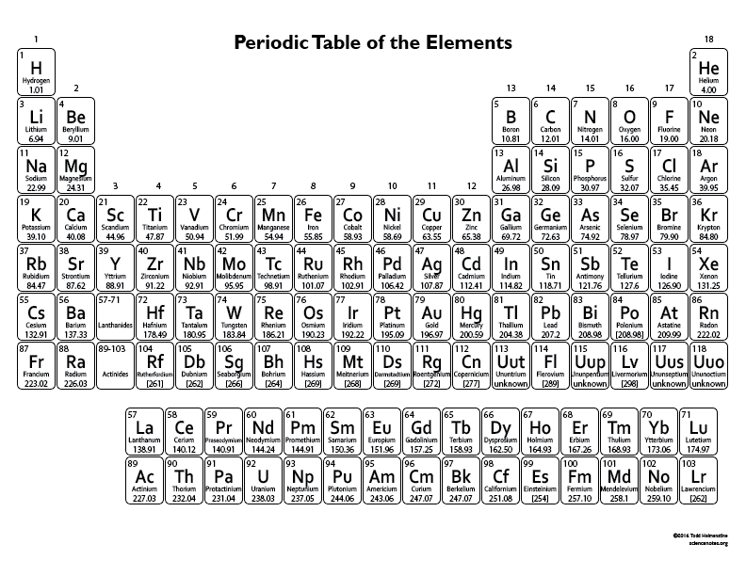

Slide 13
Rules Governing Electron Configurations
1-Aufbau principle- an electron occupies the lowest-energy orbital that can receive it
(p.111 order of increasing energy)
There are some exceptions, Cr, Cu, and many in the rare earth series
No simple explanation

Slide 14
2- Pauli Exclusion Principle :no two electrons can have the same set of four quantum numbers
atomic orbital can hold only 2 electrons and they must have opposite spins
Use ↑ or ↓ to show direction

Slide 15
3- Hund’s rule- orbitals of equal energy are each occupied by one electron before any orbital is occupied by a second electron
All electrons in singly occupied orbital must have the same spin

Slide 17
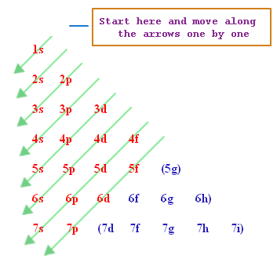

Slide 19
Electron Configuration
Order: 1s 2s 2p 3s 3p 4s 3d 4p 5s 4d 5p 6s 4f 5d 6p 7s 5f 6d (p.111)
H 1 e- 1s¹ 1 valance electron
1= energy level s= shape ¹= # of electrons
N 7 e-
1s² 2s² 2p³
5 valance electrons
Al 13 e-
1s² 2s² 2p⁶ 3s² 3p¹
3 valance electrons

Slide 21
Li 3 e-
1s² 2s¹
Ca 20 e-
1s² 2s² 2p⁶ 3s² 3p⁶ 4s²
P 15 e-
1s² 2s² 2p⁶ 3s² 3p³
Rn 86 e-
1s² 2s² 2p⁶ 3s² 3p⁶ 4s² 3d¹⁰ 4p⁶ 5s² 4d¹⁰ 5p⁶ 6s² 4f¹⁴ 5d¹⁰ 6p⁶

Slide 22
Noble gas notation (Shorthand)
Na 11 e- 1s² 2s² 2p⁶ 3s¹
[Ne] 3s¹
Use last element (Noble gas) from previous row
Kr 36 e-
[Ar] 4s²3d¹⁰ 4p⁶
Ni 28 e-
[Ar] 4s² 3d⁸

Slide 23
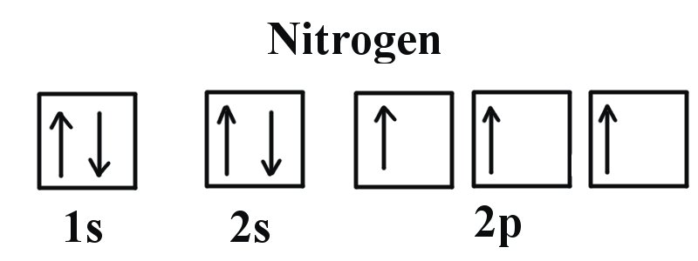
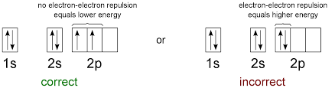
Orbital Notation (box)

Slide 24
Orbital Notation
An unoccupied orbital is represented by a line, with the orbital’s name written underneath the line
An orbital containing one electron is represented as:

Slide 25
An orbital containing two electrons is represented as:
The lines are labeled with the principal quantum number and sublevel letter. Example:
He
1s

Slide 26
Orbital Notation
P 1s² 2s² 2p⁶ 3s² 3p³ Orbital diagram =
↓↑ ↓↑ ↓↑ ↓↑ ↓↑ ↑↓ ↑ ↑ ↑
1s 2s 2p 3s 3p
F 1s² 2s² 2p⁵ Orbital diagram =
↓↑ ↓↑ ↑↓ ↑↓ ↑
1s 2s 2p

Slide 27
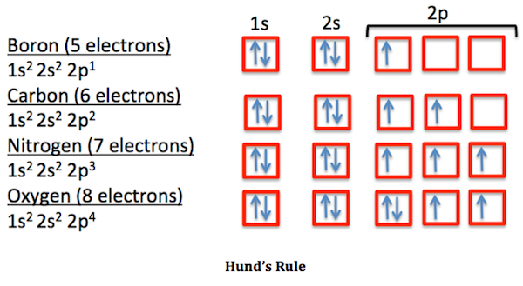

Slide 28
Can use Nobel gas notation with orbital notation
F 1s² 2s² 2p⁵ Orbital diagram =
↓↑ ↓↑ ↑↓ ↑↓ ↑
1s 2s 2p
F shorthand Orbital diagram =
[He] ↓↑ ↑↓ ↑↓ ↑
2s 2p

Slide 29
V [Ar] 4s² 3d³ Orbital diagram =
↓↑ ↑ ↑ ↑ _ _
[Ar] 4s 3d

