Slide 1
Arrangement of Electrons in Atoms
Ch 4 Chemistry

Slide 2
4-2 Learning Targets
Describe Quantum theory.
Identify energy levels, sublevels, and atomic orbitals and how they are related.
Describe the 4 quantum numbers (principle, angular, magnetic, spin)

Slide 3
Electrons as Waves
Louis Victor de Broglie in 1920’s
suggested that electrons be considered waves confined to the space around an atomic nucleus.
It followed that the electron waves could exist only at specific frequencies.
According to the relationship E = hν, these frequencies corresponded to specific energies—the quantized energies of Bohr’s orbits.

Slide 4
Electrons, like light waves, can be diffracted or interfere.
Diffraction - bending of a wave as it passes by the edge of an object or through a small opening
Interference -when waves overlap.

Slide 5
Heisenberg Uncertainty Principle
States that it is impossible to determine both the position and velocity of an electron or any other particle
1927 German physicist Werner Heisenberg
proposed that any attempt to locate a specific electron with a photon knocks the electron off its course.

Slide 6
Erwin Schrodinger
1926, Austrian physicist
developed an equation that treated electrons in atoms as waves
only waves with specific frequencies and energies would provide solution to equation

Slide 7
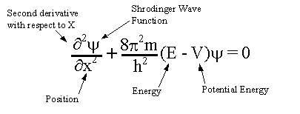
Schrodinger Wave equation
Schrodinger equation= probability of a single electron being found along a single axis

Slide 8
https://www.youtube.com/watch?v=Hk3fgjHNQ2Q
https://www.youtube.com/watch?v=UjaAxUO6-Uw
https://www.youtube.com/watch?v=8ROHpZ0A70I

Slide 9
Heisenberg uncertainty principle and Schrödinger wave equation laid the foundation for modern quantum theory.
Quantum theory describes mathematically the wave properties of electrons and other very small particles.
-Electrons do not move around the nucleus in planetary orbits
-Electrons exist in regions called orbitals-

Slide 10
Orbital
Orbital is a three-dimensional region around the nucleus that indicates the probable location of an electron.
Gives no information when an electron occupies a point or how it moves
Closer to nucleus, greater probability of finding electron

Slide 11
Quantum Numbers-
Specify the properties of atomic orbitals and the properties of electrons in orbitals
4
First three from Schrodinger equation

Slide 12
Principal quantum number
n
Indicates the main energy level occupied by the electron
How far on average the electron is from the nucleus
As n increases the electron’s energy and distance from nucleus increases

Slide 13
n²= total number of orbitals that exist in a given shell (main energy level)
Value of n must be positive integers n=1, n=2, n=3……

Slide 14
Angular momentum quantum number
l
sublevels
Indicates shape of orbital
s,p,d,f
Must be between 0 and n-1
If l equals 0 1 2 3
Use the letter s p d f

Slide 15
Magnetic Quantum number
m
Describes the orientation of the orbital in space
xyz indicate which axis it lies on (3 dimensional)
Farther from the nucleus the more orbitals
S= 1 sphere (2electrons)
P= 3 dumbbell (6 electrons)
D= 5 (10 electrons)
F= 7 similar to d (14 electrons)

Slide 16
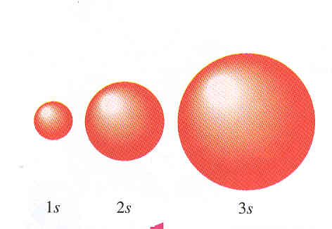
s orbital

Slide 17
P orbital
Dumbbell that can lie in the x, y, or z plane

Slide 18
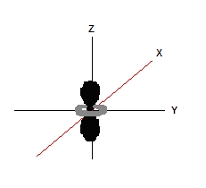
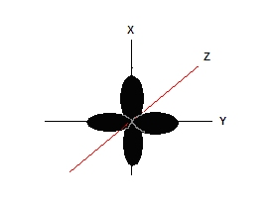
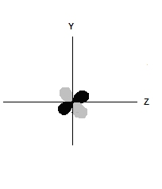
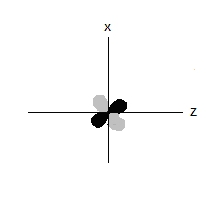
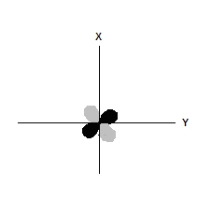
D orbital

Slide 19
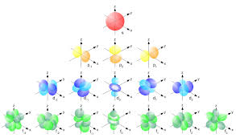

Slide 20
Spin quantum number
Spin of electrons, clockwise + 1/2 or counterclockwise -1/2
Orbital can hold only 2 electrons with opposite spins

Slide 21
Principal quantum number (n) | Sublevels (n sublevels) | Orbitals per sublevel | Total number of orbitals related to principle quantum number (n²) | Electrons
1 | s | 1 | 1 | 2
2 | s | 1 | 4 | 2
 | p | 3 |  | 6
3 | s | 1 | 9 | 2
 | p | 3 |  | 6
 | d | 5 |  | 10
4 | s | 1 | 16 | 2
 | p | 3 |  | 6
 | d | 5 |  | 10
 | f | 7 |  | 14

Slide 22
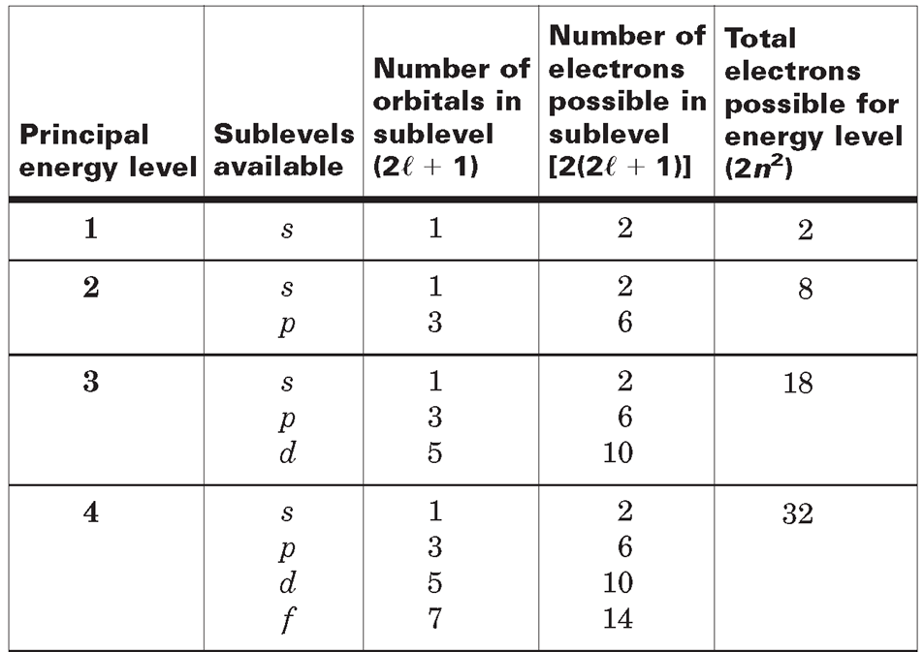

Slide 23
