Slide 1
Semester 1 Exam Review
Chemistry

Slide 2
Chemistry
The study of the composition, structure and properties of matter and the changes it undergoes
Physical science
Matter- anything that has mass and takes up space

Slide 3
Basic Research
Used to increase knowledge
How, why, what
Chance discoveries

Slide 4
Applied Research
To solve a specific problem
Example: refrigerants and ozone

Slide 5
Atom- Smallest unit of element that maintains the properties of that element
Element-Pure substance made of only one kind of atom
  Cannot be broken down into simpler substances by chemical means
Compound- Substance made of atoms of two or more different elements that are chemically combined

Slide 6
Mixture
Combination of two or more pure substances in which each substance retains its own composition and properties
Can be separated into pure substances by physical means
No exact chemical formula
Heterogeneous vs homogenous

Slide 7
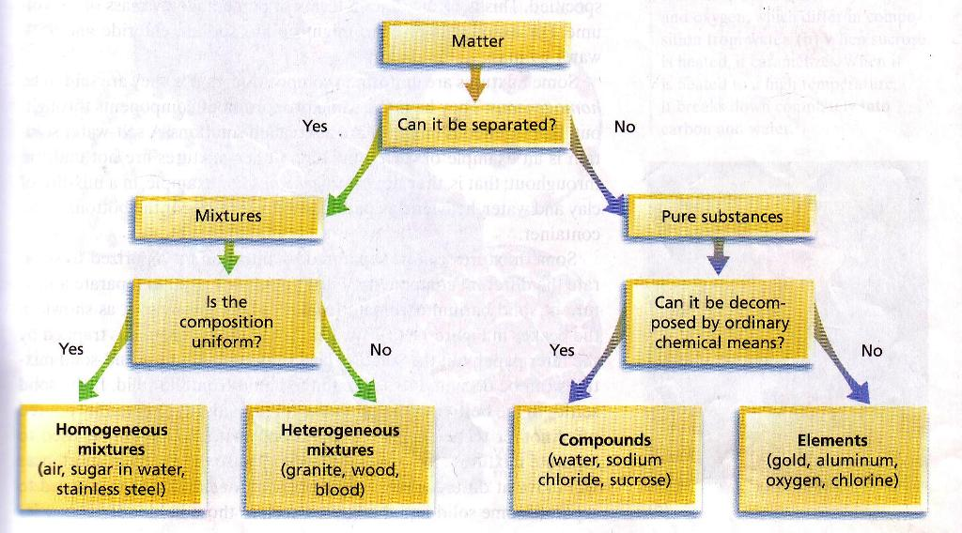

Slide 8
States of matter
Solid
Liquid
Gas
Plasma

Slide 9
Physical Properties
Chemical Properties
Characteristic that can be observed or measured without changing the identity of the substance
Odor, color, volume, state, density, melting and boiling point
Relates to a substance’s ability to undergo changes that transform it into different substances
Reactivity, flammability, oxidation

Slide 10
Properties
Extensive properties- depend on the amount of matter that is present
  Volume, mass, amount of energy
Intensive properties -do not depend on the amount of matter present
  Mp, Bp, density, conductivity

Slide 11
Physical Change
Chemical Change
Change in physical properties
No change in chemical composition or identity
State of matter change
Breaking, grinding, tearing, melting, dissolving
Composition changes by forming one or more new substances with new properties
Called reactions
  Reactants react in chemical change to form Products
Not reversible

Slide 12
Indicators of Chemical change
Change in color
Odor
Production of gas
Production of light
Production of heat
Production of new substance (precipitate)

Slide 13
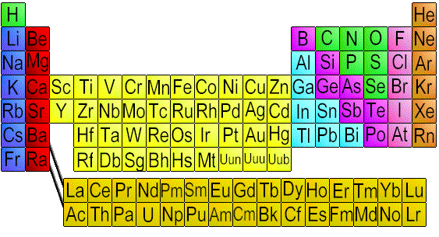
Periodic Table

Slide 14
Periodic Table
Organization of all elements by chemical and physical properties
Period=Horizontal rows on PT
Group= column, vertical

Slide 15

Metals
Shiny
Conduct heat
Conduct electricity
Form cations
Most solid at room temp
Malleable
Ductile
Left of zig-zag

Slide 16
Nonmetals
Poor conductors of heat and electricity
Brittle
Most are gases
Form anions
Low melting point
Right of zig-zag

Slide 17
Metalloids
Semiconductor- Conduct electric current better than an insulator, but not as well as a conductor
Some nonmetals and metals
Sometimes considered own group

Slide 18
Two types of Observations
Quantitative
  Observations that involve numbers
  Ex. There are three birds being fed
Qualitative
  The characteristics that cannot be measured or counted
  Ex. The girl is feeding the birds, or the birds are eating

Slide 19
Scientific Method
Observe
Formulate hypothesis
  Generalizations about data are used to formulate a testable statement
Testing(experiment)
Theorizing
Publish

Slide 20
Independent Variable
Dependent Variable
Independent Variable
The responding variable
It is determined by the independent variable only, we have no impact
The Y axis on a graph
Ex. Braking Distance
The manipulated variable
We can change this factor
This becomes the X axis on a graph
Ex. Speed of a car

Slide 21
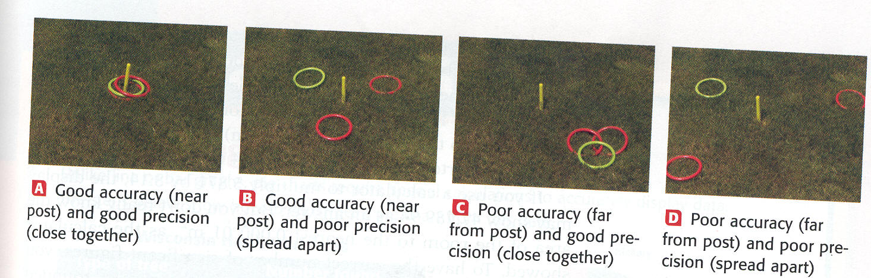
Precision vs. Accuracy

Slide 22
Density = m/v
A material has a mass of 10.0 g and volume of 6.0 mL. What is the density of this material?
10.0 g/ 6.0 mL= 1.6 g/mL
Does is float of sink in water?
Sink, greater than density of water (1.00 g/mL)

Slide 23
Percent Error (relative error)
  % Error =Value _{experimental}– Value _{accepted} x 100
  Value _{accepted}
  Value is negative if accepted value is greater than experimental value
  Value is positive if accepted value is less than experimental value

Slide 24
What is the percent error for a mass measurement of 17.7 g, given that the correct value is 21.2 g?
Percent error= (17.7g- 21.2g) x 100 =-17%
21.2 g

Slide 25
Writing Scientific Notation
Examples:
10000 m=1 x 10⁴ m
5200000 g = 5.2 x10⁶g
6230000000 cm =6.23 x10⁹ cm
0.000071 g = 7.1 x10⁻⁵

Slide 26
Derived Units
Most SI units are combination of base units (m,L,g,s)
Made by multiplying or dividing standard units

Slide 27
Metric Quiz
1) 24 ng= mg
2) 0.00046 Gm= mm
3) 25cm= mm
4) 35670 g = Mg
5) 300000L = kL
6) 2900000 µg= g
7) 89dag= cg
8) 6700000mg = kg

Slide 28
Metric Answers
1) 24 ng= 0.000024 mg
2) 0.00046 Gm= 460000000 mm
3) 25cm= 250 mm
4) 35670 g = 0.03567 Mg
5) 300000L =300 kL
6) 2900000 µg= 2.9 g
7) 89dag=89000 cg
8) 6700000mg =6.7 kg

Slide 29
Sig Fig Quiz
How many digits are significant?
23.0
20003
0.0030
700
Round to 4 significant figures.
345.076
0.028880
Solve.
3.45 +16.709
45 x 4.567
23- 2.01

Slide 30
Sig Fig Quiz
How many digits are significant?
23.0 3
20003 5
0.0030 2
700 1
Round to 4 significant figures.
345.076 345.1
0.028880 0.02888
Solve.
3.45 +16.709 = 20.16
45 x 4.567 = 205.515= 210
23- 2.01= 20.99= 21

Slide 31
Law of Conservation of Mass- mass is neither created or destroyed during ordinary chemical reactions or physical changes

Slide 32
John Dalton(1766-1844)
Dalton’s Atomic Theory 1808
1-All matter is made up of very tiny particles called atoms
2- Atoms of a given element are identical in size, mass and other properties; atoms of different elements differ in size, mass, and other properties

Slide 33
3- Atoms cannot be subdivided, created or destroyed
4-Atoms of different elements combine in simple whole-number ratios to form chemical compounds
5- In chemical reactions, atoms are combined, separated or rearranged

Slide 34
Dalton turned Democritus’s idea into a scientific theory
Needed to be tested
Problem:
  Given element can have atoms with different masses
    Isotopes- Could not explain
  Atoms are divisible (proton, neutron, electron)

Slide 35
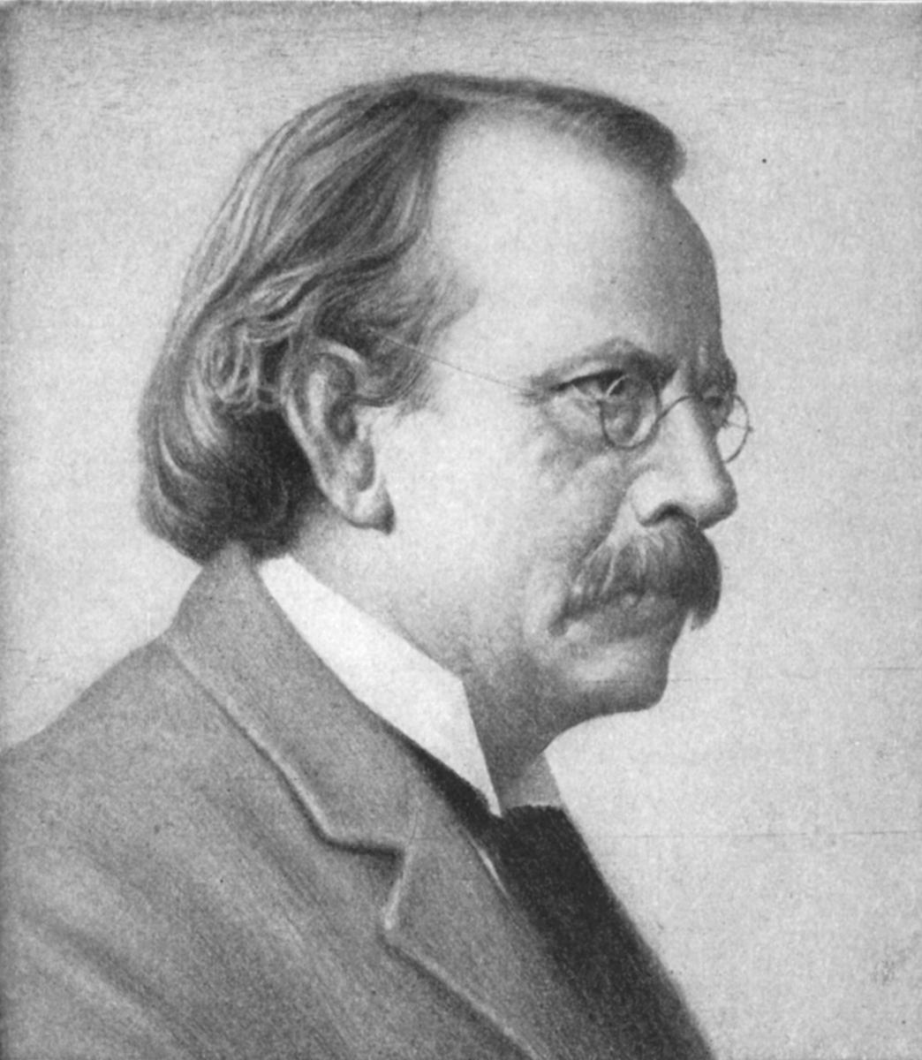
J. J. Thomson (1856-1940)
Proposed that atoms consist of small, negative electrons embedded in a massive, positive sphere.
The electrons were like currants in a plum pudding
Charge to mass ratio of electrons

Slide 36
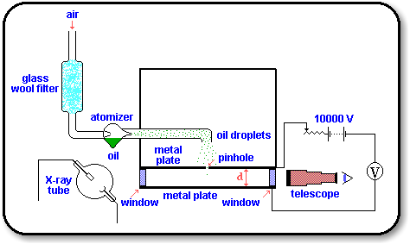
Robert A. Millikan (1909)
Determined charge of electron
Oil Drop Experiment

Slide 37
Rutherford Experiment (1911)
Determined atoms mostly empty space (nucleus)
Alpha particles (helium nuclei) fired at thin sheet of gold
Zinc sulfide coated screen surrounding gold foil produced a flash of light with hit by alpha particle
Assumed positively charged particle would bounce back if they approached positively charged
Very few particles were greatly deflected back from gold sheet

Slide 38
Particle | Symbol | Relative charge | AMU | Actual Mass
Electron | e-, ⁰ ₋₁ e | -1 | 0 | 9.109 x 10^{-31Kg}
Proton | p+, ¹ ₁ H | +1 | 1 | 1.673x 10^{-27kg}
Neutron | N^{0,} ¹ ₀n | 0 | 1 | 1.675 x 10^{-27Kg}

Slide 39
Atomic number= protons
Atomic mass = protons and neutrons

Slide 40
Can you find protons, neutrons, electrons for an element from the periodic table?
Copper
29 +
29 e
35 n
Rubidium
37 +
37 e
48 n
Helium
  2 +
  2e
  2n
  Molybdenum
  42 +
  42-
  54 n

Slide 41
Nuclear Symbol
^{A} Z X
A= mass
Z= atomic number
X= element symbol

Slide 42
Nickel
⁵⁹ ₂₈ Ni
Nitrogen
¹⁴ ₇ N
Silver
¹⁰⁸ ₄₇Ag

Slide 43
Isotopes
Atoms of the same element that have different masses
  same number of protons as other atoms of that element but different number of neutrons
Most common isotope found on PT
Most do not differ significantly in their chemical behavior
Hyphen notation (element symbol – mass)
C-12
U-238

Slide 44
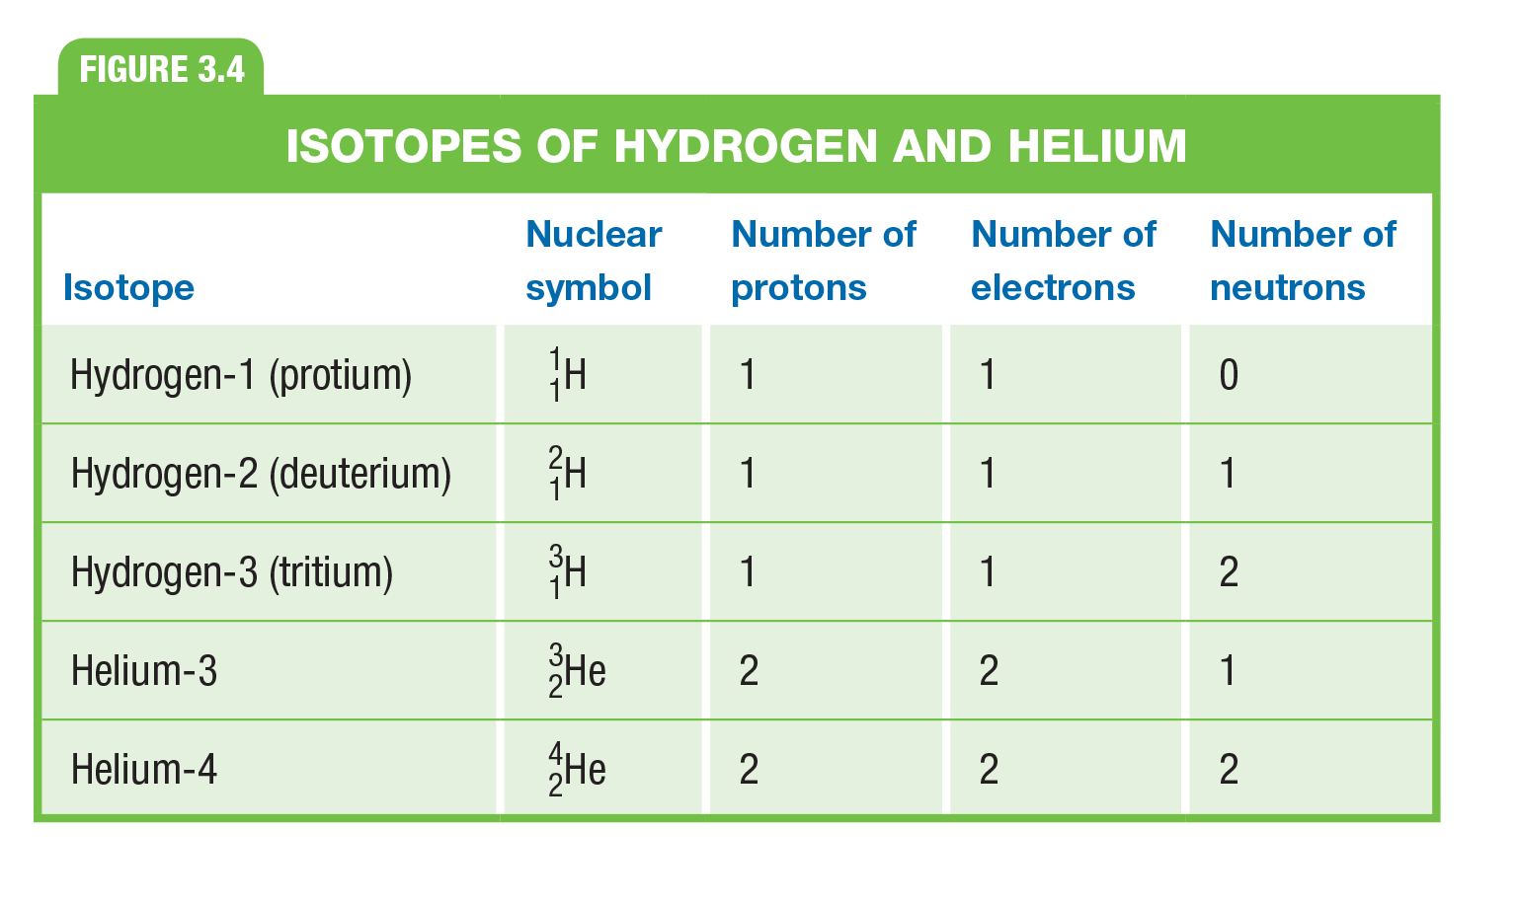
Can you do this???

Slide 45
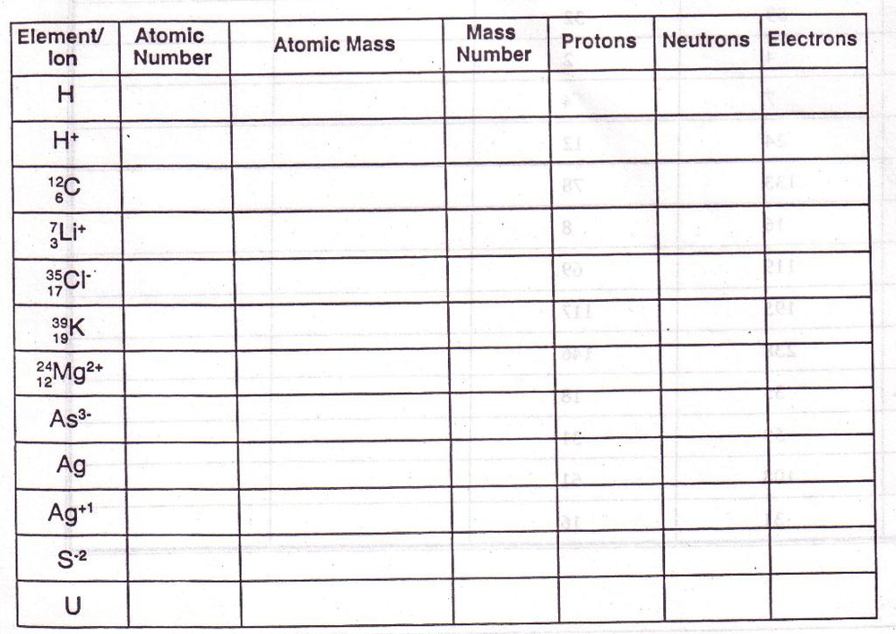

Slide 46
Atomic Mass of ?????
Isotopes Mass of Isotope Abundance
⁶X = 6.015 amu 7.50 %
⁷X = 7.016 amu 92.5%
(6.015 amu)(0.0750)+ (7.016 amu)(0.925) =
0.451amu + 6.49 amu = 6.94 amu
Lithium

Slide 47
Isotope Mass (amu) Percent Abundance
⁶³X 62.930 69.17
⁶⁵X 64.928 30.83
Calculate the atomic mass of each element described above.
63- (62.930 amu)(0.6917)=43.53 amu
65 – (64.928amu) (0.3083)= 20.02 amu
                63.55 amu
Identify the element using the periodic table.
Copper
Which isotope of X is most abundant?
63
Which isotope of X has the most effect on the atomic mass of X? Explain why?
63

Slide 48

Mole- The amount of a substance that contains as many particles as there are atoms in exactly 12 g of carbon-12
  SI base unit used to measure the amount of substance
Avagadro’s number
  6.022 x 10 ²³
  Number of particles in 1 mol
6.022 x 10²³ particle of sugar in 1 mol

Slide 49
Mole to mass (g) conversion
  Number of moles x number of grams = mass
  1 mole
  3.00 mol K x 35.09 g K = 105 g K
  1 mol

Slide 50
Mass (g) to Mole
  Mass x 1 mole = Number of moles
number of grams
45.6 g Ca x 1 mol = 1.14 mol Ca
40.08 g Ca

Slide 51
Mass(g) to Atoms (Particles)
Mass x 1 mol x 6.022 x 10 ²³ atoms = atoms
        grams mol
        23.5 g Li x 1 mol x 6.022 x 10 ²³ atoms = 2.04 x 10 ²⁴ atoms Li
        6.94 g Li 1 mol

Slide 52
Atoms (particles) to Mass (g)
Atoms x 1 mol x grams = Mass
6.022 x 10 ²³ atoms 1mol
3.45 x 10¹⁵ atoms S x 1 mol x 32.07g S = 1.84 x 10⁻⁷ g S
6.022 x 10 ²³ atoms 1 mol

Slide 53
Photon- particle of electromagnetic radiation having zero rest mass and carrying a quantum of energy
light as a stream of tiny particles of energy (particle of light)
Light divided into classes by wavelength

Slide 54
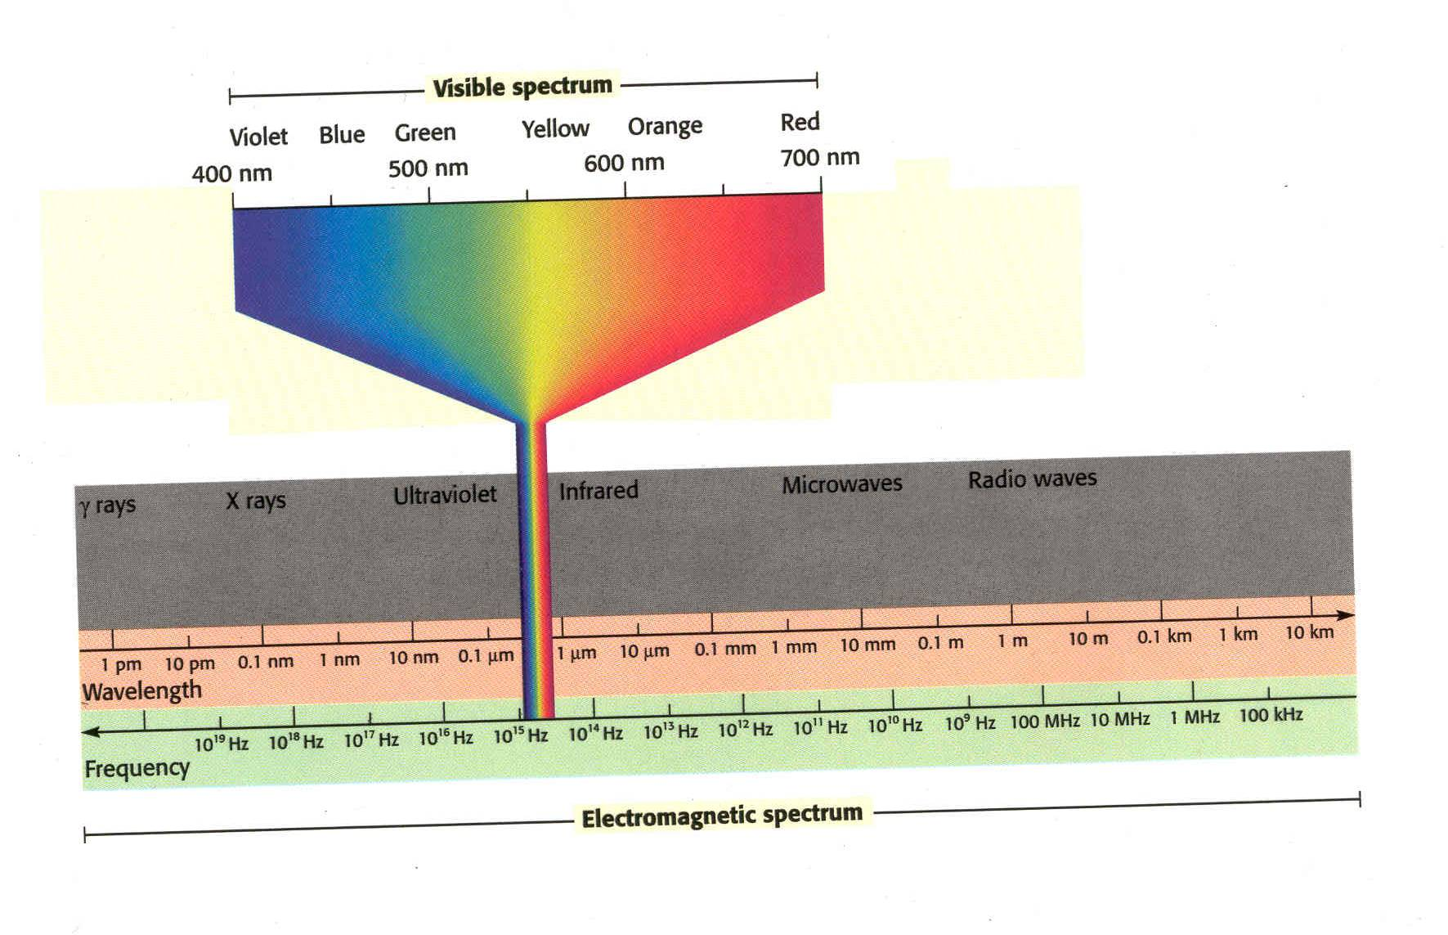

Slide 55
Waves
1- Wavelength- λ(lambda) distance (m) between 2 crests or 2 troughs
2- Frequency- ν(nu) how many waves pass a point per second
w/s or Hertz (Hz)
3- Speed- distance per time
  C= 3.00 x 10⁸ m/s speed of light CONSTANT
  Speed c= vλ

Slide 56
What is the wavelength of a microwave having a frequency of 3.44 x 10 ⁹ Hz?
  c= vλ
  3.00 x 10⁸ m/s= (3.44 x 10 ⁹ Hz) λ
  λ= 8.72 x 10⁻² m

Slide 57
What is the energy of a wave with a frequency of 9.50 x 10 ¹³ Hz?
E= hv
E= (6.626 x 10⁻³⁴ Js)(9.50 x 10 ¹³ Hz )
E= 6.29 x 10 ⁻²⁰ J

Slide 58

Wavelength and frequency inverse relationship
Frequency and energy are directly related

Slide 59
Bohr Model (1913)
Niels Bohr- Nobel prize in 1922
Proposed hydrogen atom model that linked the atoms electron to photon emission
  Electrons in fixed orbits around nucleus (planetary model)
  Electrons in orbitals, those farthest from the nucleus have more energy

Slide 60
Orbital
Orbital is a three-dimensional region around the nucleus that indicates the probable location of an electron.
Probability based
Gives no information when an electron occupies a point or how it moves
Just tell probability of being in area
Closer to nucleus, greater probability of finding electron

Slide 61
Quantum Numbers
  Principal
    n
    Indicates the main energy level occupied by the electron
  Angular
    l
    sublevels
    Indicates shape of orbital, s,p,d,f

Slide 62
Magnetic
m
Describes the orientation of the orbital in space
  xyz indicate which axis it lies on (3 dimensional)
  Farther from the nucleus the more orbitals
  S= 1 sphere (2electrons)
  P= 3 dumbbell (6 electrons)
  D= 5 (10 electrons)
  F= 7 similar to d (14 electrons)
Spin
  Spin of electrons, clockwise or counterclockwise
  Orbital can hold only 2 electrons with opposite spins

Slide 63
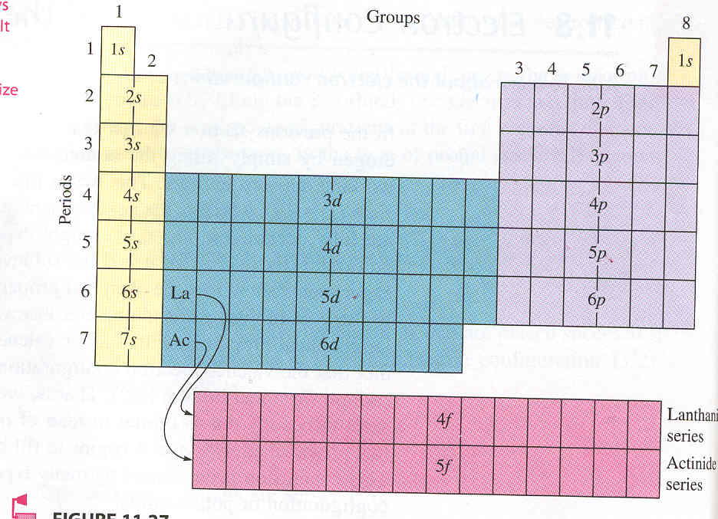

Slide 64
Rules Governing Electron Configurations
1-Aufbau principle- an electron occupies the lowest-energy orbital that can receive it
2- Pauli Exclusion Principle :no two electrons can have the same set of four quantum numbers
atomic orbital can hold only 2 electrons and they must have opposite spins (use arrows)
3- Hund’s rule- orbitals of equal energy are each occupied by one electron before any orbital is occupied by a second electron
All electrons in singly occupied orbital must have the same spin

Slide 65
Li 3 e-
1s² 2s¹
Ca 20 e-
1s² 2s² 2p⁶ 3s² 3p⁶ 4s²
P 15 e-
1s² 2s² 2p⁶ 3s² 3p³
Rn 86 e-
1s² 2s² 2p⁶ 3s² 3p⁶ 4s² 3d¹⁰ 4p⁶ 5s² 4d¹⁰ 5p⁶ 6s² 4f¹⁴ 5d¹⁰ 6p⁶

Slide 66
Orbital Notation
P 1s² 2s² 2p³ 3s² 3p³ Orbital diagram =
↓↑ ↓↑ ↓↑ ↓↑ ↓↑ ↑↓ ↑ ↑ ↑
1s 2s 2p 3s 3p
F 1s² 2s² 2p⁵ Orbital diagram =
↓↑ ↓↑ ↑↓ ↑↓ ↑
1s 2s 2p

Slide 67
Noble gas notation (Shorthand)
Na 11 e- 1s² 2s² 2p⁶ 3s¹
[Ne] 3s¹
Use last element (Noble gas) from previous row
Kr 36 e-
[Ar] 4s²3d¹⁰ 4p⁶
Ni 28 e-
[Ar] 4s² 3d⁸

Slide 68
Name the element/ion
1s² 2s² 2p⁶ 3s¹
Na
[Ar] 4s²3d¹⁰ 4p⁶
Kr
[Ar] 4s²3d¹⁰ 4p⁶
  What ion?
Se ²⁻ Br⁻ Rb⁺ Sr ²⁺

Slide 69
Dimitri Mendeleev
Russian chemist
1869 first publish PT
Organization
1-Vertical Column in atomic weight order
  Made exceptions to place elements in rows with similar properties
    Tellurium and iodine switched
2-Horizontal rows have similar chemical properties

Slide 70
Henry Moseley
1911
English scientist working with Rutherford examined spectra of 38 metals
Protons and atomic number
  1-Xray experiments revealed a way to determine the number of protons in nucleus of atom
  2- periodic table in atomic number order, not atomic mass order
    Tellurium-iodine anomaly explained

Slide 71
Periodic Law
Physical and chemical properties of the elements are periodic functions of their atomic numbers

Slide 73
Period
Group
Blocks
Group names

Slide 74
Valence Electrons
Most atoms want Octet- atoms lose, gain, or share electrons to get full valence set
Know how to find for group.

Slide 75
Find the period, block, and group
[Ne] 3s¹
Period = # of s orbital
  3
Block= what orbital is filling last
  s
Group= s + p (add d if present)
Remember f block elements don’t have group number
1

Slide 76
Find the period, block, and group
[Xe] 6s²
6th, s, 2
metal
[Kr] 5s¹
5th, s, 1
metal
[Ar] 4s²
4th, s ,2
metal
[Ar] 4s² 3d⁸
4th, d, 10
metal
[Kr] 5s² 4d ¹⁰
5th, d, 12
metal
[Ar] 4s² 3d¹⁰ 4p³
4th, p, 15
metalloid
[Ne]3s²3p³
3rd, p, 15
nonmetal

Slide 77
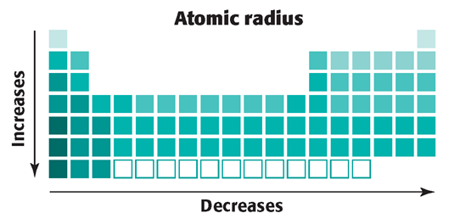

Slide 78
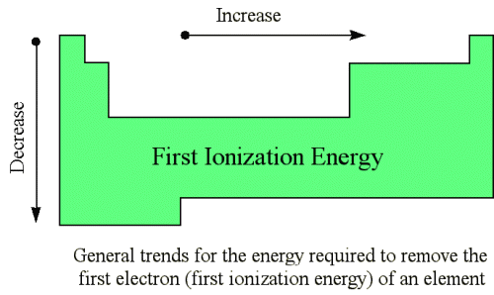
Ionization Energy Trend

Slide 79
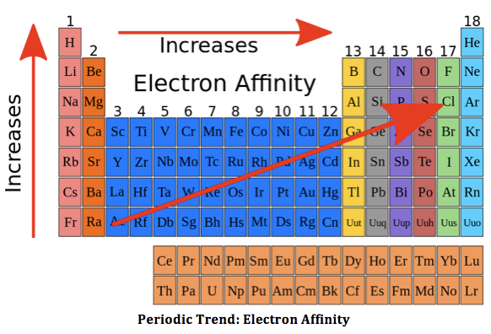

Slide 80
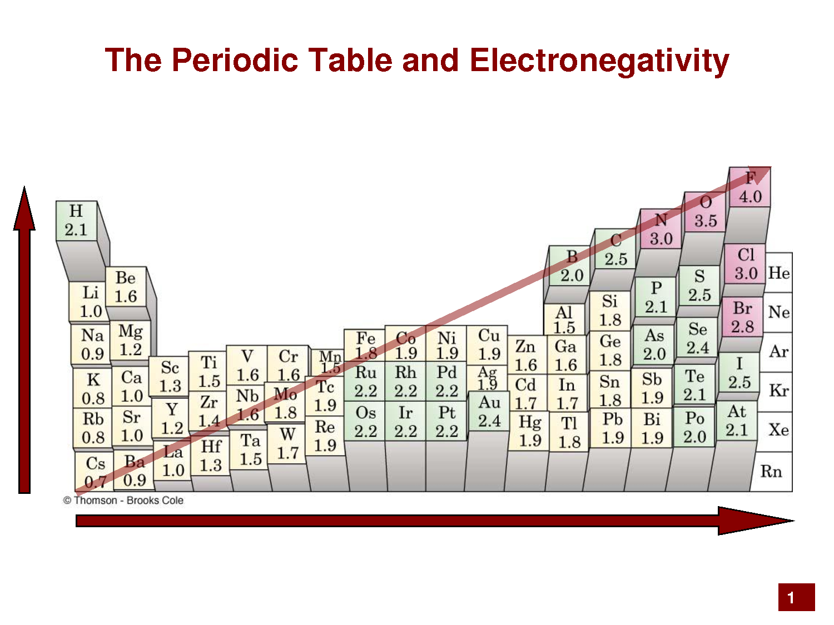

Slide 81
Trends
Largest radius
Cu Cu ²⁺
At At ⁻¹
Greatest electronegativity
F Be
N Bi
Smallest Atomic radius
K Br
Be Ba

Slide 82
Smallest ionization energy
I Sr
Li Fr

Slide 83
Ions
Charged particle due to losing or gaining electrons
Cation= lost electrons
Metals
Anions= gained electrons
nonmetals

Slide 84
Which has a larger atomic radii?
Cl⁻ Cl
Sr ⁺² Sr
S²⁻ S

Slide 86
Types of Bonds
Ionic Bonding- electrostatic force that holds oppositely charged particles together
  Electrons transferred
  Between metals and nonmetals
  Metal and oxygen= oxide
  Metal and halogen= salt

Slide 87
Covalent Bond
Covalent bonding- sharing of valence electrons between two atoms
  Between 2 nonmetals
  Sharing electrons to fill valence and be stable
  Sometimes called molecular bond
  Molecule-forms when two or more atoms bond covalently
  Neutral

Slide 88
Lewis dot structure
Draw structure using Octet and Duet rules
Polarity
Lone pair vs bonding pair
Examples:
N₂
CCl₄
H₂S

Slide 89
Electronegativity
Ability of an atom to attract electrons in a chemical bond
Difference between electronegativity between atoms
Less than 0.3 non-polar covalent (less than 5% ionic character)
0.4-1.7 polar covalent (between 5-50% ionic character)
1.7> ionic (greater than 50% ionic character)

Slide 90
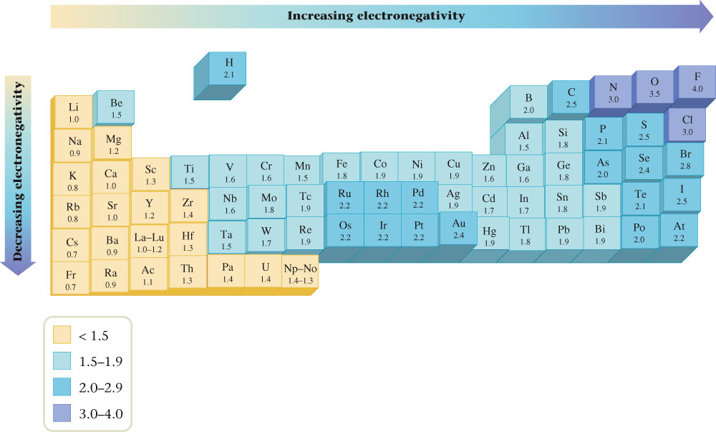
Electronegativity Values for Selected Elements

Slide 91
Use electronegativity differences to classify bonding
S and H
2.5- 2.1= 0.4
polar covalent
S and Cs
2.5 -0.7= 1.8
Ionic
S and Cl
3.0- 2.5 = 0.5
Polar covalent
Ca and Cl
3.0 -1.0 =2.0
Ionic
Cl and O
3.5 -3.0 = 0.5
Polar covalent
Cl and Br
3.0-2.8 = 0.2
Non polar covalent

Slide 92
Which bond is most polar?
C-Br 0.3
Si-O 1.7
C-O 1.0
C-Cl 0.5
Si-O most polar

