Slide 1
The Gas Laws
11-2

Slide 2
11-2 Learning Targets
State the Gas Laws: Boyle’s Law, Charles’s Law, Gay-Lussac’s Law, and Combined Gas Law
Apply the gas laws to solving problems involving pressure, temperature and volume of a gas
State the relationship among temperature, volume and pressure in the gas laws

Slide 3
Gas Laws
Simple mathematical relationship between temperature, pressure, and quantity of a gas

Slide 4
Boyle’s Law
Robert Boyle- Irish scientist (1627-1691)
made his own version of a barometer, J tube
had in entry of his house
studied pressure of trapped gas and its volume
noticed relationship between volume and pressure

Slide 5
Boyle’s Law
P
V
P and V inversely related
-constant T

Slide 6
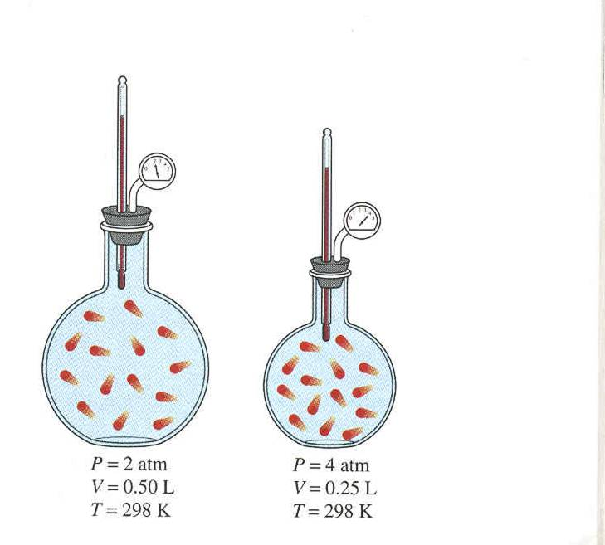
Boyle’s Law

Slide 8
Boyle’s Law
PV =k
P= pressure V= volume
k= constant @ specific temp. for given volume of gas
k=1.41 x 10³ Hg in³
original P₁V₁ = k
final P₂V₂ = k
P₁V₁ = P₂V₂
can solve for V₂ or P₂

Slide 9
Boyle’s Law Problem
A sample of neon to be used in a neon sign has a volume of 1.51 L at a pressure of 635 torr. Calculate the volume of the gas after it is pumped into the glass tubes of the sign, where it shows a pressure of 785 torr.
V₁= 1.51 L P₁ = 635 torr
V₂= ? P₂ = 785 torr
(1.51 L )( 635 torr )= V₂ ( 785 torr)
V₂ = 1.51 L x 635 torr
785 torr
V₂ = 1.22 L

Slide 10
Boyle’s Law Problem
V₁= 0.725 L P₁ = 1.00 atm
V₂= 0.075L P₂ = ?
(1.0 atm )( 0.725 L) = P₂ (0.075 L)
P₂ = (1.00atm )( 0.725 L)
0.075 L
P₂ = 9.7 atm

Slide 11
Charles’s Law
Jacques Charles (1746-1823)
French
first solo balloon flight
Charles Law
V goes up as T goes up (constant pressure)
directly related
V
T

Slide 12
Charles’s Law
Lord Kelvin- absolute temperature scale
show lowest possible temperature
-273°C = 0K absolute zero
Must use K, impossible to have negative volume or pressure
K=273 + ºC (can’t have negative K)
ºC= K-273

Slide 13
Charles’s Law
V=bT b= constant
V= volume (L)
T= temperature (K) Must be in Kelvin
V₁ =b V₂ = b
T₁ T₂
V₁ = V₂ Charles Law
T₁ T₂

Slide 14
Charles’s Law Problem
2.0L @ 298 K cooled to 278 K while the pressure is held constant, does the volume increases or decrease? What is the volume?
V₁ = V₂
T₁ T₂
2.0 L = V₂
298 K 278 K
V₂ = 1.9 L volume decreases

Slide 15
Charles’s Law Problem
2.58 L of gas @ 15°C is heated to 38 °C, what is the new volume?
15 + 273=288K
38 + 273 = 311 K
V₁ = V₂
T₁ T₂
2.58 L = V₂
288 K 311 K
V₂ = 2.79 L

Slide 16
Charles’s Law Problem
A gas with a volume of 0.625 L @ 35°C is heated and has a final a volume of 0.535 L, what is the final temperature in °C?
V₁ = V₂
T₁ T₂
35 + 273 = 308 K
0.675 L = 0.535 L T₂ = 244 K
308 K T₂ 244K - 273 = -29 °C

Slide 17
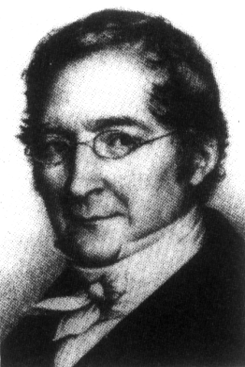
Gay-Lussac
1778-1850
French physicists and chemist
Studied gases

Slide 18
Gay-Lussac’s Law
Pressure of gas varies directly with the Kelvin temperature at a constant volume
Spray cans, if heated explode
P₁ = P₂
T₁ T₂
P
T

Slide 19
Gay-Lussac Problem
Gas in an aerosol can is at a pressure of 4.2 atm at 22º C. What would the gas pressure in the can be at 62 ºC?
P₁ = P₂ 4.2 atm = P₂
T₁ T₂ 295 K 335 K
P₂= 4.8 atm

Slide 20
Combined Gas Law
Expresses the relationship between pressure, volume and temp of fixed amount of gas
Use when moles are held constant
P₁V₁ = P₂V₂
T₁ T ₂ Combined gas law

Slide 21
Combined Gas Law Problem
The volume of a gas is 32.1 mL at 22 ºC and 0.875 atm. What will the volume be at 15 ºC and 0.900 atm?
P₁V₁ = P₂V₂ (0.875atm)( 32.1 mL) = (0.900atm)V₂
T₁ T ₂ 295K 288 K
V₂ = 30.5 mL

Slide 22
#1- A 32.0 mL sample of hydrogen is collected over water at 20. ºC and 750.0 torr. What is the volume of the dry gas at STP? (vapor pressure of water at 20 ºC = 17.5 torr)
P _{atm} = P _{gas} + P _{water}
750.0 torr = P _{gas} + 17.5 torr
= 732.5 torr
Use combined gas law
(732.5 torr)(32.0 mL) = (760 torr) V
293 K 273 K
28.7 mL

Slide 23
#2- A 54.0 mL sample of oxygen is collected over water at 23 ºC and 770.0 torr. What is the volume of the dry gas at STP? (vapor pressure of water at 23 ºC =21.1 torr)
P _{atm} = P _{gas} + P _{water}
770.0 torr = P _{gas} + 21.1 torr
= 749.9 torr
Use combined gas law
(749.9 torr)(54.0 mL) = (760 torr) V
296 K 273 K
49.1 mL
49.1 mL

