Slide 1
Gases and Pressure
11-1

Slide 2
11-1 Learning Targets
Define pressure
Describe how pressure is measured
Convert between different units of pressure
Define STP
Apply Dalton’s Law of Partial Pressure

Slide 3
KMT
Kinetic Molecular Theory (KMT)- particles of matter are always in constant motion
Explains behavior of solids, liquids, gases
relates to ideal gas
Ideal gas- imaginary gas that perfectly fits all assumptions of the KMT

Slide 4
KMT (Kinetic Molecular Theory) based on five assumptions:
1- gases consist of large numbers of tiny particles that are far apart relative to their size
Molecules farther apart than molecules in other states
Most volume occupied by gas is empty space
Allows for low density and easy compression

Slide 5
2- Collisions between gas particles and between particles and container are elastic
(Elastic collision- no net loss of kinetic energy)
Total kinetic energy of two particles remains the same as long as temp is constant

Slide 6
3- Gas particles are in constant, rapid, random motion
Particles move in all directions
Move in straight lines until collide with each other or container walls

Slide 7
4- No forces of attraction or repulsion between gas particles
When collide do not stick, but immediately bounce apart

Slide 8
5- The temperature of a gas depends on the average kinetic energy of the particles of the gas
KE= ½ mv²
If same gas, same mass, so KE depends only on speed
KE increases as temp increases
All gases at same temp have same average KE
At same temp lighter particles have higher average speeds

Slide 9
Kinetic Molecular Theory
1-gas consists of tiny particles
2-there size is so small and the distance between them so great their volume is zero
3-random constant motion causes pressure
4-particles do not attract or repel
5-average KE is directly proportional to Temp (K)

Slide 10
Physical Properties of Gases- explained by KMT
Expansion- completely fill container
No definite shape
No definite volume
Fluidity- flows
Due to attractive forces between gas molecules are insignificant
Slide pass each other

Slide 11
Compressible
Volume greatly decreased
Low density
1/1000 the density of the same substance in the liquid or solid state
Gases exert pressure

Slide 12
Real gas
Gas that does not behave completely according to the assumptions of KMT
Deviates from ideal gas behavior
The more polar a gas the more likely acts as real gas
Due to greater attractive forces between molecules

Slide 13
At very low temp and high pressures deviation from KMT is considerable
At high temp and low pressure real gases act most like ideal gases
Nobel gases, diatomic, non polar most like ideal gas

Slide 14
Pressure
Pressure (P)- Force per unit area of a surface
Metric=Pascal (Pa)
P= force/area
Force SI unit Newton (N)
Area m²
Average atmospheric pressure= 760 mm Hg, 0º C at sea level

Slide 15
Barometer
Measures atmospheric pressure
Invented in 1643, Evangelista Torricelli (Italian)
Student of Galileo
Made by filling glass tube with mercury and inverting in a dish of mercury (p 351)
Weight of atmosphere change column height
Column of air has mass
Pressure changes with altitude
Aneroid barometer is similar

Slide 16
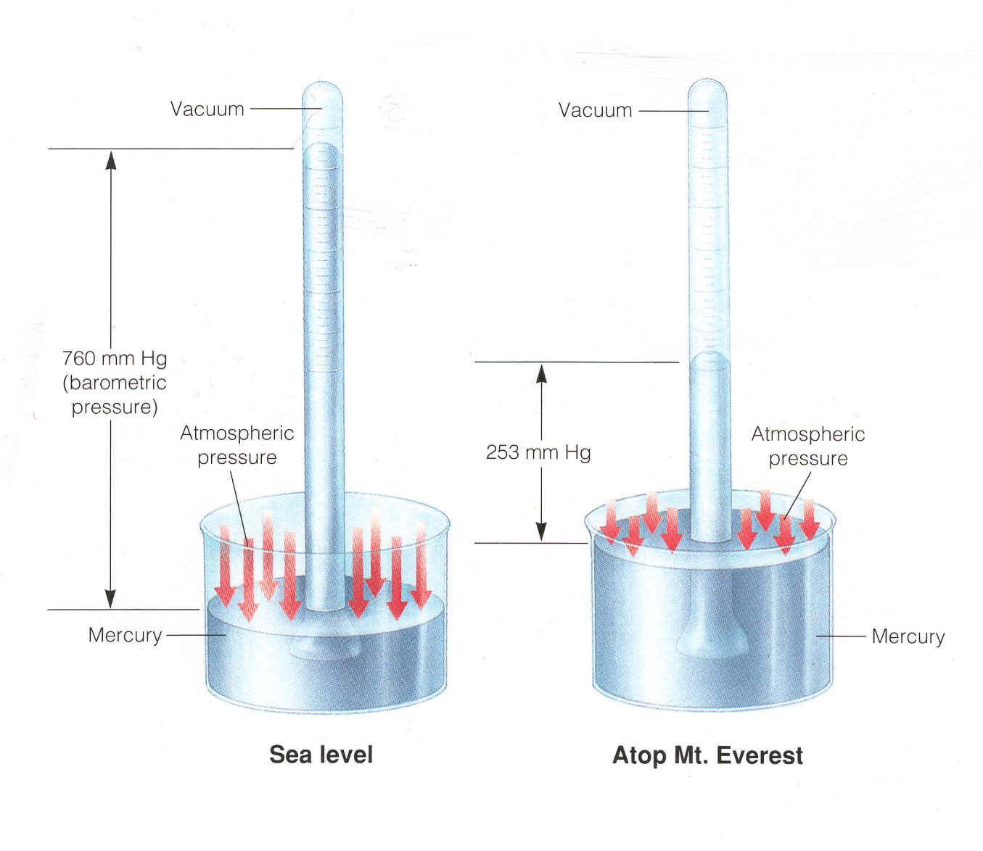
Barometer

Slide 17
Manometer
-Measures pressure of gas in container
p. 351

Slide 18
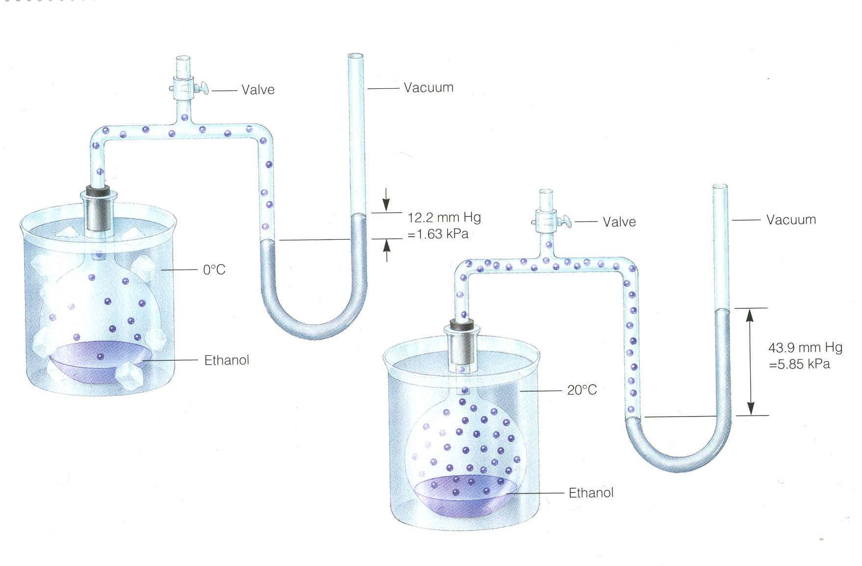
Manometer

Slide 19
Units of Pressure
mmHg- millimeter of mercury
Torr- in honor of Torncelli
these both measure same thing, used interchangeably
Standard atmosphere (atm)
SI unit= Pascal (Pa)
1 N/m²
– small, don’t use often
PSI- used in engineering

Slide 20
Pressure Conversions
MUST KNOW
1.0 atm= 760.0 mmHg= 760.0 torr
1.0 torr=1mmHg
1.0 atm= 101,325 Pa (101.325 kPa)
1.0 atm = 14.69 PSI

Slide 21
? atm = 820. torr x 1.0 atm = 1.08 atm
760 torr
? torr = 1.25 atm x 760.0 torr = 950. torr 1.00 atm
? Pa = 1.9 atm x 101,325 Pa = 1.9 x 10⁵ Pa 1.0atm
? KPa = 1.9 x 10⁵ Pa = 190 KPa

Slide 22
Standard Temperature and Pressure
STP= 1 atm and 0 ºC

Slide 23
Dalton’s Law of Partial Pressures
For a mixture of gases in a container, the total pressure equals the sum of pressures of all the individual gases
True regardless of the number of different gases present
Each gas behaves as if alone
Partial pressure= pressure of gas alone
Dalton’s Law of Partial Pressure
P _{total} = P₁ + P₂ + P₃ …..

Slide 24
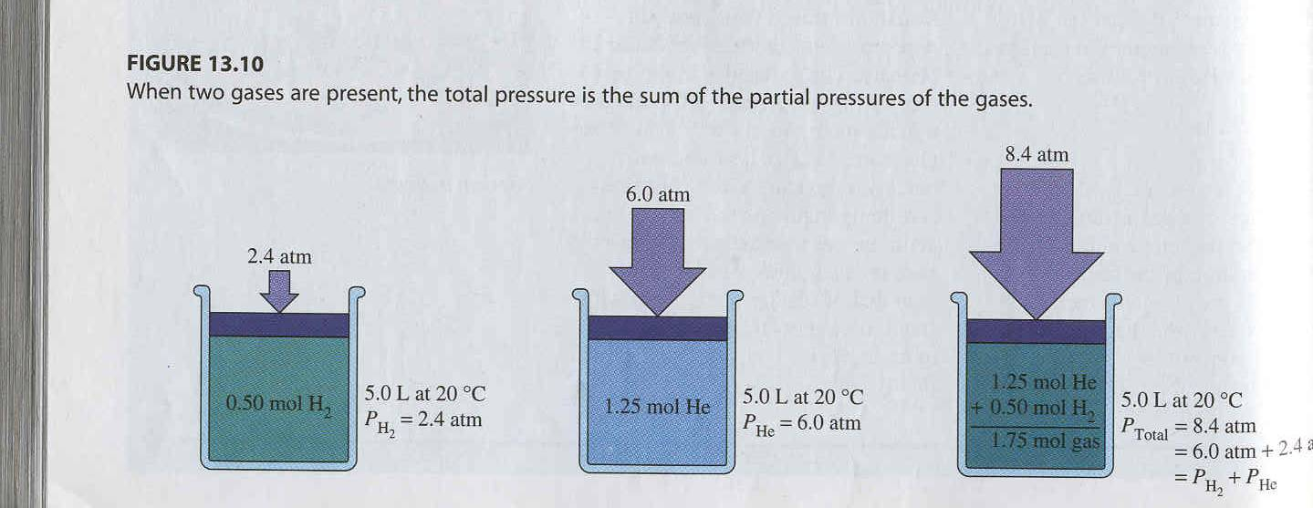
Dalton’s Law

Slide 25
A mixture of gases at high temperature is created. Suppose that gas X has a pressure of 50 atm, gas Y has a pressure of 20 atm, and gas Z has a pressure of 10 atm. What is the total pressure in this system?
P _{total} = P₁ + P₂ + P₃ …..
P _{total} = 50 atm + 20 atm + 10 atm
= 80 atm

Slide 26
Gases collected by Water displacement
Gases typically collected over water in lab
Not pure, mixed with water vapor
Pressure of gas and water vapor
P _{atm} = P _{gas} + P _{water}
Atmospheric pressure is from a barometer in lab
P _{water} can be found in a reference table/book, make sure at temp of experiment

Slide 27
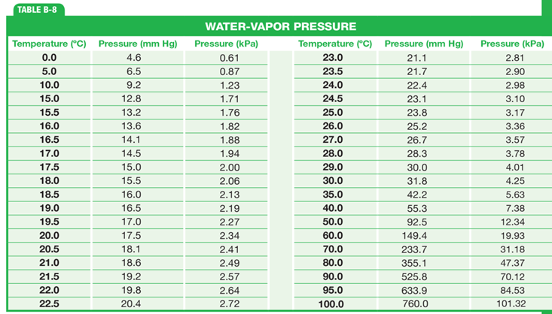

Slide 28
Hydrogen gas is collected over water at 20.0 ºC. The partial pressure of hydrogen is determined to be 742.5 torr. What is the barometric pressure at the time the gas was collected?
P _{atm} = P _{gas} + P _{water}
P _{atm} = 742.5 torr + 17.5 torr (found in table B-8 in book p R79, make sure in correct units)
P _{atm}= 760.0 torr

Slide 29
Helium gas is collected over water at 25 ºC. What is the partial pressure of the helium, given that the barometric pressure is 750.0 mmHg?
P _{atm} = P _{gas} + P _{water}
750.0 mm Hg= P _{gas} + 23.8 mmHg
726.2 mm Hg

Slide 30
A 250. ml sample of oxygen is collected over water vapor at 25 ºC and 760.0 torr pressure. What is the pressure of the dry gas alone? (water vapor pressure at 25 ºC =23.8 torr)
P _{atm} = P _{gas} + P _{water}
760.0 torr = P _{gas} + 23.8 torr
736.2 torr

