Slide 1
Chapter 20: Sound
© 2015 Pearson Education, Inc.

Slide 2
This lecture will help you understand:
Nature of Sound
Origin of Sound
Sound in Air
Media That Transmit Sound
Speed of Sound in Air
Reflection of Sound
Refraction of Sound
Energy in Sound Waves
Forced Vibrations
Natural Frequency
Resonance
Interference
Beats

Slide 3
Nature of Sound
Sound is a form of energy that exists whether or not it is heard.

Slide 4
Origin of Sound
Most sounds are waves produced by the vibrations of matter.
For example:
In a piano, a violin, and a guitar, the sound is produced by the vibrating strings;
in a saxophone, by a vibrating reed;
in a flute, by a fluttering column of air at the mouthpiece;
in your voice due to the vibration of your vocal chords.

Slide 5
Origin of Sound, Continued
The original vibration stimulates the vibration of something larger or more massive, such as
the sounding board of a stringed instrument,
the air column within a reed or wind instrument, or
the air in the throat and mouth of a singer.
This vibrating material then sends a disturbance through the surrounding medium, usually air, in the form of longitudinal sound waves.

Slide 6
Origin of Sound, Continued-1
Under ordinary conditions, the frequencies of the vibrating source and sound waves are the same.
The subjective impression about the frequency of sound is called pitch.
The ear of a young person can normally hear pitches corresponding to the range of frequencies between about 20 and 20,000 Hertz.
As we grow older, the limits of this human hearing range shrink, especially at the high-frequency end.

Slide 7
Origin of Sound, Continued-2
Sound waves with frequencies below 20 hertz are infrasonic (frequency too low for human hearing).
Sound waves with frequencies above 20,000 hertz are called ultrasonic (frequency too high for human hearing).
We cannot hear infrasonic and ultrasonic sound.

Slide 8
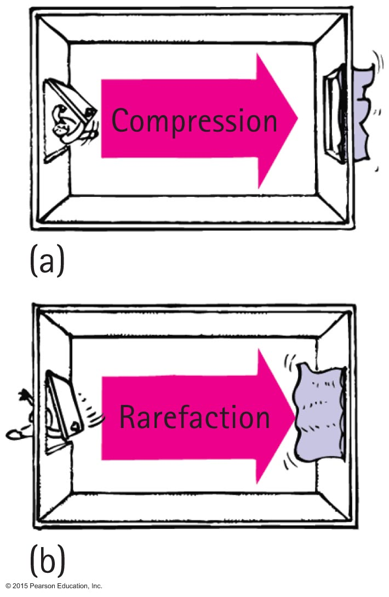
Sound in Air
Sound waves
are vibrations made of compressions and rarefactions.
are longitudinal waves.
require a medium.
travel through solids, liquids, and gases.

Slide 9
Sound in Air, Continued
Wavelength of sound
Distance between successive compressions or rarefactions

Slide 10
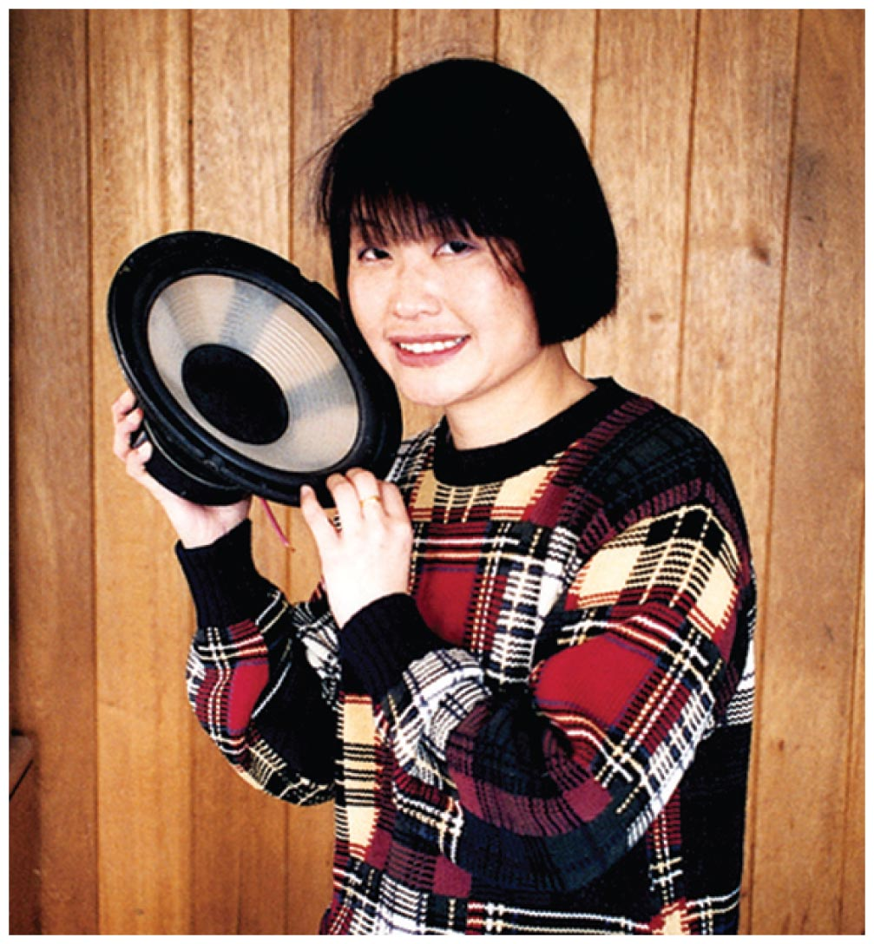
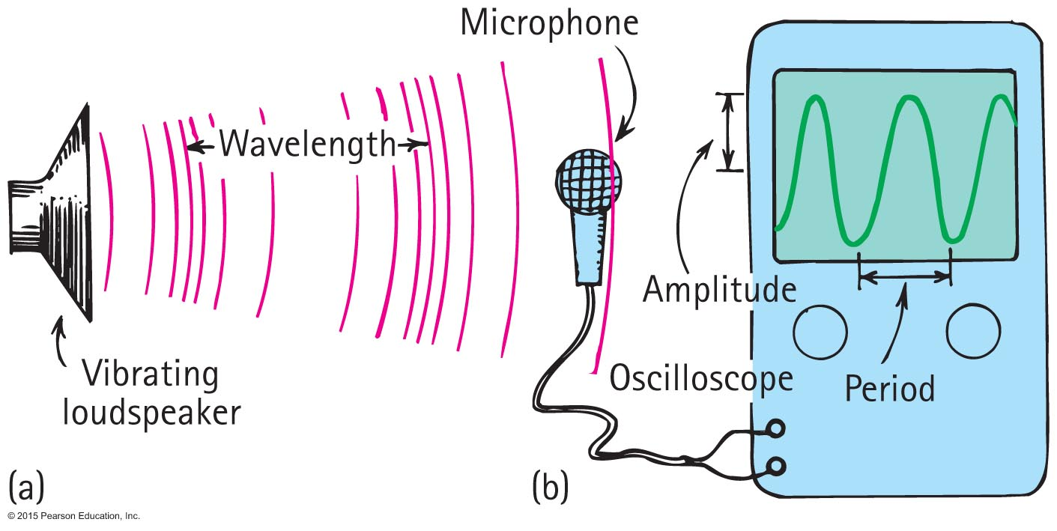
Sound in Air, Continued-1
How sound is heard from a radio loudspeaker
Radio loudspeaker is a paper cone that vibrates.
Air molecules next to the loudspeaker set into vibration.
Produces compressions and rarefactions traveling in air.
Sound waves reach your ears, setting your eardrums into vibration.
Sound is heard.

Slide 11
Media That Transmit Sound
Any elastic substance — solid, liquid, gas, or plasma — can transmit sound.
Elastic liquids and solids, the atoms are relatively close together, respond quickly to one another's motions, and transmit energy with little loss.
Steel is elastic
Sound travels about 4 times faster in water than in air and about 15 times faster in steel than in air.

Slide 12
Speed of sound
https://www.youtube.com/watch?v=UgE2GIQwUCw

Slide 13
Speed of Sound in Air
Speed of sound
Depends on temperature and mass of particles
Speed in dry air at 0°C is about 330 m/s.
Room temperature speed about 340 m/s
In water vapor slightly faster.
In warm air faster than cold air.
Each degree rise in temperature above 0°C, speed of sound in air increases by 0.6 m/s
Speed in water about 4 times speed in air.
Speed in steel about 15 times its speed in air.

Slide 14
Energy in sound waves
Small amount of energy in comparison to EM waves
Sound energy dissipates to thermal energy when traveling in air
High frequency waves the energy is transformed into internal energy faster than for low frequency waves

Slide 15
Speed of Sound in Air CHECK YOUR NEIGHBOR
You watch a person chopping wood and note that after the last chop you hear it 1 second later. How far away is the chopper?
330 m
More than 330 m
Less than 330 m
There's no way to tell.
Notes:
A. 330 m

Slide 16
Speed of Sound in Air CHECK YOUR ANSWER
You watch a person chopping wood and note that after the last chop you hear it 1 second later. How far away is the chopper?
330 m
Notes:
A. 330 m

Slide 17
Speed of Sound in Air CHECK YOUR NEIGHBOR, Continued
You hear thunder 2 seconds after you see a lightning flash. How far away is the lightning?
340 m/s
660 m/s
More than 660 m/s
There's no way to tell.
Notes:
B. 660 m/s

Slide 18
Speed of Sound in Air CHECK YOUR NEIGHBOR, Continued
You hear thunder 2 seconds after you see a lightning flash. How far away is the lightning?
660 m/s
Notes:
B. 660 m/s

Slide 19
Sound Intensity and Loudness
Intensity proportional to square of amplitude of sound wave
I=(A) ²
The intensity of sound depends on the amplitude of pressure variations within the sound wave

Slide 20
Sound Intensity and Loudness, Continued
Because the range is so great, intensities are scaled by factors of 10, with the barely audible
as a reference intensity called
0 bel (a unit named after Alexander Bell).
A sound 10 times more intense has an intensity of 1 bel
or
10 decibels (dB)
TABLE 21. COMMON SOURCES AND SOUND INTENSITIES
Source of Sound
Intensity
Sound Level (dB)
Jet airplane 30 m away
Air-raid siren, nearby
Disco music, amplified
Riveter
Busy street traffic
Conversation in home
Quiet radio in home
Whisper
Rustle of leaves
Threshold of hearing

Slide 21
Sound Intensity and Loudness, Continued-1
Sound intensity is a purely objective and physical attribute of a sound wave, and it can be measured by various acoustical instruments.
Loudness is a physiological sensation.
The ear senses some frequencies much better than others.
A 3500-Hz sound at 80 decibels sounds about twice as loud to most people as a 125-Hz sound at 80 decibels.
Humans are more sensitive to the 3500-Hz range of frequencies.
Physiological hearing damage begins at 85dB

Slide 22
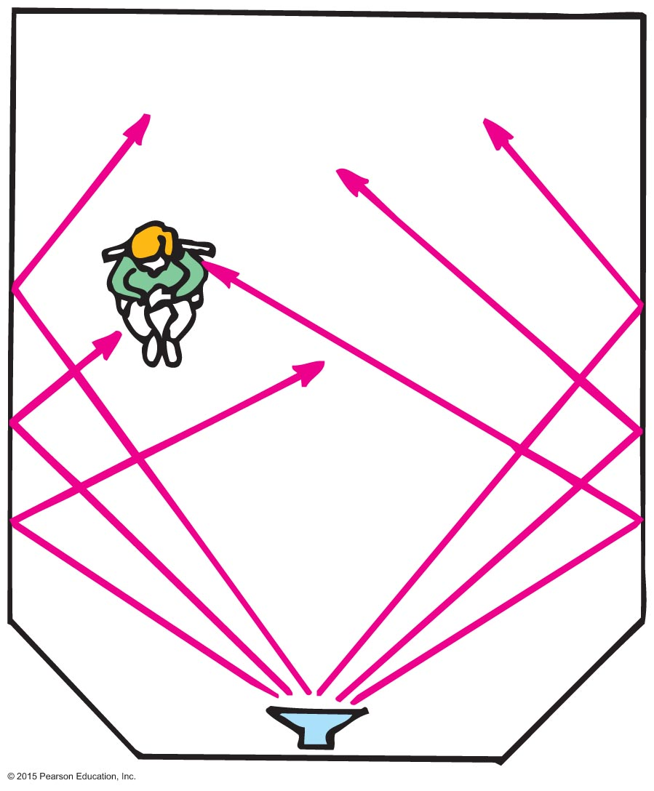
Reflection of Sound
Reflection
Process in which sound encountering a surface is returned
Often called an echo
Energy not reflected is absorbed or transmitted
Multiple reflections—called reverberations

Slide 23
Reflection of Sound CHECK YOUR NEIGHBOR
Reverberations are best heard when you sing in a room with
carpeted walls.
hard-surfaced walls.
open windows.
None of the above.
Notes:
B. hard-surfaced walls.

Slide 24
Reflection of Sound CHECK YOUR ANSWER
Reverberations are best heard when you sing in a room with
hard-surfaced walls.
Explanation:
Rigid walls better reflect sound energy. Fabric is absorbent, and open windows let sound energy escape from the room.
Notes:
B. hard-surfaced walls.

Slide 25
Reflection of Sound A situation to ponder…
Consider a person attending a concert that is being broadcast over the radio. The person sits about 45 m from the stage and listens to the radio broadcast with a transistor radio over one ear and a nonbroadcast sound signal with the other ear. Further suppose that the radio signal must travel all the way around the world before reaching the ear.

Slide 26
A situation to ponder… CHECK YOUR NEIGHBOR
Which signal will be heard first?
Radio signal
Nonbroadcast sound signal
Both at the same time.
None of the above.
Notes:
C. Both at the same time.

Slide 27
A situation to ponder… CHECK YOUR ANSWER
Which signal will be heard first?
Both at the same time.
Explanation:
A radio signal travels at the speed of light, 3 x 10⁸ m/s.
Time to travel 45 m at 340 m/s ≈ 0.13 s. Time to travel
(Earth's circumference) at
Therefore, if you sit
farther back at the concert, the radio signal would reach you first!
Notes:
C. Both at the same time.

Slide 28
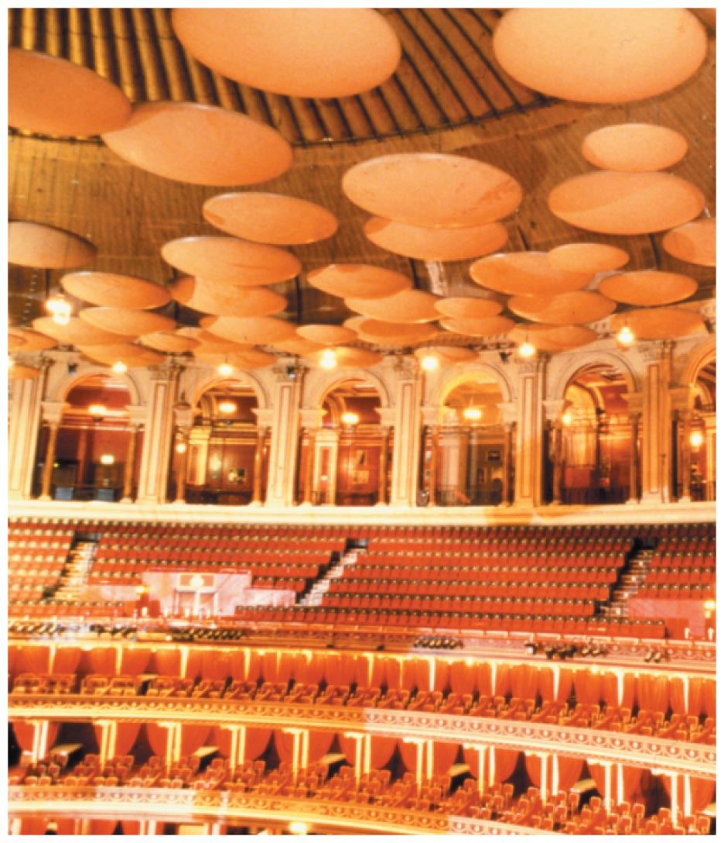
Reflection of Sound, Continued
Acoustics
Study of sound
Example: A concert hall aims for a balance between reverberation and absorption. Some have reflectors to direct sound (which also reflect light—so what you see is what you hear).

Slide 29
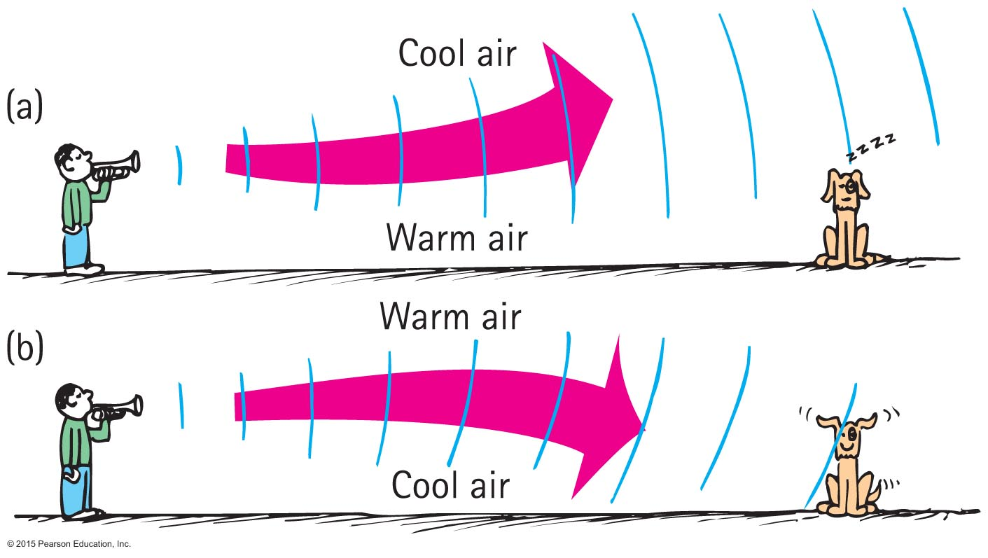
Refraction of Sound
Refraction
Bending of waves—caused by changes in speed affected by (parts of wave travel faster than others)
wind variations.
temperature variations.

Slide 30
Refraction of Sound CHECK YOUR NEIGHBOR
When air near the ground on a warm day is warmed more than the air above, sound tends to bend
upward.
downward.
at right angles to the ground.
None of the above.
Notes:
A. upward.

Slide 31
Refraction of Sound CHECK YOUR ANSWER
When air near the ground on a warm day is warmed more than the air above, sound tends to bend
upward.
Notes:
A. upward.

Slide 32
Refraction of Sound CHECK YOUR NEIGHBOR, Continued
In the evening, when air directly above a pond is cooler than air above, sound across a pond tends to bend
upward.
downward.
at right angles to the ground.
None of the above.
Notes:
B. downward.

Slide 33
Refraction of Sound CHECK YOUR NEIGHBOR, Continued
In the evening, when air directly above a pond is cooler than air above, sound across a pond tends to bend
downward.
Explanation:
This is why sound from across a lake at night is easily heard.
Notes:
B. downward.

Slide 34
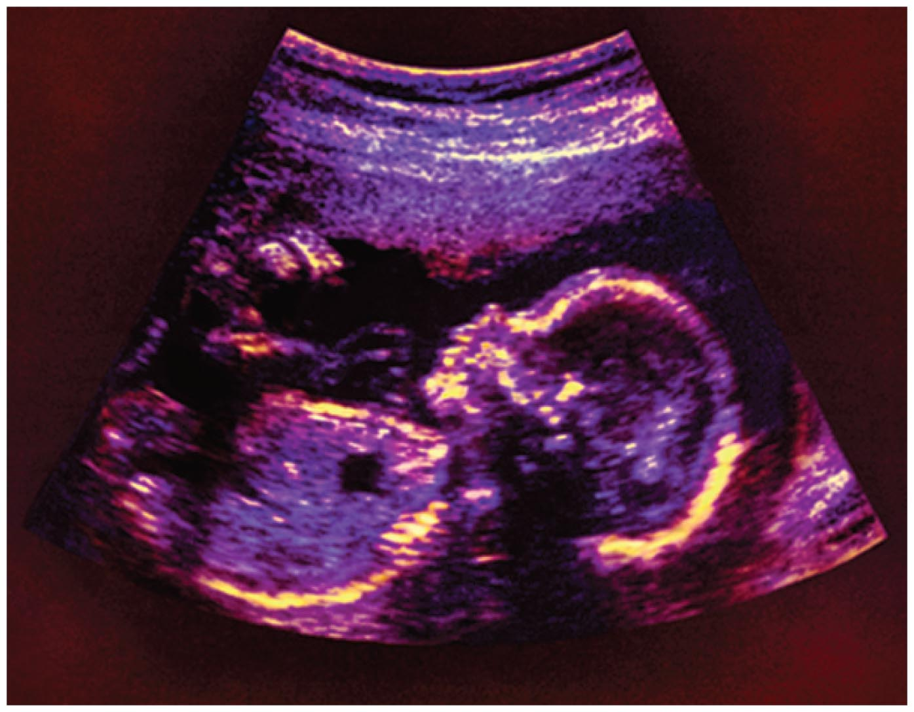
Reflection and Refraction of Sound
Multiple reflection and refractions of ultrasonic waves
Device sends high-frequency sounds into the body and reflects the waves more strongly from the exterior of the organs, producing an image of the organs.
Used instead of X-rays by physicians to see the interior of the body.

Slide 35
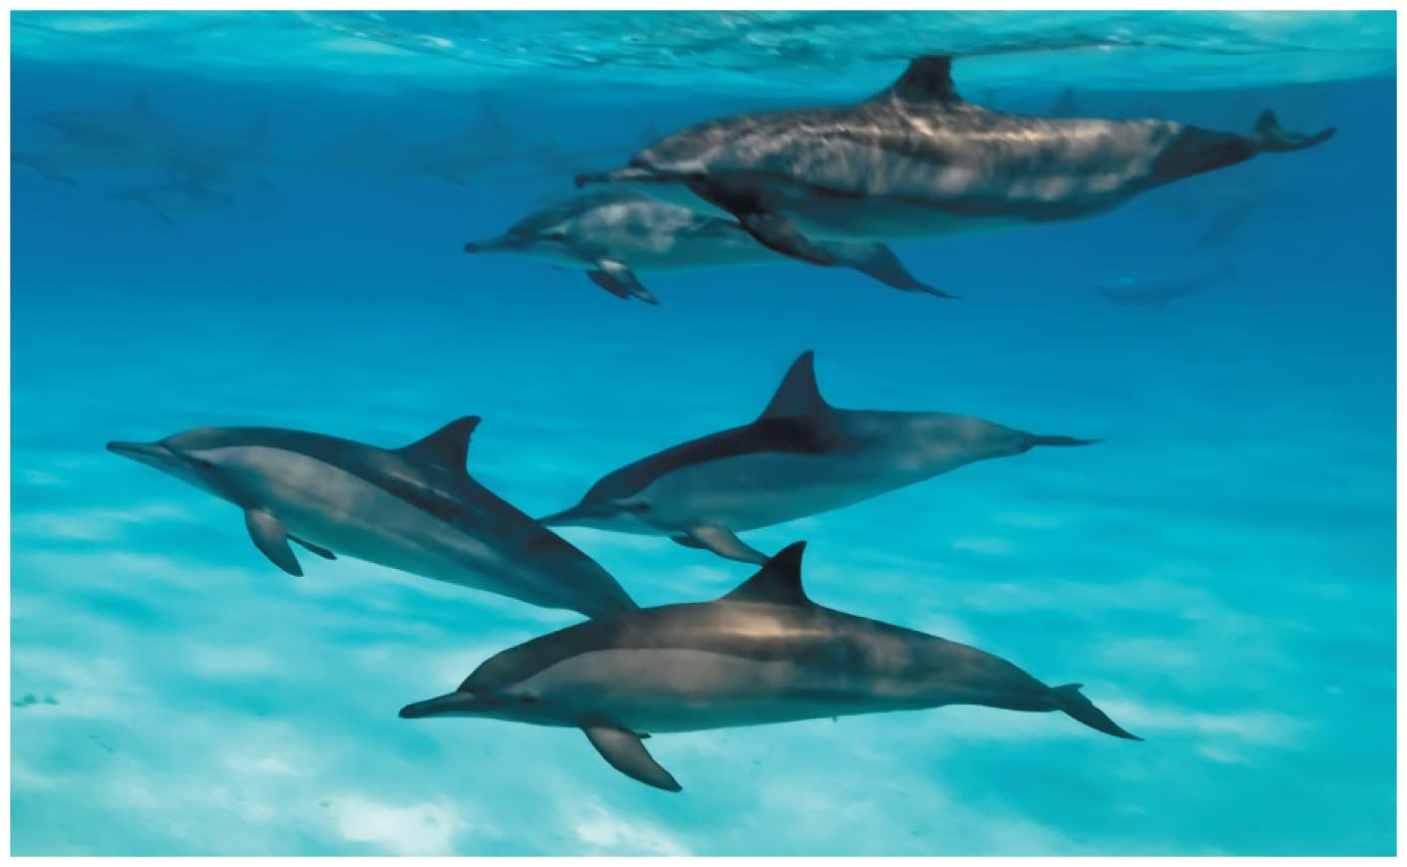
Reflection and Refraction of Sound, Continued
Dolphins emit ultrasonic waves to enable them to locate objects in their environment.

Slide 36
Forced Vibrations
Forced vibration
Setting up of vibrations in an object by a vibrating force
Example: factory floor vibration caused by running of heavy machinery
Sounding boards- music box, string instruments

Slide 37
Natural Frequency
Natural frequency
Frequency at which an object vibrates when disturbed
Own unique frequency (or set of frequencies)
Dependent on
elasticity
shape of object

Slide 38
Resonance
A phenomenon in which the frequency of forced vibrations on an object matches the object's natural frequency
Examples:
Swinging in rhythm with the natural frequency of a swing
Tuning a radio station to the "carrier frequency" of the radio station
Troops marching in rhythm with the natural frequency of a bridge (a no-no!)

Slide 39
resonance
https://www.youtube.com/watch?v=urYWaHfel6g
https://www.youtube.com/watch?v=joS6kfjuKQo
Bridge

Slide 40
Resonance, Continued
Dramatic example of wind-generated resonance

Slide 41
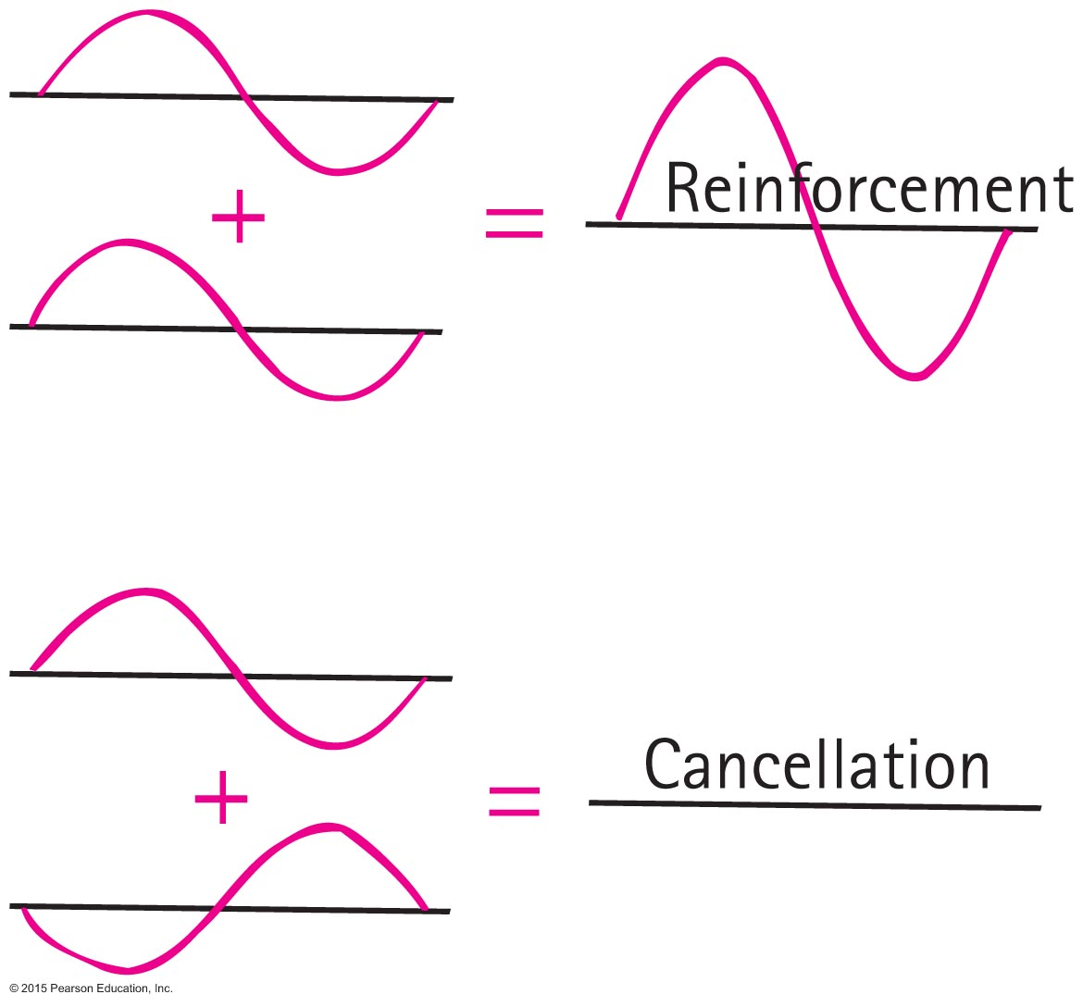
Interference
Interference
Property of all waves and wave motion
Superposition of waves that may either reinforce or cancel each other

Slide 42
Interference CHECK YOUR NEIGHBOR
Interference is a property of
sound.
light.
Both A and B.
Neither A nor B.
Notes:
C. Both A and B.

Slide 43
Interference CHECK YOUR NEIGHBOR, Continued
Interference is a property of
Both A and B.
Explanation:
Interestingly, the presence of interference tells a physicist whether something is wavelike. All types of waves can interfere.
Notes:
C. Both A and B.

Slide 44
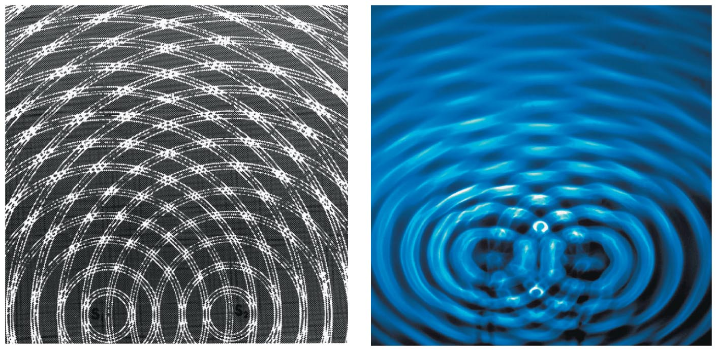
Interference, Continued
Two patterns of interference
Constructive interference
increased amplitude when the crest of one wave overlaps the crest of another wave
Destructive interference
reduced amplitude when the crest of one wave overlaps the trough of another wave

Slide 45
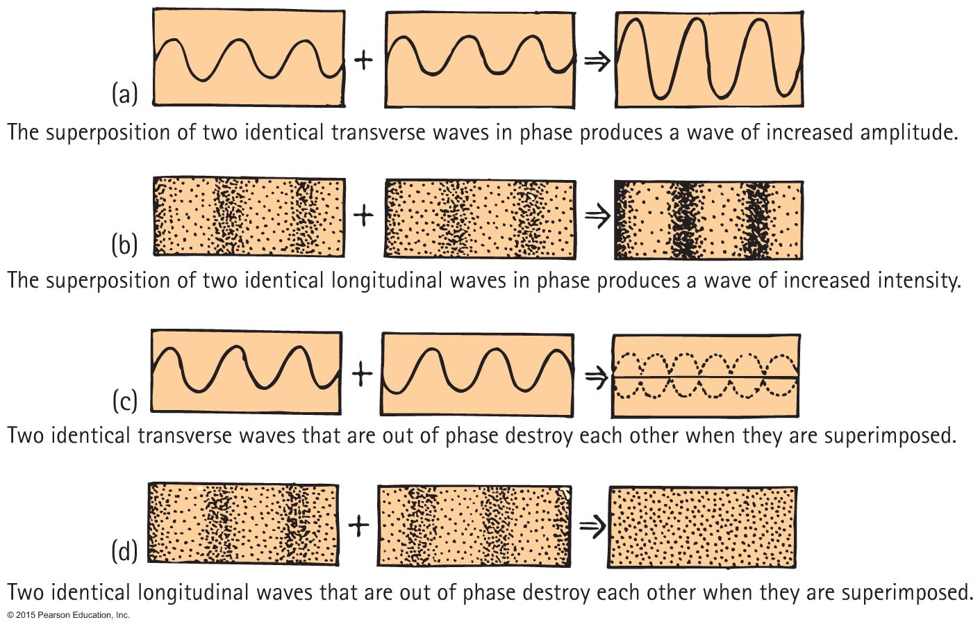
Interference, Continued-1

Slide 46
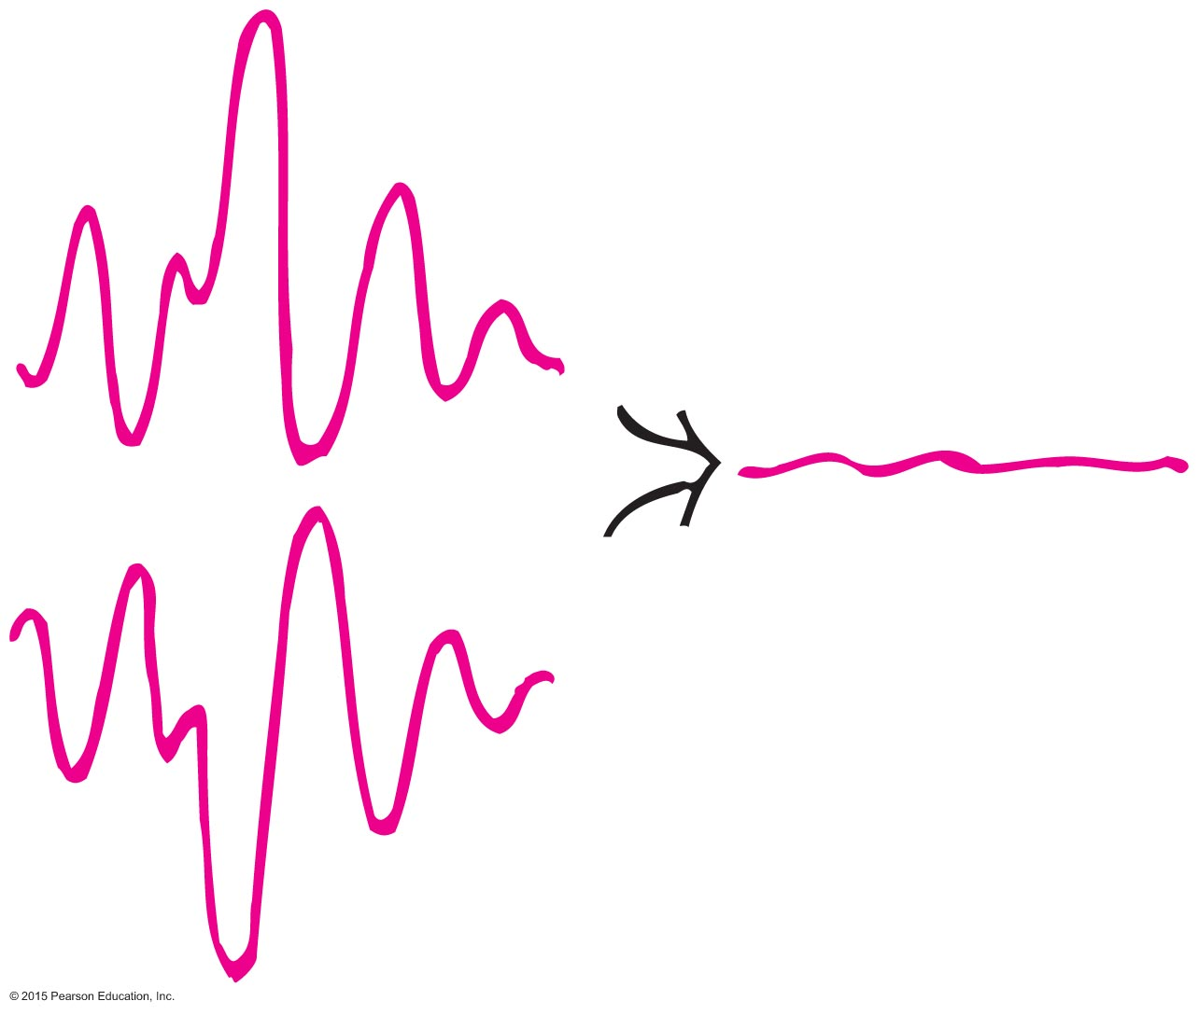
Interference, Continued-2
Application of sound interference
Destructive sound interference in noisy devices such as jackhammers that are equipped with microphones to produce mirror-image wave patterns fed to operator's earphone, canceling the jackhammer's sound

Slide 47
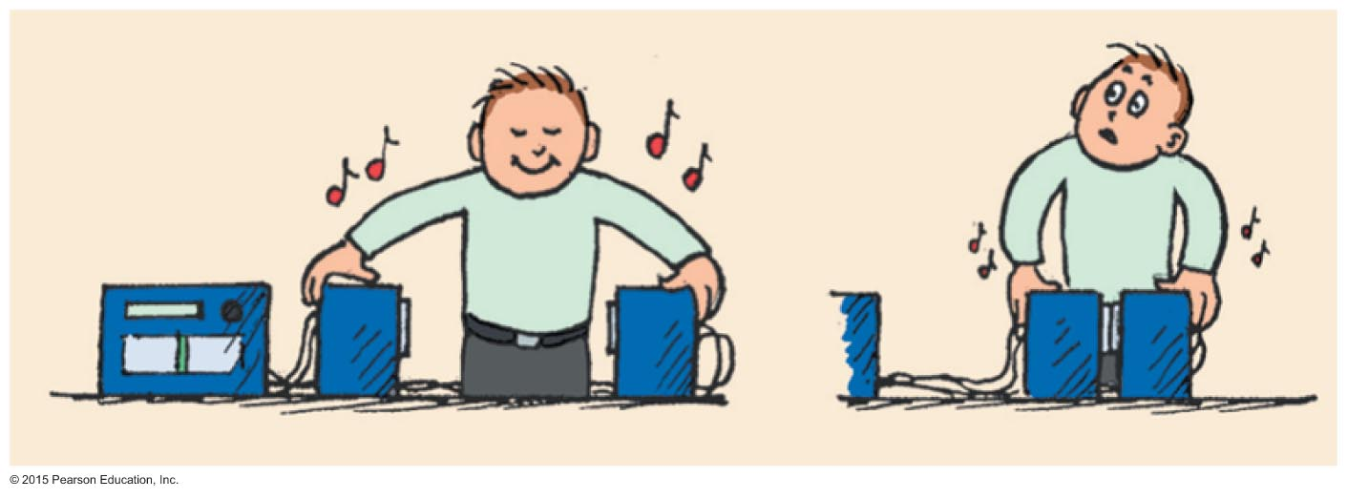
Interference, Continued-3
Application of sound interference (continued)
Sound interference in stereo speakers out of phase sending a monoaural signal (one speaker sending compressions of sound and other sending rarefactions)
As speakers are brought closer to each other, sound is diminished.

Slide 48
Beats
Periodic variations in the loudness of sound due to interference
Occur with any kind of wave
Provide a comparison of frequencies

Slide 49
Beats, Continued
Applications
Piano tuning by listening to the disappearance of beats from a tuning fork and a piano key
Tuning instruments in an orchestra by listening for beats between instruments and piano tone
The human ear is capable of detecting beats with frequencies of 7 Hz and below

Slide 50
https://www.youtube.com/watch?v=pRpN9uLiouI
https://www.youtube.com/watch?v=i886Lbjbl9k
demonstration

Slide 51
What is the beat frequency when a 262 Hz tuning fork and a 266 Hz tuning fork when sounded together?
266-262= 4 Hz
=You will hear 264 Hz
A 262 Hz and a 272 Hz tuning fork?
272-262= 10 Hz
10 hz is to rapid for most human hears to hear
Is it correct to say in every case radio waves travel faster than sound waves?
Yes, radio are EM waves and travel at the speed of light.

Slide 52
Ch 20 homework
P.389-390
#33,34,40-45,48-52,55-57,61-63,67,71,73,80,82,84

