Slide 1
Chapter 11: The Atomic Nature Of Matter
© 2015 Pearson Education, Inc.

Slide 2
This lecture will help you understand:
The Atomic Hypothesis
Characteristics of Atoms
Atomic Imagery
Atomic Structure
The Elements
The Periodic Table of Elements
Relative Sizes of Atoms
Isotopes
Compounds and Mixtures
Molecules
Antimatter
Dark Matter

Slide 3
Atoms
"All things are made of atoms—little particles that move around in perpetual motion, attracting each other when they are a little distance apart, but repelling upon being squeezed into one another."
—Richard Feynman

Slide 4
The Atomic Hypothesis
The idea of matter:
First thought by Aristotle to be a combination of four elements—earth, air, fire, and water
Thought to be composed of atoms by Greeks from the fifth century BC
Further proposed as atoms in 1800s by meteorologists and schoolteacher John Dalton

Slide 5
The Atomic Hypothesis, Continued
In 1827, Robert Brown, a botanist, observed collisions between visible particles and invisible atoms (Brownian motion)—later confirmed by Einstein as evidence for the existence of atoms.
Observed dust particles in state of agitation
Brownian motion- the movement of tiny particle suspended in a gas or liquid that results from their bombardment by fast moving atoms or molecules of gas or liquid.

Slide 6
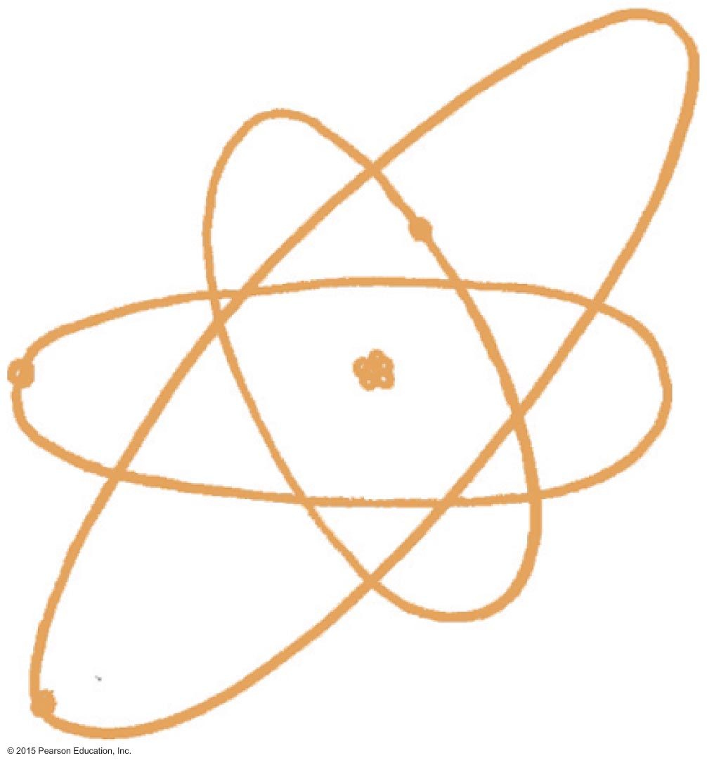
Characteristics of Atoms
Characteristics of atoms:
Incredibly tiny
Numerous
Perpetually in motion
Ageless
Smallest unit of element that keeps property of element

Slide 7
Characteristics of Atoms CHECK YOUR NEIGHBOR
Which of the following are incorrect statements about the atom?
Atoms are smaller than the wavelength of visible light.
Atoms are mostly empty space, just as the solar system is mostly empty space.
Atoms are perpetually moving.
Atoms are manufactured in plants, and in humans during pregnancy.
All are correct.
Notes:
D. Atoms are manufactured in plants and in humans during pregnancy.

Slide 8
Characteristics of Atoms CHECK YOUR ANSWER
Which of the following are incorrect statements about the atom?
Atoms are manufactured in plants, and in humans during pregnancy.
Notes:
D. Atoms are manufactured in plants and in humans during pregnancy.

Slide 9
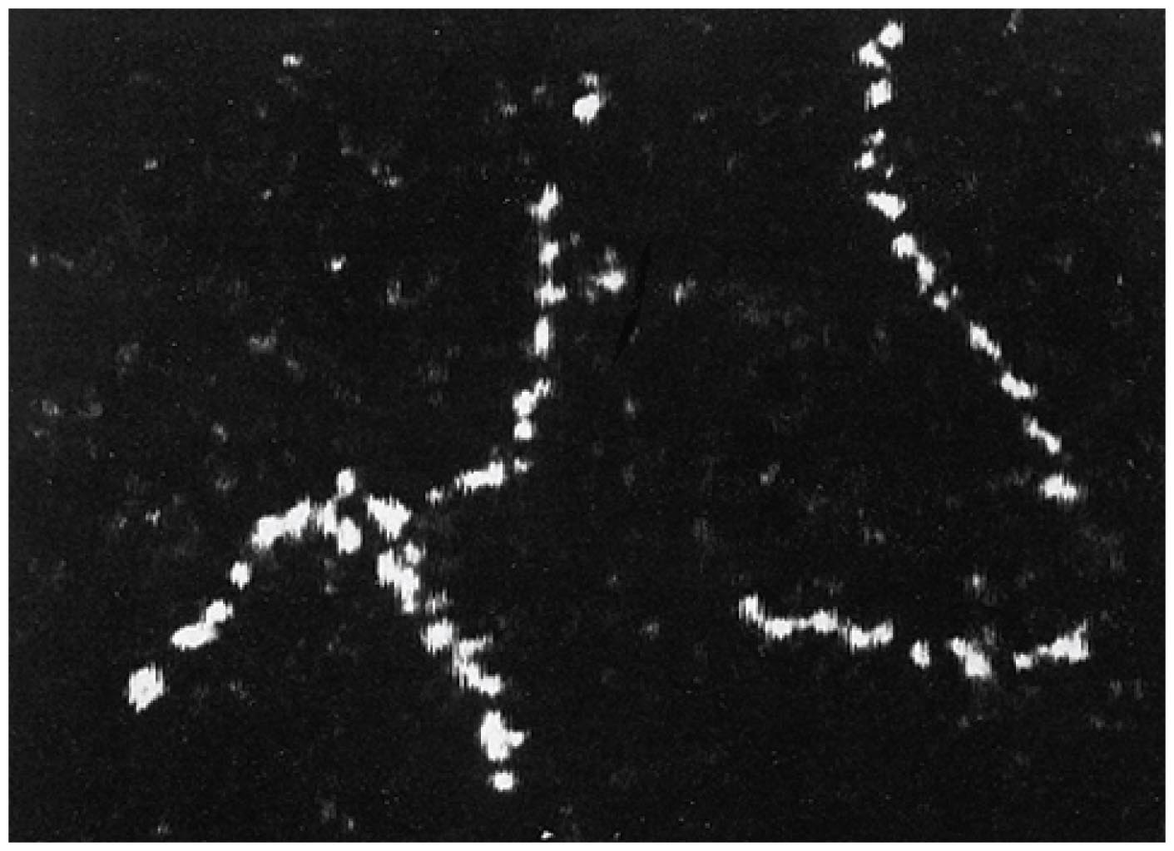
Atomic Imagery
View of atoms
Too small to be seen with visible light
As chains of individual thorium atoms in a 1970 electron micrograph image
Revealed as ripples in rings by scanning tunneling microscope in mid-1980s
Classical model has a nucleus at the center, surrounded by electrons

Slide 10
Atomic Structure
Atomic structure composed of
atomic nucleus (protons and neutons)
concentration of nearly all the mass
nucleons
building block of nucleus
all are identical
in a neutral state—a neutron
in a positively charged state—a proton
positive charges repel positive charges and attract negative charges
quarks—particles that make up a nucleon

Slide 11
Electrons
Negative
Orbit atomic nucleus (cloud)
Most volume of atom
Number is equal to number of protons unless ion
Ion- Atom with a net charge

Slide 13
The Elements
Atoms
Refer to particles that make up a substance
Elemental substance
Composed of only one kind of atom
Lightest and most abundant is hydrogen.
To date, about 118 are known.
90 occur in nature.
Others produced in laboratory are unstable.
Words atom and element can be used interchangeably.

Slide 14
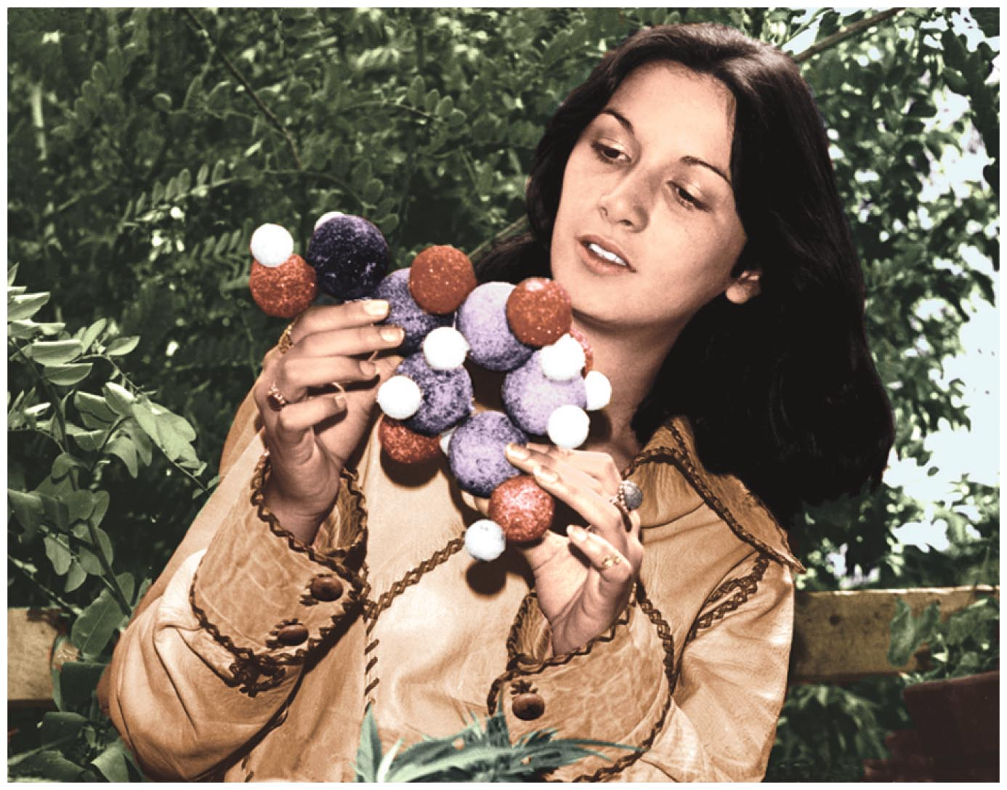
The Elements, Continued
Composition of living things include these 5 elements:
Oxygen
Carbon
Hydrogen
Nitrogen
Calcium

Slide 15
Periodic Table of the Elements
Periodic table:
A chart (chemist's road map) of elements arranged by atomic number
Classified by the number of protons in the nucleus
Atomic mass= protons + neutrons
Arranged from left to right
Each having one more proton and electron than the preceding element
On the far right, outer shells are filled to capacity, known as noble gases

Slide 16
Atomic number= protons
Mass number = protons + neutrons
Atomic mass= average of the masses of isotopes of a given element
Protons= electrons (if not an ion)

Slide 17
Atomic mass unit (AMU)
Specially defined unit of mass
Nucleon has mass of 1 amu
1/12th fo the mass of carbon-12 amu
Proton= 1 amu
Neutron= 1 amu
Electron is so small considered 0 amu

Slide 18
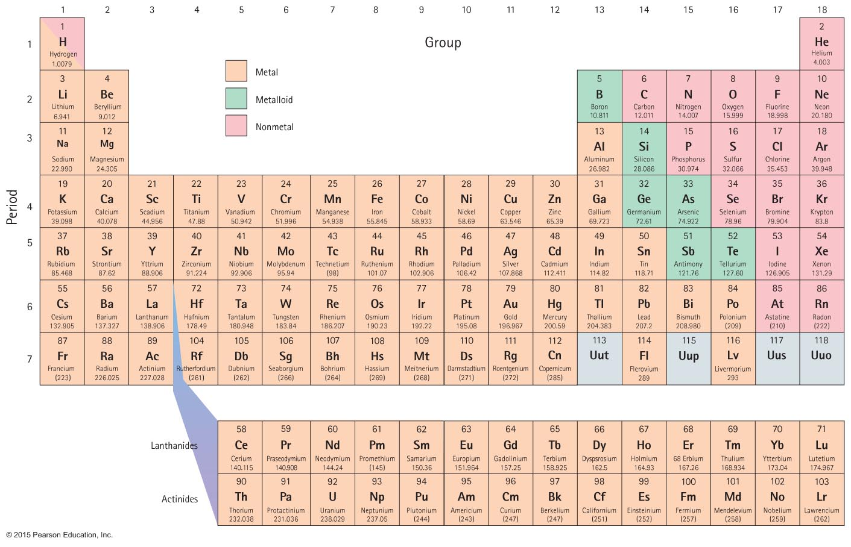
Periodic Table of the Elements, Continued

Slide 19
Relative Sizes of Atoms
Diameters of the outer electron shells:
are determined by the amount of electrical charge in nucleus.
gradually decrease from left to right across the periodic table.
As nuclear charge increases and electrons are added to outer orbits, the inner orbit shrinks.
Heavier elements are not much larger in diameter than the lighter elements

Slide 20
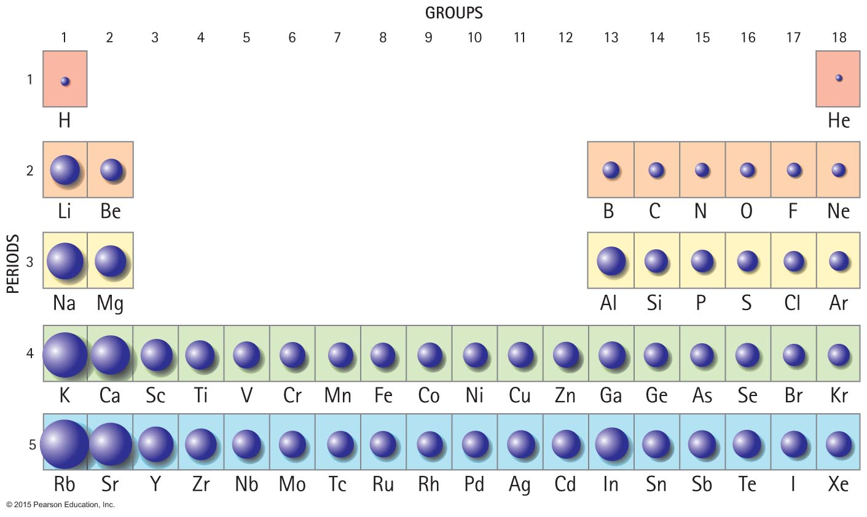
Relative Sizes of Atoms, Continued

Slide 21
Ions and Isotopes
An ion is a charged atom.
Positive ion (cation) has deficiency of electrons.
Negative ion (anion) has an excess of electrons.
Isotopes:
Atoms of the same element with different numbers of neutrons
Identical behavior

Slide 22
Isotopes
Protons in nucleus matches electrons around nucleus, but not necessarily neutrons.
Isotopes:
Atoms of the same element with different numbers of neutrons
Identical behavior
Identified by their mass number (total number of protons and neutrons in the nucleus or number of nucleons)
Example: Iron isotope with 26 protons contain 30 neutrons. Mass number is number 56, referred to as iron-56.

Slide 23
Isotopes CHECK YOUR NEIGHBOR
The atomic number of an element matches the number of
protons in the nucleus of an atom.
electrons in a neutral atom.
Both of the above.
None of the above.
Notes:
C. Both of the above.

Slide 24
Isotopes CHECK YOUR ANSWER
The atomic number of an element matches the number of
Both of the above.
Comment:
When the atomic number doesn't match the number of electrons, the atom is an ion.
Notes:
C. Both of the above.

Slide 25
Isotopes CHECK YOUR NEIGHBOR, Continued
A nucleus with an atomic number of 44 and a mass number of 100 must have
44 neutrons.
56 neutrons.
100 neutrons.
All of the above.
Notes:
B. 56 neutrons.

Slide 26
Isotopes CHECK YOUR ANSWER, Continued
A nucleus with an atomic number of 44 and a mass number of 100 must have
56 neutrons.
Comment:
Be sure to distinguish between neutron and nucleon. Of the 100 nucleons in the nucleus, 56 are neutrons. A neutron is a nucleon, as is a proton.
Notes:
B. 56 neutrons.

Slide 27
Fusion- to come together, combining of nuclei (usually proton addition)
As number of protons increases the identity of the atom changes

Slide 28
Compounds
When atoms of different elements bond to one another, they make a compound.
A compound is different from the elements from which it is made.
It can only be separated into its constituent elements by chemical means.
Have properties different than individual elements that make up compound
Example: Salt (a compound of sodium and chlorine)

Slide 29
Chemical formula- tells proportion and kind of each atom in compound
How many atoms?
H₂O
NaCl
Ca(OH)₂

Slide 30
Mixtures
A substance that is mixed together without chemically bonding is called a mixture.
Example: Air (a mixture of several gases)

Slide 31
Molecules
Molecules
Smallest particle of a substance consisting to 2 or more atoms bonded together
Example:
(ammonia)
3 atoms of hydrogen and 1 atom of nitrogen

Slide 32
Usually gas and liquids at room temperature
Most metals and crystalline are made of atoms not joined in molecules

Slide 33
Molecules, Continued
Chemical reaction:
A process in which atoms rearrange to form different molecules
Example:
Pulling molecules apart requires energy.
During photosynthesis, sunlight's energy breaks bonds of
to produce
and C.
Combining atoms releases energy.
Oxygen atoms combine with iron atoms to form rust.

Slide 34
Phases of matter
4 phases- solid, liquid, gas, plasma
Plasma- positive ions and free electrons that exist only at high temperatures
Which form has more KE and why?

Slide 35
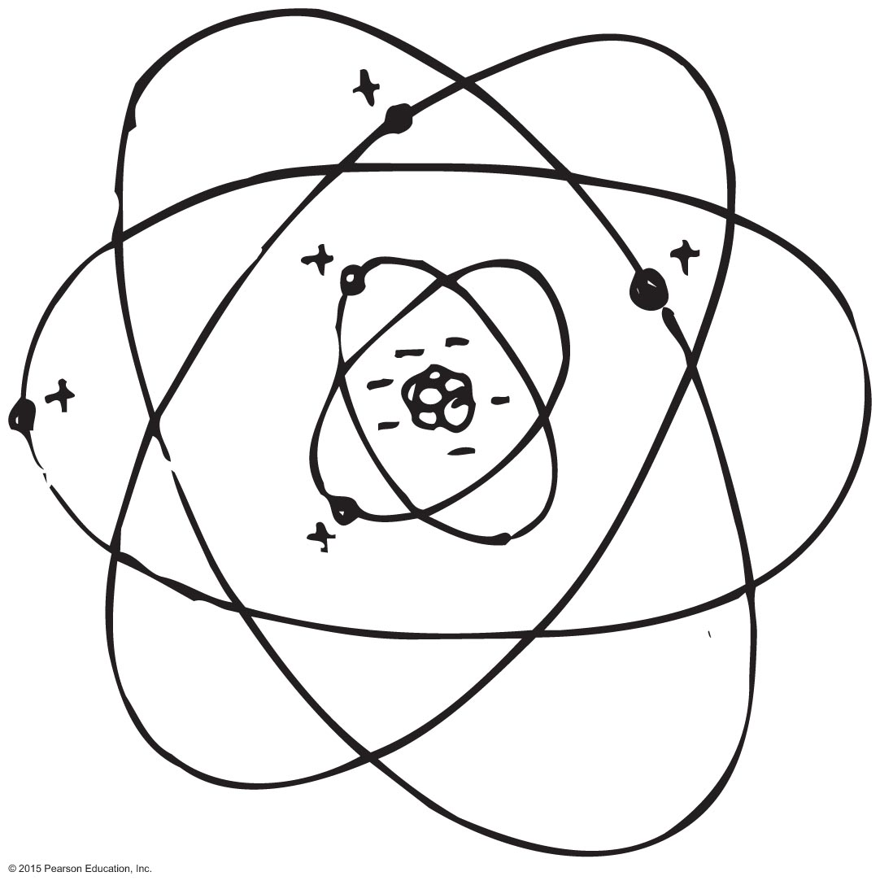
Antimatter
Matter:
Composed of atoms with positive nuclei and negative electrons
Antimatter:
Composed of atoms with negative nuclei and positive electrons (positrons)
Both matter and antimatter cannot exist in our environment.

Slide 36
Antimatter, Continued
Positrons
have the same mass as an electron but are positively charged.
Antiprotons
have the same mass as protons but are negatively charged.

Slide 37
Dark Matter
Dark matter
is unseen and unidentified matter very different from the elements that comprises about 23% of matter in the universe.
Dark energy
is an antigravity energy comprising 73% of the universe.

Slide 38
Dark Matter, Continued
Finding the nature of the dark matter and the nature of the energy of empty space are high-priority quests in these times.
What we will have learned by 2050 will likely dwarf all that we have ever known.

Slide 39
Chapter 11 Homework
P. 224-225
#33-58

