Slide 1
Arrangement of Electrons in Atoms
Ch 4 Chemistry

Slide 2
The Development of a new atomic model
4-1

Slide 3
4-1 Learning Targets
Identify electromagnetic radiation
Describe the relationship between wavelength and frequency and be able to calculate each.
Describe the photoelectric effect
Calculate the energy of a photon.
Contrast continuous electromagnetic spectrum and atomic emission spectra.
Describe Bohr’s model of the atom

Slide 4
Properties of Light
Before 1900 scientists thought light behaved solely as wave
Later changed, believe light can act as particle also

Slide 5
Electromagnetic Radiation and Energy
Electromagnetic radiation (light)
  Form of energy that exhibits wavelike behavior as it travels through space
  Light from sun, x-rays, radiant energy
  All different yet act like waves

Slide 6
Electromagnetic spectrum
All the forms of electromagnetic radiation
All move at constant speed of 3.00 x 10⁸ m/s in vacuum

Slide 7
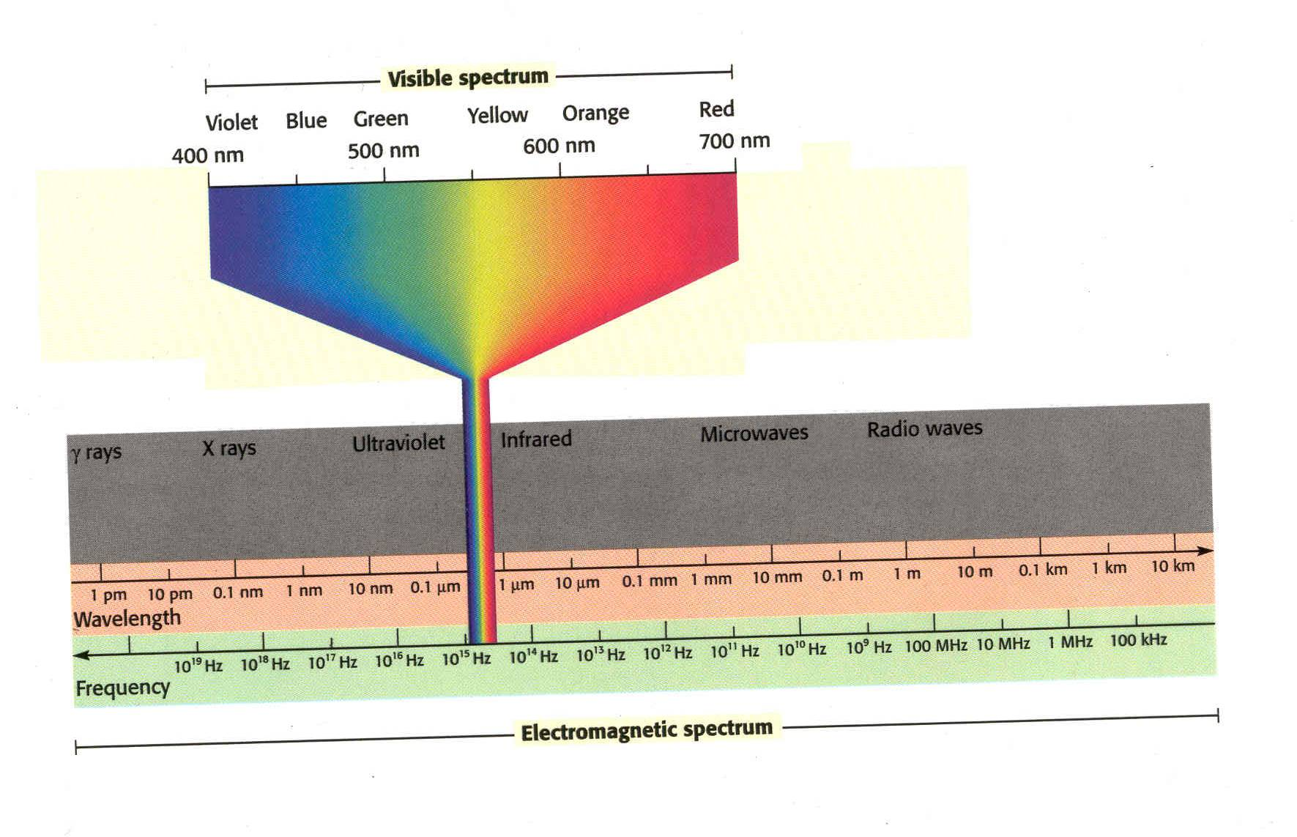

Slide 8
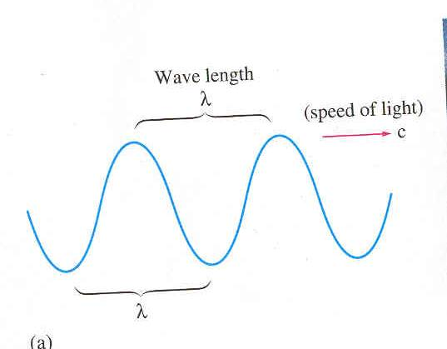

Slide 9
Waves
1- Wavelength- λ(lambda) distance (m) between 2 crests or 2 troughs
2- Frequency- ν(nu) how many waves pass a point per second
w/s or Hertz (Hz)
3- Speed- distance per time
  C= 3.00 x 10⁸ m/s speed of light
  Speed c= vλ

Slide 10
What is the wavelength of a microwave having a frequency of 3.44 x 10 ⁹ Hz?
  c= vλ
  3.00 x 10⁸ m/s= (3.44 x 10 ⁹ Hz) λ
  λ= 8.72 x 10⁻² m

Slide 11

Wavelength and frequency inverse relationship
Frequency and energy are directly related

Slide 12
Photoelectric Effect
In early 1900’s experiments involving interactions of light and matter could not be explained by the wave theory, one was
Photoelectric effect- refers to the emission of electrons from a metal when light shines on the metal
  Light had to have a minimum frequency for the effect to work
  Why??

Slide 13
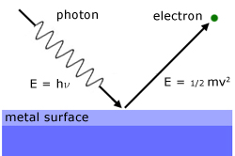

Slide 14
E_{photon}= hv
In order for an electron to be ejected from the metal surface the electron must be struck by a photon possessing the minimum energy required to knock the electron loose

Slide 15
Max Plank
Studied the emission of light by hot objects
Suggested objects emitted energy in small specific amounts called quanta
Quantum- the minimum quantity of energy that can be lost or gained by an atom
E= hv
E= energy (J)
h= Planks constant 6.626 x 10⁻³⁴ Js
V= frequency (Hz)

Slide 16
What is the energy of a wave with a frequency of 9.50 x 10 ¹³ Hz?
E= hv
E= (6.626 x 10⁻³⁴ Js)(9.50 x 10 ¹³ Hz )
E= 6.29 x 10 ⁻²⁰ J

Slide 17
Can relate quantum of energy to speed light:
  c= vλ so v=c/λ
  Substitute v into quantum equation
  E=hc/λ

Slide 18
Light- a wave or particle?
Einstein (1905) expanded Plank’s theory- light could have dual wave-particle nature
Wave particle model – see light as both wave and particle

Slide 19
Photon- particle of electromagnetic radiation having zero rest mass and carrying a quantum of energy
light as a stream of tiny particles of energy (particle of light)
Light divided into classes by wavelength

Slide 20
Energy Levels
lowest highest
ROYGBIV
(visible light)
High frequency waves carry the most energy
Low frequency carry low amount of energy
Higher frequency the shorter the wavelength

Slide 22
Energy Levels
Ground state- lowest possible energy state of an atom
Excited state- a state in which an atoms has a higher potential energy than it has in its ground state
Emit photons to move from excited to lower state
Energy in photons corresponds to change in energy that atom experiences
Emit only certain types of photons (we use color to distinguish)
The more energy, closer to blue

Slide 23
  When an electron falls to a lower energy level (closer to nucleus), a photon (energy) is emitted, -emission
  Energy must be added to an atom in order to move an electron from a lower energy level to a higher energy level-absorption.

Slide 24
Emission Line Spectrum
Narrow beam of emitted light is passed through a prism or spectroscope, it is separated into specific colors (wavelengths) of the visible spectrum

Slide 25
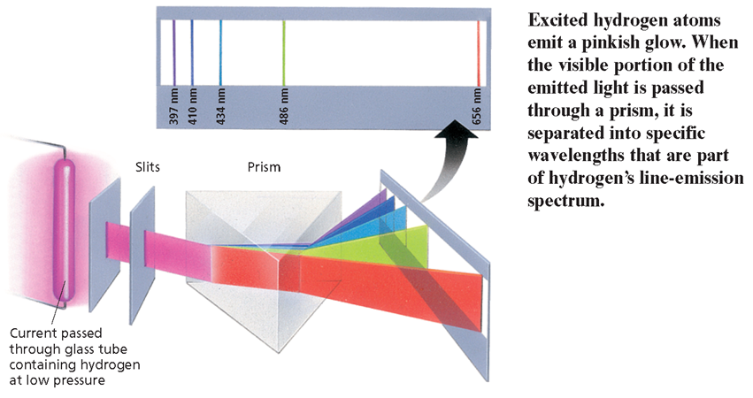
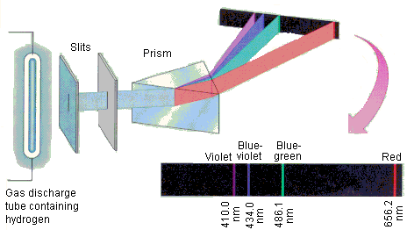
Emission Line spectrum

Slide 26
Continuous Spectrum
Emission of a continuous range of frequencies of electromagnetic spectrum (rainbow)
Classical theory predicted H should emit continuous spectrum
Didn’t happen
Attempts to explain led to new theory- Quantum theory

Slide 27
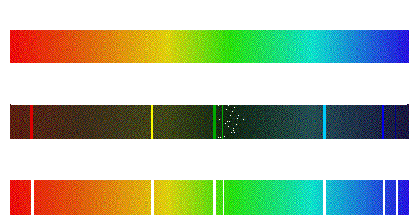

Slide 28
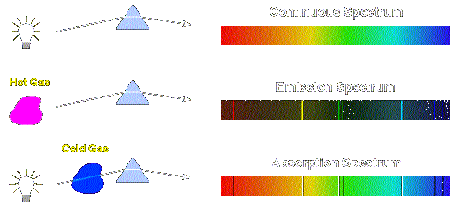

Slide 29
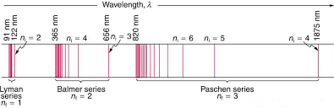
Additional series of lines were discovered in UV and infrared regions of H emission line spectrum

Slide 30
Bohr Model (1913)
Niels Bohr- Nobel prize in 1922
  Early 20th century physicist
Proposed hydrogen atom model that linked the atoms electron to photon emission
  Electrons in fixed orbits around nucleus (planetary model)
  Electrons in orbitals, those farthest from the nucleus have more energy

Slide 31
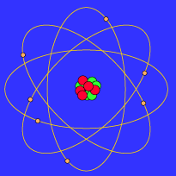
Bohr Model

Slide 32
Bohr cont.
  When an electron falls to a lower energy level ( closer to nucleus), a photon (energy) is emitted, -emission
  Energy must be added to an atom in order to move an electron from a lower energy level to a higher energy level-absorption.

Slide 33
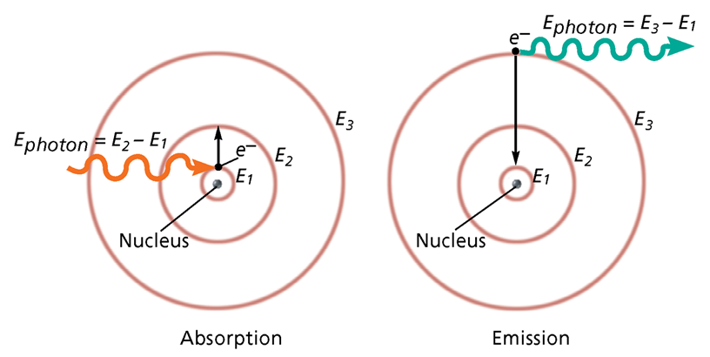

Slide 34
Shortcomings:
  Theory only explained atoms with one electron (H)
  Doesn’t explain chemical behavior

