Slide 1
Atoms : The Building Blocks of Matter
Chemistry
Chapter 3

Slide 2
Counting Atoms
3-3

Slide 3
3-3 Learning Targets
Explain the role of atomic number in determining the identity of an atom.
Define an isotope and identify isotopes using percent abundance
Explain why atomic masses are not whole numbers.
Calculate the number of electrons, protons, and neutrons in an atom given its mass number and atomic number.
Explain the relationship between a mole and Avogadro’s number
Calculate molar mass
Do mole/ gram conversions
Calculate conversions with Avogadro’s number

Slide 4
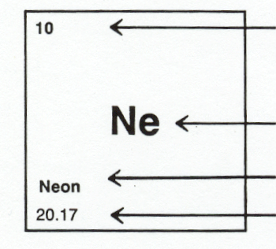
Atomic Number
Chemical Symbol
Chemical Name
Atomic Mass

Slide 5
Atomic number
Number of protons in the nucleus of the atom
Never changes
Increases on PT
Identifies element
Because atoms are neutral, #protons= # electrons

Slide 6
Atomic Mass
Na
22.99
Listed on the periodic table
Gives the mass of “average” atom of each element compared to ¹²C
Average atom based on all the isotopes and their abundance %
Atomic mass is not a whole number … mass number is a whole number

Slide 7
Mass number
Sum of the protons and neutrons in the nucleus of the atom
Average on PT
All isotopes are taken into account

Slide 8
Nuclear Symbol
^{A} Z X
A= mass
Z= atomic number
X= element symbol

Slide 9
Nickel
⁵⁹ ₂₈ Ni
Nitrogen
¹⁴ ₇ N
Silver
¹⁰⁸ ₄₇Ag

Slide 10
Calculating Neutrons
Mass number- atomic number = neutrons
Need to determine isotopes

Slide 11
Ions
Atom or group of atoms that has lost or gained electrons
Gain or lose electrons in valence shell
Will have positive or negative charge

Slide 12
Anion
Negatively charged ion
Gained an electron(s)

Slide 13
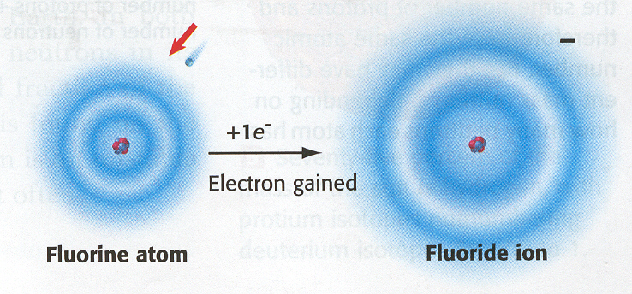
F ion

Slide 14
Cation
Positively charged ion
Lost electron(s)

Slide 15
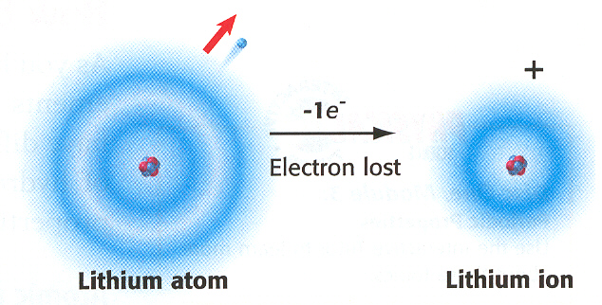
Li cation

Slide 16
Isotopes
Atoms of the same element that have different masses
  same number of protons as other atoms of that element but different number of neutrons
Most common isotope found on PT
Most do not differ significantly in their chemical behavior
Some are unstable, radioactive

Slide 17
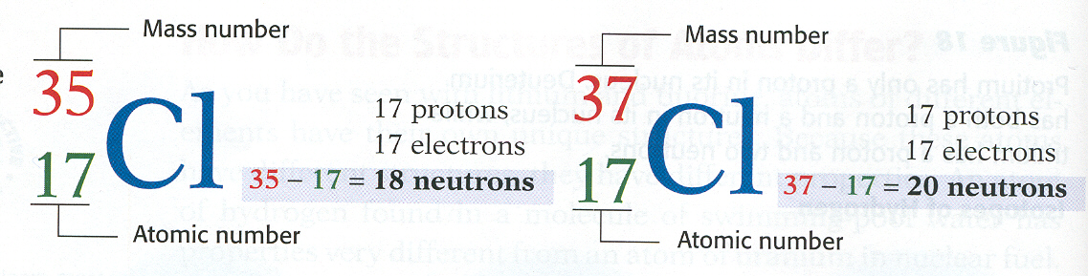
Isotope

Slide 18
Nuclide- general term of any isotope of any element
Designating Isotopes
  Hyphen notation- mass number is written after the name of the element
  C-14 (mass of 14)
  Nuclear symbol
  ¹⁴ ₆ C

Slide 19
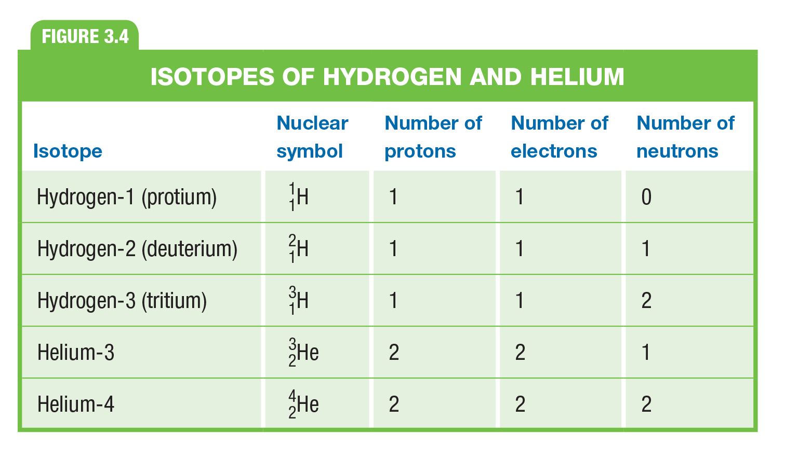

Slide 20
Isotopes of Carbon
Naturally occurring carbon consists of three isotopes, ¹²C, ¹³C, and ¹⁴C. State the number of protons, neutrons, and electrons in each of these carbon atoms.
¹²C ¹³C ¹⁴C
6 6 6
#P _6______ _6______ __6_____
#N __6____ __7____ ____8___
#E __6_____ __6__ _____6__

Slide 21
Atomic Mass of ?????
Isotopes Mass of Isotope Abundance
⁶X = 6.015 amu 7.50 %
⁷X = 7.016 amu 92.5%
(6.015 amu)(0.0750)+ (7.016 amu)(0.925) =
0.451amu + 6.49 amu = 6.94 amu
Lithium

Slide 22
Atomic Mass of ?????
mass number | exact weight | percent abundance
12 | 12.000000 | 98.90
13 | 13.003355 | 1.10
(12.000000 amu) (0.9890) + (13.003355 amu) (0.0110) =
11.87 amu +0.143 amu =12.01 amu
What is the element?
Carbon

Slide 23
Atomic Mass of ?????
mass number | exact weight | percent abundance
14 | 14.003074 | 99.63
15 | 15.000108 | 0.37
(14.003074 amu) (0.9963) + (15.000108amu) (0.0037) =
13.95 amu +0.056 amu = 14.01 amu
What is the element?
Nitrogen

Slide 24
Unified
Atomic Mass Unit (AMU)
Used to describe the mass of atoms or molecule
  1/12th the mass of a carbon atoms with the mass number 12
All masses on PT are relative to the carbon-12 standard

Slide 25
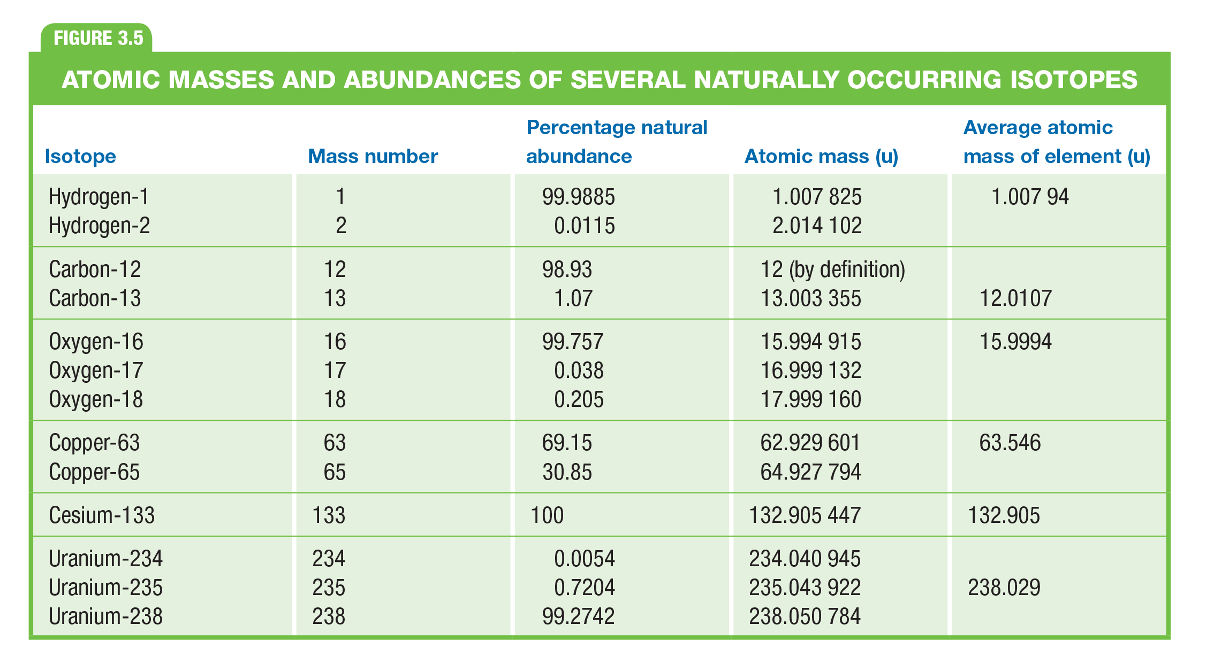

Slide 26
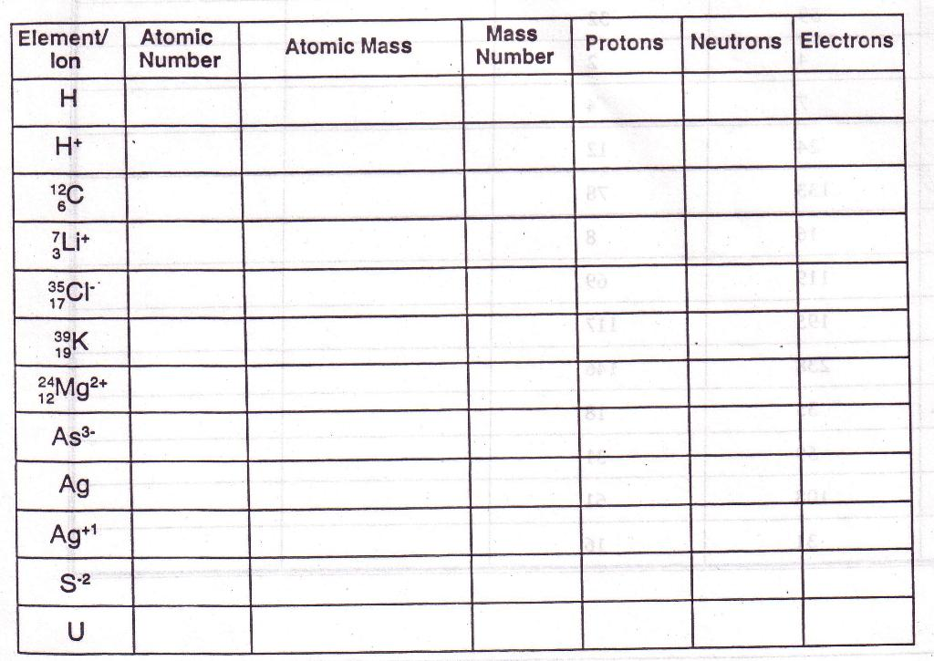

Slide 27
Mole (mol)
The amount of a substance that contains as many particles as there are atoms in exactly 12 g of carbon-12
SI base unit used to measure the amount of substance

Slide 28

Avagadro’s number
6.022 x 10 ²³
Number of particles in 1 mol
6.022 x 10²³ particle of sugar in 1 mol

Slide 29
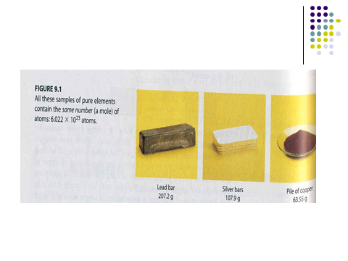
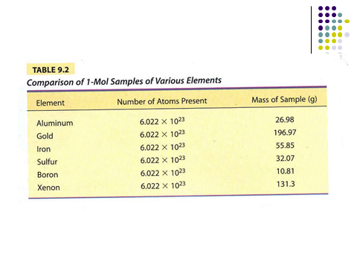

Slide 30
Average Atomic Masses
Weighted average of the atomic masses of the naturally occurring isotopes of an element
Atomic masses on PT are average masses
Calculations using atomic masses round the masses to two decimal places

Slide 31
Molar Mass
Mass in grams of 1 mole of a pure substance
Units are g/mol
Where do we find this??
Periodic table
1 mol of Al = 26.98 g/mol
1 mol H = 1.01 g/mol

Slide 32
Calculating with Moles
Conversion factor- a ratio used to convert one unit to another
Conversion factor= Mole/molar mass (g)
Set up with boxes
Cancel units to get to desired unit
What solving for on top (numerator)
What canceling on bottom (denominator)

Slide 33
Moles to Mass (grams)
Mol x molar mass of element =mass (g) 1 mol of element

Slide 34
Moles to Mass (grams)
2.67 mol C 12.01 g = 32.1 g C
1 mol
3.450 mol V 50.94 g = 175.7 g V
1 mol
1.65 mol P 30.97 g = 51.1 g P
1 mol

Slide 35
Mass (grams)to Moles
Mass (g) X mol of element = mol mass of element

Slide 36
Mass (grams)to Moles
12.4 g H 1mol = 12.3 mol H
1.01 g
24.5 g Pb 1mol = 0.118 mol Pb
207.20 g
34.2 g Zn 1mol = 0.523 mol Zn
65.38 g

Slide 37
Mass to # of atoms
Mass x 1 mol of element x 6.022 x 10 ^{23 atoms} = #of atoms
molar mass of element 1 mol

Slide 38
Mass to # of atoms
98.2 g F 1 mol 6.022 x 10 ^{23atoms} = 3.11 x 10 ²⁴ atoms F
19.00 g 1 mol
65. 7 g Ag 1 mol 6.022 x 10 ^{23 atoms} = 3.67 x 10 ²³ atoms Ag
107.87 g 1 mol
43.2 g Kr 1 mol 6.022 x 10 ^{23 atoms} = 3.10 x 10 ²³ atoms Kr
83.80 g 1 mol

Slide 39
Number of atoms to Mass
=#of atoms x 1mol x molar mass of element = Mass 6.022 x 10 ²³ atoms 1 mol of element

Slide 40
Number of atoms to Mass
6.022x 10 ²³ atoms Se 1 mol 78.96 g Se =
6.022 x 10 ^{23 atoms} 1 mol
= 78.96 g Se
2.00 x 10 ²⁴ atoms Ne 1 mol 20.18 g Ne =
6.022 x 10 ^{23 atoms} 1 mol
= 67.0 g Ne

Slide 41
3.72 x 10 ¹⁴ atoms Ca 1 mol 40.08 g Ca =
6.022 x 10 ²³ 1 mol
= 2.48 x 10 ⁻⁸ g Ca

