Slide 1
Measurements and Calculations
Chapter 2

Slide 2
Using Scientific Measurements
2-3

Slide 3
2-3 Learning Targets
Distinguish precision and accuracy
Use correct number of significant figures in calculations and measurements
Use proper scientific notation
Make a proper graph
Describe the mathematical relationship of data on a given graph

Slide 4
Accuracy
Description of how close a measurement is to the true accepted value of the quantity being measured

Slide 5
Precision
The agreement between numerical values of two or more measurements that have been made in the same way
  Can be precise without being accurate
  Systematic errors can cause results to be precise but not accurate

Slide 6
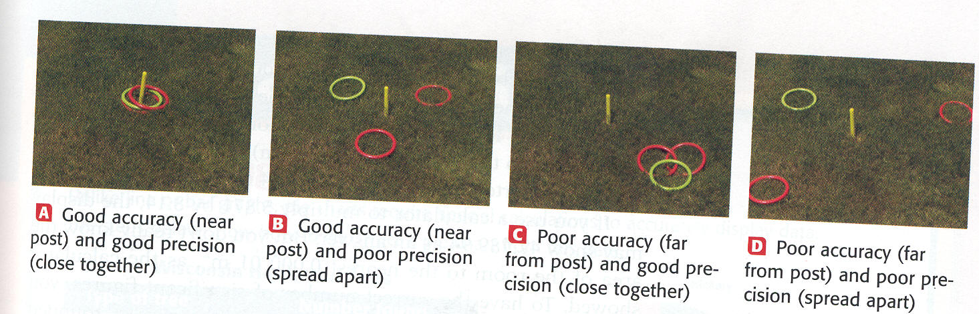
Precision vs. Accuracy

Slide 7
Percent Error (relative error)
  % Error =Value _{experimental}– Value _{accepted} x 100
  Value _{accepted}
  Value is negative if accepted value is greater than experimental value
  Value is positive if accepted value is less than experimental value

Slide 8
What is the percent error for a mass measurement of 17.7 g, given that the correct value is 21.2 g?
Percent error= (17.7g- 21.2g) x 100 =-17%
21.2 g

Slide 9
Error in Measurement
Some error or uncertainty exists in all measurements
  No measurements is known to an infinite number of decimal places
All measurements should include every digit know with certainty plus the first digit that is uncertain- these are the significant figures
Example: meter stick

Slide 10
Significant Figures
All nonzero digits are significant
875 = 3SF
5.56 = 3 SF
2.3 x 10⁹ = 2 SF
Zeros between nonzero digits are significant
405 = 3 SF
1001 = 4 SF

Slide 11
Significant figures
Zeros before the first nonzero are not significant
0.012= 2 SF
0.00003 = 1 SF
Zeros to the right of the decimal at the end of a number are significant
0.0020= 2 SF
853.0 = 4 SF

Slide 12
450. = 3 SF
340000= 4 SF
Better to write as
3.400 x 10 ⁵

Slide 13
Significant Figures
When quantities are multiplied or divided the number of SF in the answer is the same as that in the smallest quantity in the problem
15.7029 x 4.86 =76.316094
Answer has 3 SF
15.7029 x 4.86 =76.3

Slide 14
Significant Figures
When quantities are added or subtracted the number of SF is the number of decimal places is the same as the smallest number of decimal places in the problem
4.2 + 9.831 +15.60 = 29.631
Answer has 1 place past decimal
4.2 + 9.831 +15.60 = 29.6

Slide 15
Conversion factors that are known exactly have no uncertainty factor and do not contribute to limitations in calculations
Example:
1 ft= 12 in 1000g = 1 kg
Whole items (people, objects)
Calculators do not follow sig fig rules!!!!
Using SN helps

Slide 16
Scientific Notation
Method of representing very large or very small numbers
Saves time
Less confusion
M x 10 ^{n}
  M is a number between 1 and 9.9
  n is an integer
  All digits in M are significant

Slide 17
Writing Scientific Notation
Examples:
10000 m=1 x 10⁴ m
5200000 g = 5.2 x10⁶g
6230000000 cm =6.23 x10⁹ cm
0.000071 g = 7.1 x10⁻⁵ g

Slide 18
Writing in long form
6.3 x10 ⁵ cm = 630000 cm
7.99 x10³ g = 7990 g
5.26 x10⁻⁵ mL= 0.0000526 mL
9.8 x 10⁻⁸ mm = 0.000000098 mm

Slide 19
Reducing to Scientific Notation
Move decimal so that M is between 1 and 9.9
Determine n by counting the number of places the decimal point was moved
  Moved to the left, n is positive
  Moved to the right, n is negative

Slide 20
Rules for Rounding p. 52
Of the digit following the last digit to be retained is: | Then the last digit should | Example (rounded to 3 sig figs)
Greater than 5 | Be increased by 1 | 42.68 g = 42.7 g
Less than 5 | Stay the same | 17.32 m= 17.3 m
5, followed by nonzero digit(s) | Be increased by 1 | 2.7851 cm = 2.79 m
5, not followed by nonzero digit(s), and preceded by an odd digit | Be increased by 1 | 4.635 g = 4.64 g
5, not followed by nonzero digit(s), and the preceding significant digit is even | Stay the same | 78.65 mL = 78.6 mL

Slide 21
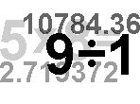
Math with Exponents

Slide 22
Addition/Subtraction
First, check that all of the units are the same, then check your exponents
If the exponents are the same, simply add or subtract the whole number values
If the exponents are different, then first make them the same and then add / subtract

Slide 23

Example
6.02 x 10²³ + + 6.02 x 10²³
12.04 x 10²³
1.20 x 10²⁴
3.14 x 10² + +6.2 x 10³
6.514 x 10³
6.5 x 10³

Slide 24
Multiplication / Division
If Multiplying
  First multiply the whole numbers then add the exponents
If Dividing
  First divide the whole numbers then subtract the exponents

Slide 25
Example
(2 x 10⁴m)(4 x 10⁴m) =
8 x 10⁸ m²
(4 x 10⁸m) / (2 x 10⁴m) =
2 x 10⁴

Slide 26
Displaying Data
Graphing Data
  The first thing you need to do is analyze the data

Slide 27
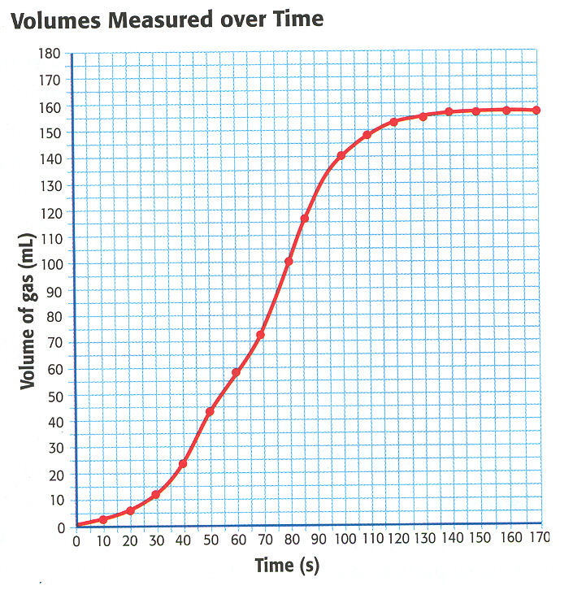
Line Graph

Slide 28

Independent Variable
The manipulated variable
We can change this factor
This becomes the X axis on a graph
Ex. Speed of a car

Slide 29
Dependent Variable
The responding variable
It is determined by the independent variable only, we have no impact
The Y axis on a graph
Ex. Braking Distance

Slide 30
Directly Proportional
Dividing one by other gives constant
Graph is straight line
Y= kx
                Y
                X

Slide 31
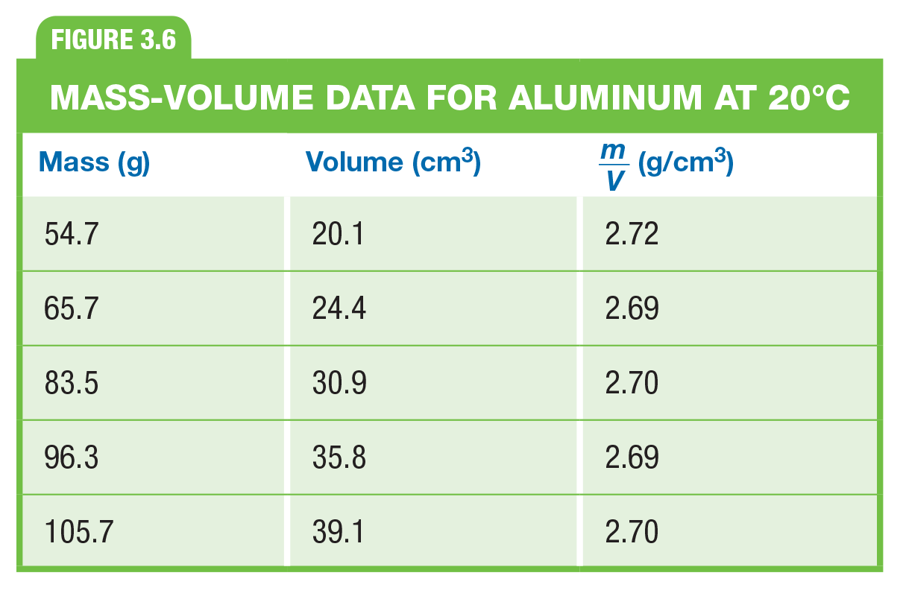
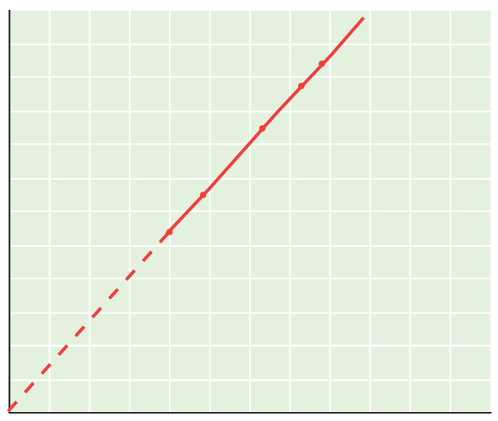
Trend= as mass increases, volume increases, Direct

Slide 32
Indirectly Proportional (inverse)
Product of the two variables is a constant
Graph is hyperbola
Y = k/x
As value of one variable increase, the value of the other must decrease
                Y
                X

Slide 33
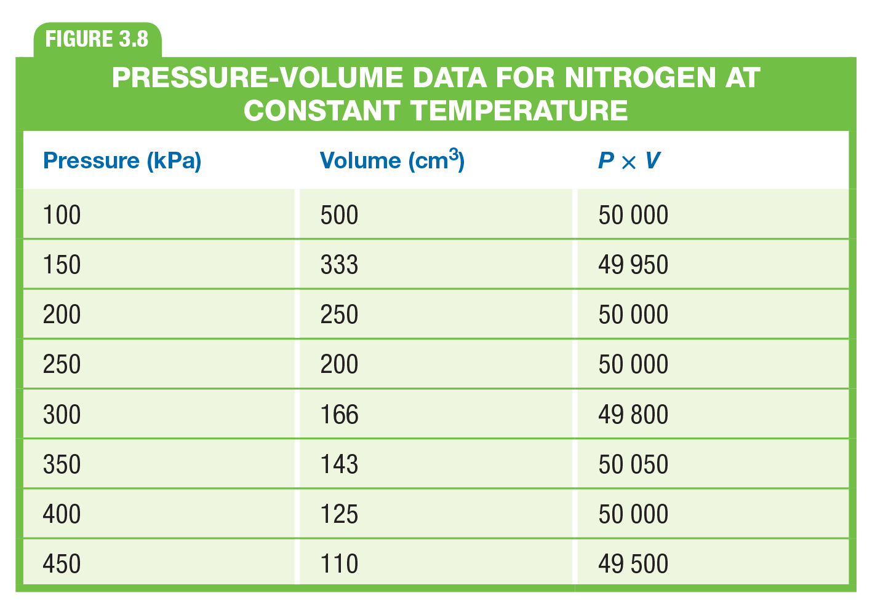
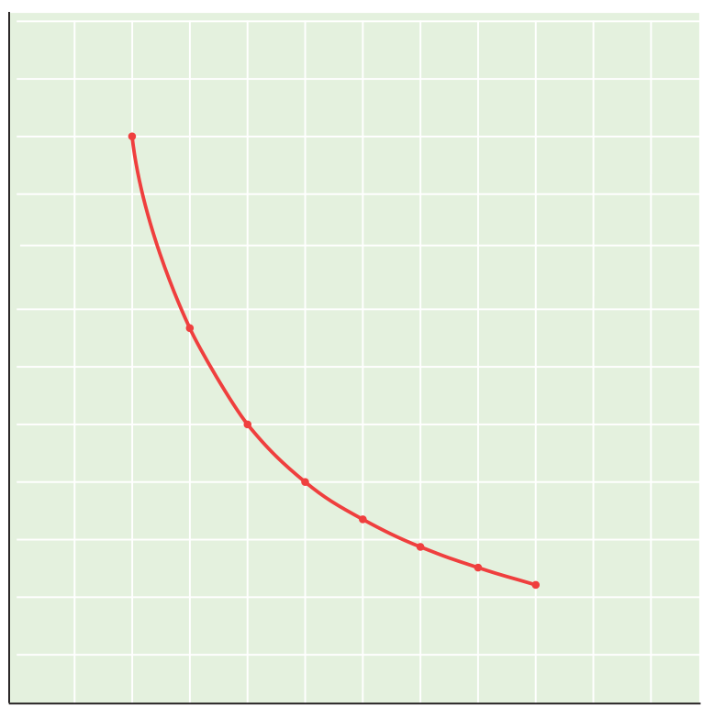
Trend = as pressure increases, volume decreases= indirect

Slide 34
Bar Graph
Used to compare sets of measurements, amount, or changes

Slide 35
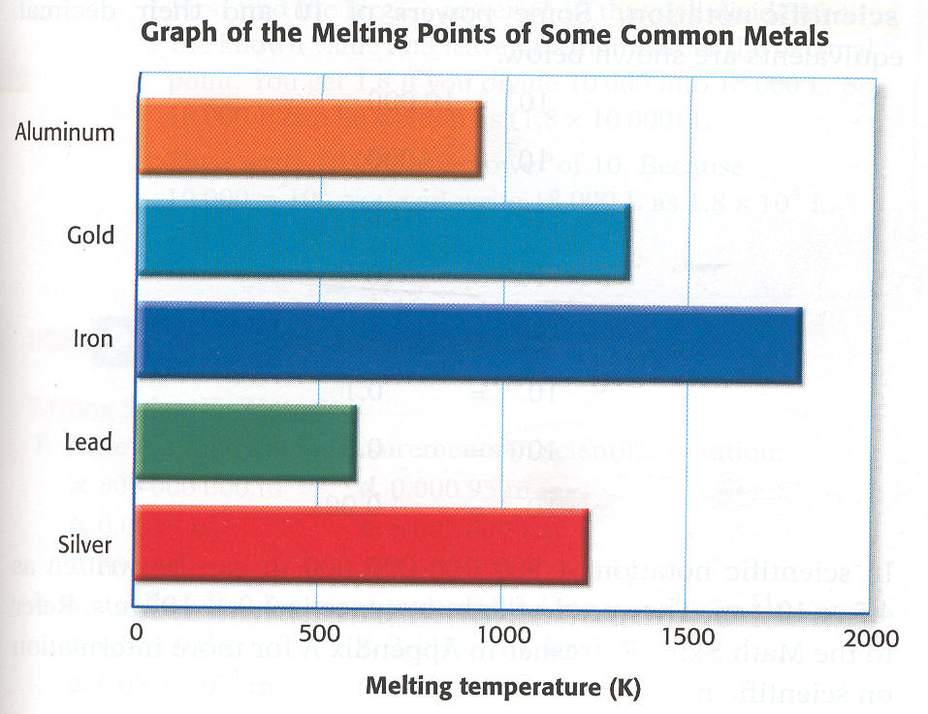

Slide 36
Graphs Need
Title (Y versus X)
Label X and Y
Units for X and Y
Connect data points
Appropriate scale for axis
Key (if needed)

