Slide 1
Concentration of Solutions
12-3

Slide 2
12-3 Learning Targets
Calculate Molarity
Calculate Molality

Slide 3
Concentration= ratio of solute to solvent
Many ways to express
Molarity= mole/ liter
Molality= mole/ kg

Slide 4
Molarity (M) – concentration of a solution as the amount of solute in a given volume of solution
number of moles of solute per volume of solution in L
M = moles solute = mol
Liter solution L
1.0 molar solution = 1 mol of solute per liter

Slide 5
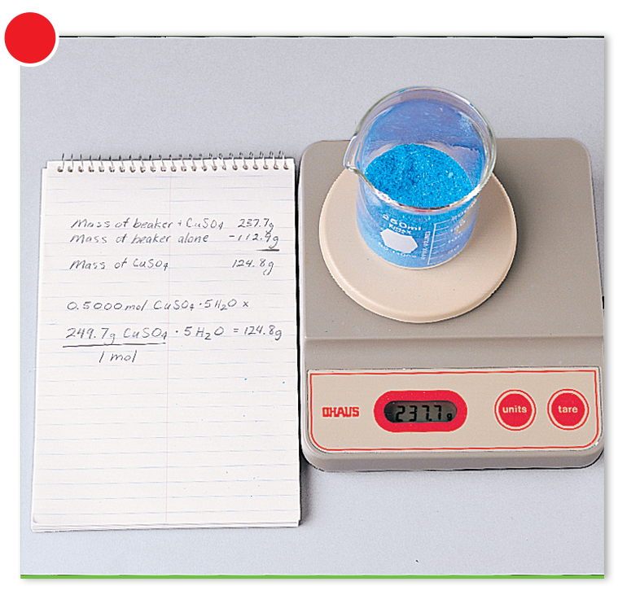
Standard Solution- solution with accurately known concentration
1-calculate mass needed of solute

Slide 6
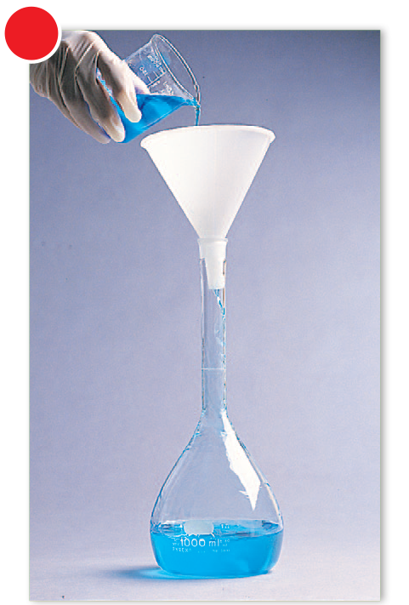
2-add some solvent to dissolve solute and add to volumetric flask

Slide 7
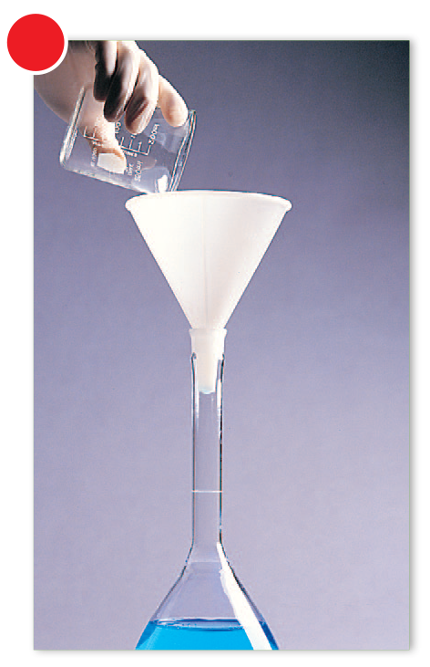
3-Rinse weigh beaker and add solvent to near line on flask

Slide 8
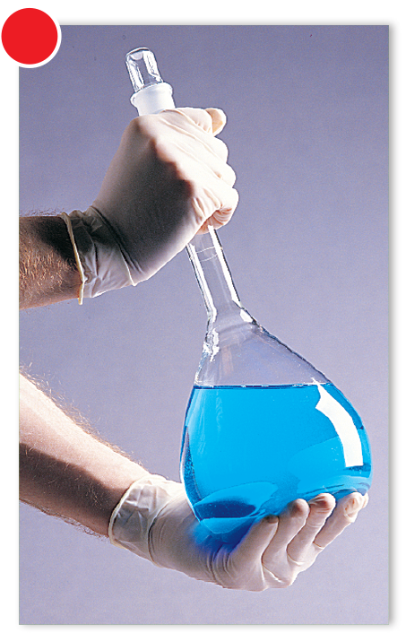
4- stopper flask and swirl
mixing

Slide 9
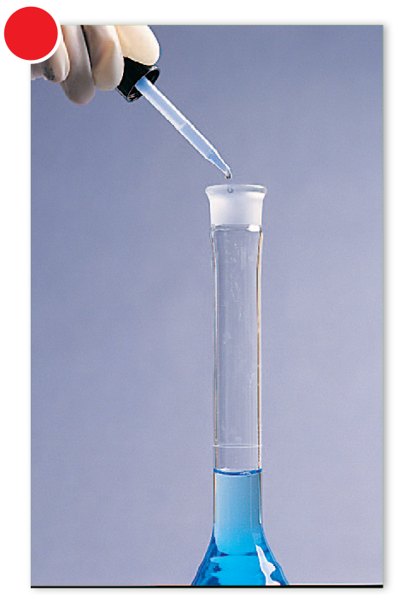
5- carefully fill flask to 1.0 L mark (or desired volume line)

Slide 10
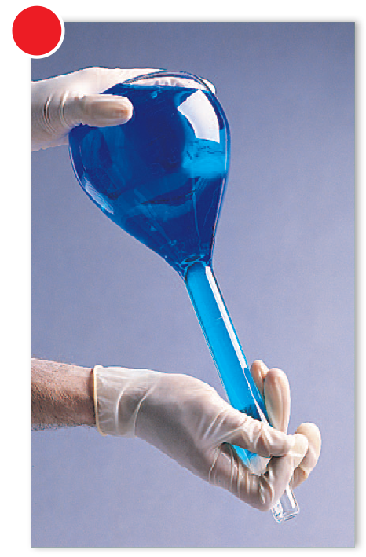
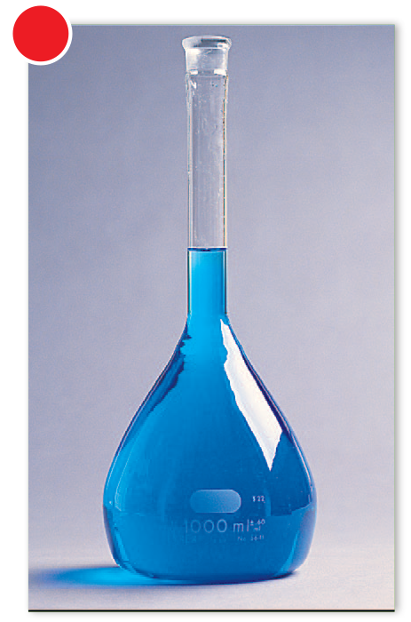
6- restopper and invert flask to ensure complete

Slide 12
Finding Molarity
What is the molarity of 11.5 g NaOH in1.5 L H₂O?
11.5 g x 1 mol NaOH = 0.288 mol NaOH
40.00 g NaOH
0.288 mol NaOH = 0.192 M NaOH
1.5 L H₂O

Slide 13
Calculating # of moles
How many moles of Ag⁺ ions are in 25mL of .75 M AgNO₃?
Molarity = mol/L
0.75 M = mol
0.025 L
mol= (0.75 M) ( 0.025L)
mol = 0.019 mol

Slide 14
Finding Mass from Molarity
1.00 L of 0.200 M potassium dichromate (K₂Cr₂O₇)
How much solid K₂Cr₂O₇ is needed?
Molarity = mol/L
0.200 M = mol
1 L
mol= (0.200M) (1L)
mol= 0.200 mol K₂Cr₂O₇
mass = 0.200 mol K₂Cr₂O₇ x ( 294.2 g/ mol) = 58.5 g K₂Cr₂O₇

Slide 15
Dilution
Dilution- process of adding more solvent to solution
-solute amount stays the same, only solvent amount changes
M₁V₁= M₂V₂
-always add concentrated acid to water, when doing acid dilution

Slide 16
Stock Solution- conc. Solution, dilute as needed
During dilution M decreases
Mol constant
Volume increases
M = mol
Volume

Slide 17
Problem
What volume of 16 M sulfuric acid must be prepared to make 1.5 L of 0.10 M H₂SO₄?
M₁V₁= M₂V₂
(16 M)(V₁) = (.10M)(1.5 L)
V₁ = 0.0094 L

Slide 18
Problem
What volume of 12 M HCl must be taken to prepare 0.75L if 0.25M HCl?
M₁V₁= M₂V₂
(12M)(V₁)=( 0.25M)(0.75L)
V1= 0.016L

Slide 19
Molality
Concentration of a solution expressed in moles of solute per kilogram of solvent
Symbol= m
molality= moles solute
mass of solvent (kg)
Concentrations expressed as molalites when studying solution related to vapor pressure and temp changes, because does not change with temperature

Slide 20
1kg = 1000 mL

Slide 21
Molality Problem
A solution was prepared by dissolving 17.1 g of sucrose (C₁₂H₂₂O₁₁) in 125 g of water. Find the molal concentration of the solution.
17.2 g x 1mol/ 342.34 g C₁₂H₂₂O₁₁ = 0.0500 mol C₁₂H₂₂O₁₁
125g water= 0.125 kg water
0.0500 mol C₁₂H₂₂O₁₁ / 0.125 kg water= 0.400 m C₁₂H₂₂O₁₁

Slide 22
What mass of Urea (CH₄N₂O) must be dissolved in 2250 g of water to prepare a 1.50 m solution?
2250 g CH₄N₂O = 2.25 kg CH₄N₂O
2.25 kg CH₄N₂O x 1.5 mol CH₄N₂O
1 kg
= 3.38 mol CH₄N₂O
3.38 mol CH₄N₂O x 60.06 g/mol = 203 g

