Slide 1
Solution Process
12-2

Slide 2
12-2 Learning Targets
Describe factors that affect dissolving
Define solubility
Describe factors that affect solubility
Compare saturated, unsaturated, and supersaturated solutions

Slide 3
What affects Dissolving?
Surface area
The more area exposed leads to more solvent-solute collisions
Stirring or shaking
Increases area exposed to solvent
Speeds up diffusion
Heat solvent
Higher kinetic energy- particles move faster and transfer more energy

Slide 4
Solubility
Amount of solute that will dissolve in given amount of solvent
Depends on :
how solvent and solute interact
temperature
surface area (increase by stirring or breaking up solute)
Gases affected by pressure

Slide 5
Solution equilibrium- physical state in which the opposing processes of dissolution and crystallization of a solute occurs at equal rates
Hard to predict
Depends on temp, nature of solvent and solute

Slide 6
Saturated- solution contains as much solute as will dissolve at that temperature
Unsaturated- solution that has not reached the limit of solute that will dissolve in it
Supersaturated- solution that contains more dissolved solute than a saturated solution contains under the same conditions

Slide 7
Dilute- little solute to given amount of solvent
Concentrated- large solute to given amount of solvent

Slide 8
Hydration- solution process with water as the solvent

Slide 9
Water
Universal solvent- can dissolve many different substances
Why?- strong attraction between polar solute and polar water
Due to structure-Polar compound
Polar compound- has an uneven distribution of electrons
Polar molecules interact with ions and replace the strong ionic forces
Dipole attraction

Slide 10
Water
One end of molecule is more positive then other end
Hydrogen end is partially positive
Oxygen end is partially negative

Slide 11
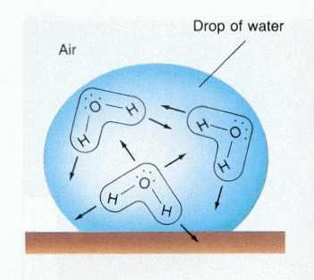

Slide 12
Water with ionic compounds
Charged hydrogen and oxygen on water attract charged parts of ionic compounds, easily dissolving them
Pulls crystals apart
Depends on forces between particles, if greater than waters force will not dissolve

Slide 13
Water dissolves molecular compounds
Hydrogen bonding- intermolecular force occurring when a hydrogen atom (slightly positive) is attracted to another molecule with unshared electrons
Hydrogen being attracted to the electrons pulls the molecule apart
Sugar in water

Slide 14
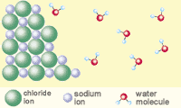

Slide 15
NH₄NO₃ + H₂O → NH₄+ + NO₃- these molecules stay together because of covalent bonds
Oil and Water, don’t mix because no polar bonds!!
“Like dissolves like”

Slide 16
Liquid solutes and solvents
Immiscible- liquid solutes and solvents that are not soluble in each other
Miscible- liquids that dissolve freely in one another in any proportion

Slide 17
Effects of Pressure on Solubility
Pressure changes have little effect on solids and liquids
Increase pressure increases gas solubility in liquids
Gas + solvent ↔ solution
Shifts equilibrium, less gas molecules

Slide 18
Henry’s Law- the solubility of a gas in a liquid is directly proportional to the partial pressure of that gas on the surface of the liquid
Gas-liquid solutions at constant temp
Carbonated beverages- solubility of CO₂ increased by increasing pressure
Effervescence- rapid escape of a gas form a liquid in which it is dissolved

Slide 19
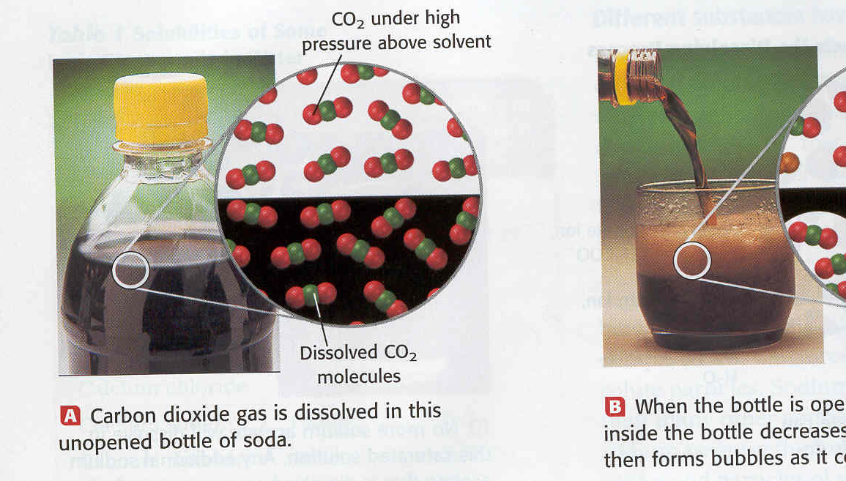

Slide 20
Effects of Temp on Solubility
Increasing temp usually decreases gas solubility
For solids, increasing temp usually increases solubility

Slide 21
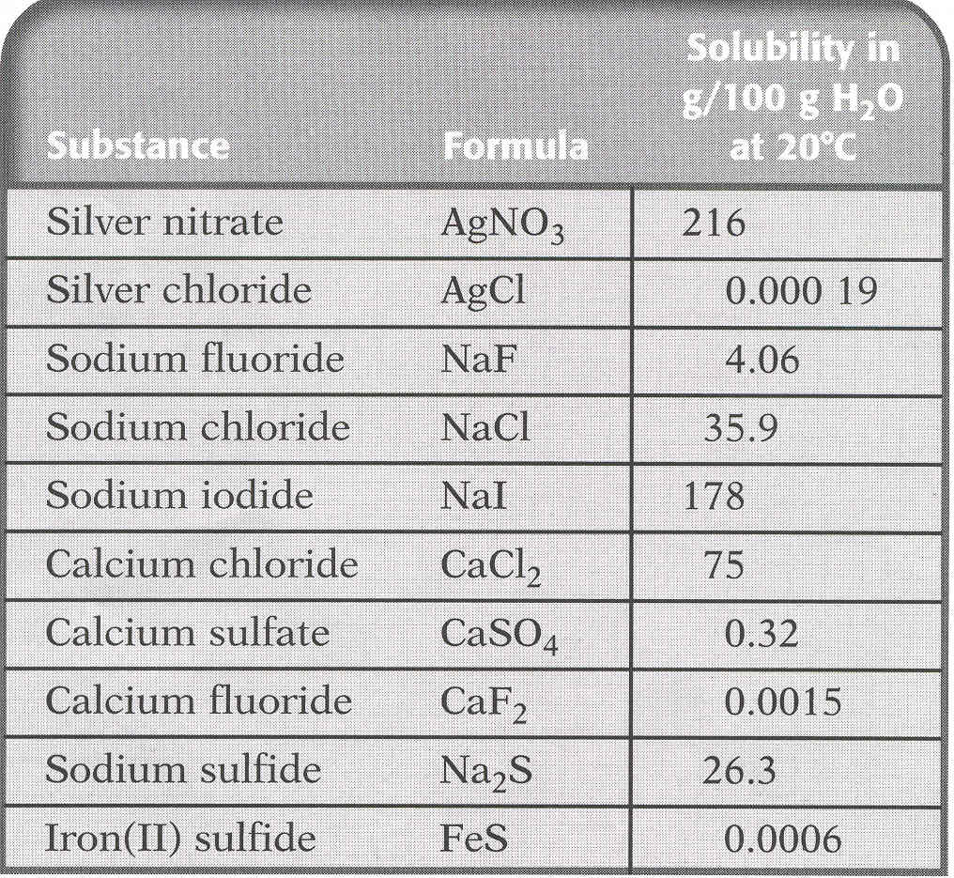

Slide 22
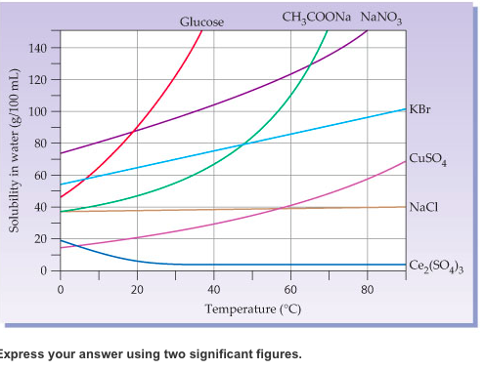

Slide 23
Which substance has the highest solubility at 60°C?
NaNO₃
Which substance has the lowest solubility at 70°C?
Ce₂(SO₄)₃
How many grams of KBr will dissolve at 60°C?
85 g
A solution containing 40 g of CuSO₄ dissolved in 100 g of water is heated from 60°C to 80°C. According to information in the figure, this temperature change would result in…..

Slide 24
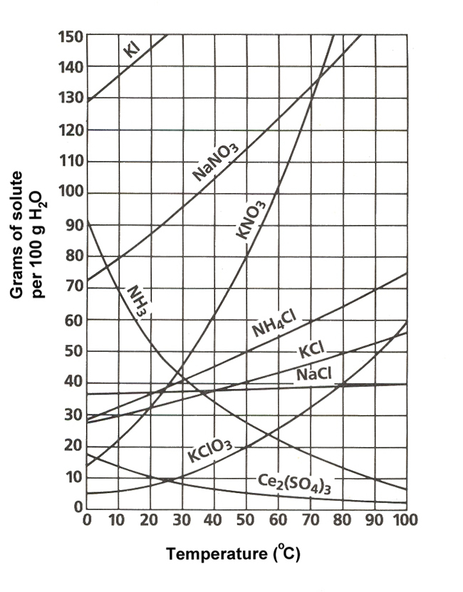
Which substance has the highest solubility at 20°C?
KI
Which substance has the highest solubility at 70°C?
NaNO₃
How many grams of KCl will dissolve at 80°C?
50 g
How many grams of NH₃ will dissolve at 20°C?
52 g

Slide 25
Solvated- solute particles that is surrounded by solvent molecules
Energy is released

Slide 26
Heat of Solution
Heat of Solution- energy released or absorbed when solute dissolves in solvent
Amount of heat in kJ to dissolve 1 mol at solute at 25 ºC
(-) exothermic- energy released, feels warm
(+) endothermic- energy absorbed, feels cool

Slide 27
